Slide 1




Comments on Teaching Plan
Lesson 11
This Is Paul Speaking.
ABCDEFGHIJKLMNHIJKLMNOPQRSTUVWXYZ
Xiaoxiba MIddle School

Slide 2
A Cat, a Bag and Kate.
Lesson 1
Looking Ahead
By the end ofthis lesson, you will be able to:
read the words with the letters “al” “au””c+e/i/y””c”and”ck”correctly;
正确朗读含有”al””au””c+e/i/y”c”和”ck”的单词;
read the words, phrases and sentences correctly;
正确朗读单词、短语和句子;
role-play the conversation fluently;
流利地分角色表演对话;
write the words according to their sounds correctly;
根据发音正确写出单词;
infer the sound of the letters “augh”;
推断字母“augh”的发音;
mark multi-syllable words and their stress correctly.
正确划分多音节词并标注其重音。

Slide 3
game time
Oo
Ii
Rr
Jj
Aa
Bb
Tt
Ww
Vv
Pp
Xx
Qq
Ss
Yy
Cc
Ff
Gg
Zz
Dd
Kk
Ee
Hh
Ll
Nn
Mm
Uu

Slide 4
letters
Aa Bb Cc Dd Ee Ff Gg Hh
Ii Jj Kk Ll Mm Nn Oo Pp Qq Rr Ss Tt Uu Vv Ww Xx Yy Zz

Slide 5


Slide 6

Learning to Learn
al |  | au |  | c+e/i/y | c | ck
/ɔ:/ | /ɔ:l/ | /ɑ:/ | /ɔ:/ | /s/ | /k/
basketball talk walk | already also always | aunt laugh laughter | astronaut August autumn | city cycle nice | calendar confident cousin | duck jacket neck

Slide 7
Learning to Learn
al |  | au |  | c+e/i/y | c | ck
/ɔ:/ | /ɔ:l/ | /ɑː/ | /ɔ:/ | /s/ | /k/
/s/和/k/ 发音时，声带不震动。

Slide 8

Learning Actively
1、Listen and find out the rules.听一听，找出规律。
1）Color the underlined letters according to their sounds. You need five colors.根据发音将画线字母（组合）上色，你需要五种颜色。
My name is Dick. I was born in August, but my favorite season is autumn. I like to play basketball and cycle with my friends. I also like to talk and laugh with my cousin Jack. He is my aunt’s son, also my best friend. We live in the same nice city and we always care about each other.

Slide 9
Learning Actively
1、Listen and find out the rules.听一听，找出规律。
1）Color the underlined letters according to their sounds. You need five colors.根据发音将画线字母（组合）上色，你需要五种颜色。
My name is Dick. I was born in August, but my favorite season is autumn. I like to play basketball and cycle with my friends. I also like to talk and laugh with my cousin Jack. He is my aunt’s son, also my best friend. We live in the same nice city and we always care about each other.

Slide 10
Learning Actively
2）Fill in the table.填表格
My name is Dick. I was born in August, but my favorite season is autumn. I like to play basketball and cycle with my friends. I also like to talk and laugh with my cousin Jack. He is my aunt’s son, also my best friend. We live in the same nice city and we always care about each other.
/ɔ:/ |  | /ɔ:l/ |  |  | /k/
au |  |  | au | c+ / /y
/s/
al
al
e
i
c
ck
相同的字母组合发音不一定相同。如：talk/tɔ:k/--also/'ɔ:lsəʊ/，autumu/'ɔ:təm/--laugh/lɑːf/。

Slide 11
2、 Read and think.读一读，想一想。
1)
/ɑːnt/
/'sɪ/
/ti/
/'sɪti/
/ɔ:l/
/'re/
/di/
/ɔ:l'redi/
/'kʌm/
/pə/
/ni/
/'kʌmpəni/
1)/i/的发音更接近/i:/，但发音时长比/i:/要短；
2)英语单词有单音节词、双音节词和多音节词之分，正确划分音节是拼读双音节词或多音节词的关键。例如：city→ci/ty,calendar→ca/len/dar。

Slide 12
2、 Read and think.读一读，想一想。
1)
false
jacket
ja
cket
calendar
ca
len
dar
astronaut
as
tro
naut
1)/i/的发音更接近/i:/，但发音时长比/i:/要短；
2)英语单词有单音节词、双音节词和多音节词之分，正确划分音节是拼读双音节词或多音节词的关键。例如：city→ci/ty,calendar→ca/len/dar。

Slide 13
Learning Actively
3、Follow the example to mark the syllables and stress in the words and read them Then listen and repeat.依据下列示例，把单词的音节和重音划分出来并读一读，然后听录音并跟读。
Words | Word Stress
chick/en
laughter
August
basketball
citizen
camera
confident
communicate
音节中含有三个或三个以上的元音音素的单词称为“多音节词”。
双音节和三音节词的重音通常在第一个音节上，三音节以上的多音节词的重音一般在倒数第三个音节上。如：communicate

Slide 14
4、 Read the word pairs.Write S for the same sound you hear, and D for the different.Then listen and check.（读词对，有相同音素的写S,不同音素的写D。然后听录音核对。）
S
S
talk--walk
_______
certain--recycle
_______
chalk--almost
S
S
_______
calendar--neck
_______
aunt--autumn
D
D
_______
duck--cinema
_______
caught--laughter
D
cite--cousin
D
_______
_______
“al”置于词首时，通常发/ɔ:l/，若在词中则通常发/ɔ:/，”c”与i/e/y搭配时通常发/s/，”ck”则通常发/k/。

Slide 15




1、 Read and write. Then listen and repeat,paying attention to word stress.读一读，写一写，然后听录音再跟读，注意单词重音。
1) I bought a birthday /keɪk/
in the /mɔ:l/.
cake
mall
2) I /'ɔ:lweɪz/ ride my bike in
/'ɔ:gəst/.
always
August
3) My /ɑːnt/ has a /naɪs/ cat and also a /kju:t/ /dʌk/.
aunt
nice
cute
duck

Slide 16
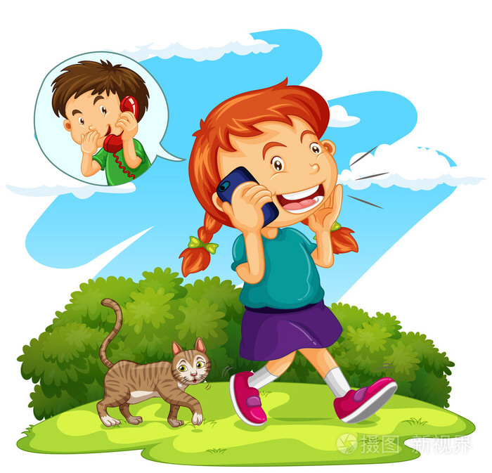
2、Role-play the conversation.分角色表演对话。
Paul: Hello,Paul speaking.
Laura: Hi,Paul. This is Aunt Laura. I need your help.
Paul: Well, what’s up?
Laura: Oh, it’s Eric. His classmates laugh at him because he can’t play baseball well. He always cries at school. Can you help him?
Paul: Sure. I’ll ask him to go for a walk and talk to him when he is back from school.
Laura: Oh, it’s so nice of you. Thank you very much.
Paul: You are welcome.

Slide 17
2、Read the sentence and choose one for Eric. Then mark the syllables of the bold words.读一读，帮Eric选一选，然后标出粗体词的重音。
I will choose _____________to help Eric cheer up.
A. A good beginning is half done.
B. A good medicine tastes bitter.
C. Experience is the mother of wisdom.
D. All things are difficult before they are easy.

Slide 18

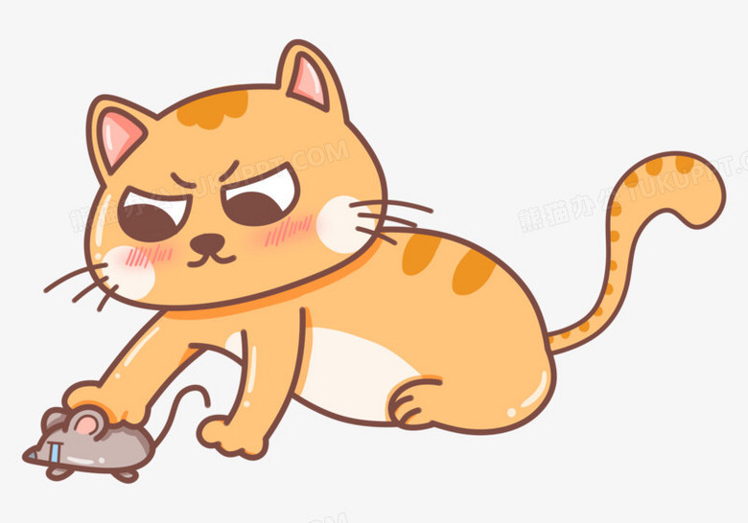

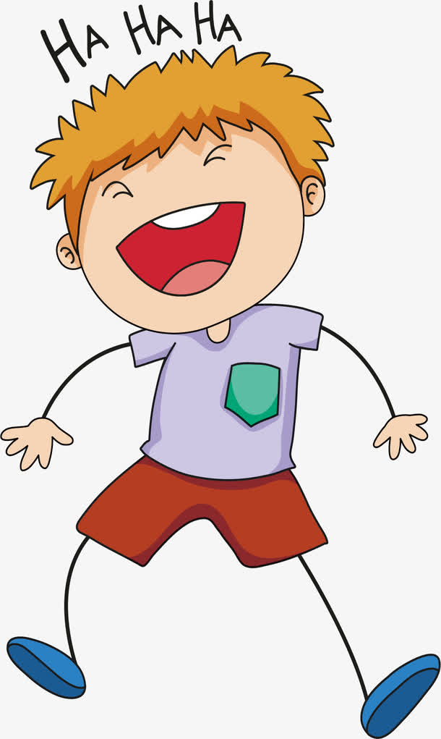
Challenging Yourself
1、Listen, repeat and choose the correct sound of the letters “augh”.
听录音跟读，并选出字母组合 “augh”的正确发音。
A. /ɔ:/
B. /ɔ:f/
C./ɑː/
D./ɑːf/
The rat is caught by the cat.
She is my aunt’s daughter.
She taught us English.
The naughty boy is laughing.

Slide 19
Challenging Yourself
2、Read first and then tell the joke to your partner.先读一读，然后向同伴讲讲这个笑话。
Father: Who is naughty in our family?
Jack: I don’t know.
Father: Think! When Jean(Jack’s mum) taught him to do his work, he was always caught playing. Who is he?
Jack: Oh,it’s you, Dad.

Slide 20
2、Read and create.朗读并创作。
My mum taught me to walk.
She taught me to use chopsticks.
She taught me to play badminton.
She also taught me to use the computer.
She always taught me to take up challenges.
___________________________________________________________________________
1)Divide the bold words into syllables and read them.划分加粗单词的音节并朗读。
2)Listen and repeat.听录音，并跟读。
3)Add one more sentence and share what your mum taught you.
加一句话，分享你的妈妈教会了你什么。

Slide 21
Learning Reflectively
1、Try to work out the rules. 试着找出规律。
1) We can pronounce the letter “ ” as /ɔ:/and /ɔ:l/in walk and also.
2) We can pronounce the letter “ ”as/ɑː/and /ɔ:/ in aunt and August.
3) We can pronounce the letters “ck”and “c”as in cute and duck.
4) We can pronounce the letters “c”+e/i/y as in city,nice and cycle.
al
au
/k/
/s/

Slide 22
Learning Reflectively
2、Tick(√) what you can do.看看你今天学会了什么。
Now I can...
Great
Good
Ok
Try hard
read the words with “al” “au” “c+e/i/y” “c” and “ck”correctly;
read the words,phrases and sentences correctly；
role-play the conversation fluently；
write the words according to their sounds correctly；
infer the sound of the letters “augh”；
mark multi-syllable words and their stress correctly.

Slide 23
Learning Reflectively
3、Write vour learning log.完成学习日志
1)学完本课后你有什么收获呢?
2) 学完本课后你还有什么疑惑呢? 大胆写下来吧!

Slide 24
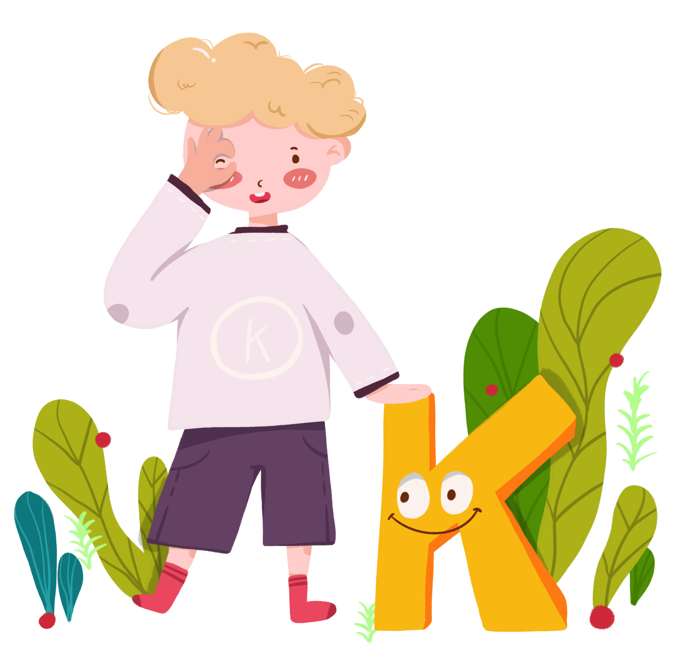
Comments on Teaching Plan
感谢您的观看
thanks
thanks
ABCDEFGHIJKLMNHIJKLMNOPQRSTUVWXYZ

