Slide 1




Comments on Teaching Plan
Lesson 10
He Cares about His Daughter
ABCDEFGHIJKLMNHIJKLMNOPQRSTUVWXYZ
Miss Yang

Slide 2
A Cat, a Bag and Kate.
Lesson 1
Looking Ahead
By the end of this lesson, you will be able to:
●read the words with the letters "air" "are" "augh" "aw" "able" "ange" and "ation" correctly;
正确朗读含有“air”“are” “augh”“aw”“able” “ange”和“ation”的单词；
● choose the correct sound of different words；
选出不同单词的正确发音；
● describe pictures with word chunks correctly;
使用语块正确地看图描述；
● complete a passage according to their sounds;
根据音标完成短文；
●infer the sound of the letters"tion";
推断字母组合“tion”的发音；
●use the rising tone, falling tone and word stress in speaking correctly.
在口语中正确使用升调、降调和单词重音。

Slide 3
game time
Oo
Ii
Rr
Jj
Aa
Bb
Tt
Ww
Vv
Pp
Xx
Qq
Ss
Yy
Cc
Ff
Gg
Zz
Dd
Kk
Ee
Hh
Ll
Nn
Mm
Uu

Slide 4
letters
Aa Bb Cc Dd Ee Ff Gg Hh
Ii Jj Kk Ll Mm Nn Oo Pp Qq Rr Ss Tt Uu Vv Ww Xx Yy Zz

Slide 5


Slide 6

Learning to Learn
air | are | augh | aw | able | ange | ation
/eə/ |  | /ɔ:/ |  | /eibl/ | /eindʒ/ | /eiʃn/
air fair hair | care dare share | caught daughter taught | draw law saw | fable stable unable | change range strange | nation relation station

Slide 7
try to read
/eə/
/ɔ:/
/eIbl/
/eIndʒ/
/eIʃn/

Slide 8
have a try
/eə/
/ɔ:/
/eIbl/
/eIndʒ/
/eIʃn/

Slide 9
air
/eə/
are

Slide 10
augh
/ɔ:/
aw

Slide 11
able
/eIbl/
ange
/eIndʒ/
ation
/eIʃn/

Slide 12
Learning to Learn
air | are | augh | aw | able | ange | ation | air
/eə/ |  | /ɔ:/ |  | /eibl/ | /eindʒ/ | /eiʃn/ | /eə/

Slide 13
Learning Activeiy
1、Listen and circle the correct sound of the underlined part.
听录音，圈出画线部分的正确发音。
1)The man lives with his dear wfe. （/iə/ /eə/）
2)He cut down plants by the saw. （/əu/ /ɔ:/）
3)I will change the situation. （/eindʒ/ /indʒ/）
4)He told his daughter the fables. （/ebl/ /eibl/）
5)He likes to climb the stairs. （/eə/ /uə/）

Slide 14
2、Read and think.读一读，想一想。
1) /skeə(r)/ /ʌn'eibl/ /kəmpeə(r)/ /'nɔ:ti/ /streindʒ/ /ri'leiʃn/
2) chair dare law taught fable range awful careful
3) a stranger a train station break the law
draw pictures set the table

Slide 15
3、Listen and find out the same sound. Then try to read them.
听录音，并找出相同的发音。然后试着读一读。
hair draw naughty range care
table station change fair nation
share daughter stable strawberry
hair
draw
range

Slide 16
4、Listen and complete the word chunks wih the letters in the box. Then listen again, check and repeat.
听录音,用方框中所给字母组合补全词块。然后再听一遍录音,核对答案并跟读。
ation aw augh able air are
f h p
st t
dr str berries
n ’s situ
n ty d ter

Slide 17
Learning Creatively
1、 Read the following sounds aloud and write the words.
大声朗读下列发音，并写出单词。
1) The /eə(r)/ blew through his silver /heə(r)/.
2) The three /'strɔ:bəriz/ are left on the /lɔ:n/.
3) He and his /'dɔ:tə(r)/are climbing up the /steəz/.

Slide 18
Learning Creatively
2、Read and then role-play the dialogue with correct rising tone, faling tone and word stress.
阅读并分角色表演对话。注意使用正确的升调、降调和单词重音。
Dale: Anna, you don't look well. What's wrong?
Anna: I caught a cold at the bus station yesterday.
Dale: That sounds awful. Maybe you shouldgo to see a doctor.
Anna: I went to see the doctor this morningBut I broke /brəuk/ the chair there.
Dale: You should be careful next time. Did you tell your mum and dad about that?
Anna: No. I'm afraid they will get mad.
Dale: But they can help you deal with the problem /’probləm/.
Anna: Well. I'll try.

Slide 19
3、Write the words or phrases. Then listen and repeat.
写出单词或短语。然后听录音，并跟读。
Babysitter Wanted
Hello, my name is Bill Hawking. I need a babysitter to/teik keə(r)əv/ my /nɔ:ti'dɔ:tə(r)/ . She has/blæk heə(r)/ and big eyes. She is /skeəd/ of little /'ænimlz/ and /'strendʒəz/ .You can/feə(r)/ interesting stories with her. And you can teach her to /drɔ:/ pictures. Please call me at 689-7726.

Slide 20
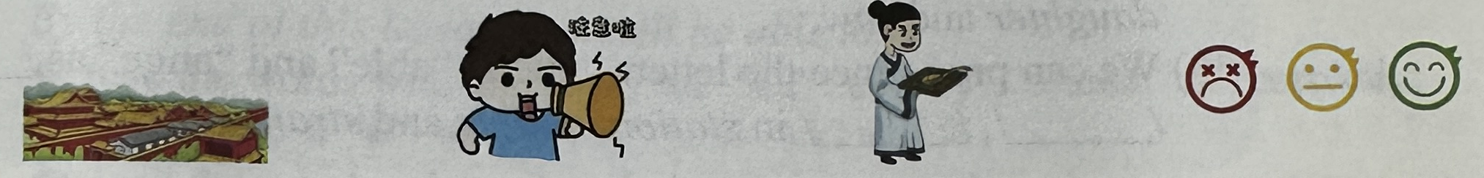
Challenging Yourself
1、Listen, repeat and choose the correct sound of the letters "tion".
听录音跟读，并选出字母组合“tion”的正确发音。
A./ʃn/ B./ʃ/ C./ʃi:n/ D./tn/
a great nation pay attention a great invention different emotions

Slide 21
Challenging Yourself
2、Listen and mark the stress of the words. Then read the sentences.
听录音，标出单词的重音。然后朗读句子。
E.g. fable /'feibl/
1) dictionary /dikʃənri/ You can use a dictionary to help you learn English.
2) relation /rileiʃn/ Cancer has close relations with smoking.
3) attention /ətenʃn/ You need to pay attention to teachers' words.

Slide 22
Challenging Yourself
3、Listen and write the words. Then read the poem aloud.
听录音写出单词，并大声朗读诗歌。
One day a letter caught her .
It was from her father's .
He thanked her father for saving the .
She was that love for the country was the greatest .

Slide 23
Learning Reflectively
1、Try to work out the rules.试着找出规律。
1) We can pronounce the letters"air" "are" as / / in hair, chair, care and square.
2) We can pronounce the letters" "and" "as/ɔ:/in daughter and saw.
3)We can pronounce the letters"ation” "able”and "ange”as/ /, / /, / / in station, unable and strange.

Slide 24
Learning Reflectively
2、Tick(√) what you can do.看看你今天学会了什么。
Now I can...
Great
Good
Ok
Try hard
read the words with the letters "air""are""augh""aw""able""ange"and“ation”correctly;
choose the correct sound of different words；
describe pictures with word chunks correctly；
complete a passage according to their sounds；
infer the sound of the letters “tion”；
use the rising tone, falling tone andword stress in speaking correctly.

Slide 25
Learning Reflectively
3、Write vour learning log.完成学习日志
1)学完本课后你有什么收获呢?
2) 学完本课后你还有什么疑惑呢? 大胆写下来吧!

Slide 26
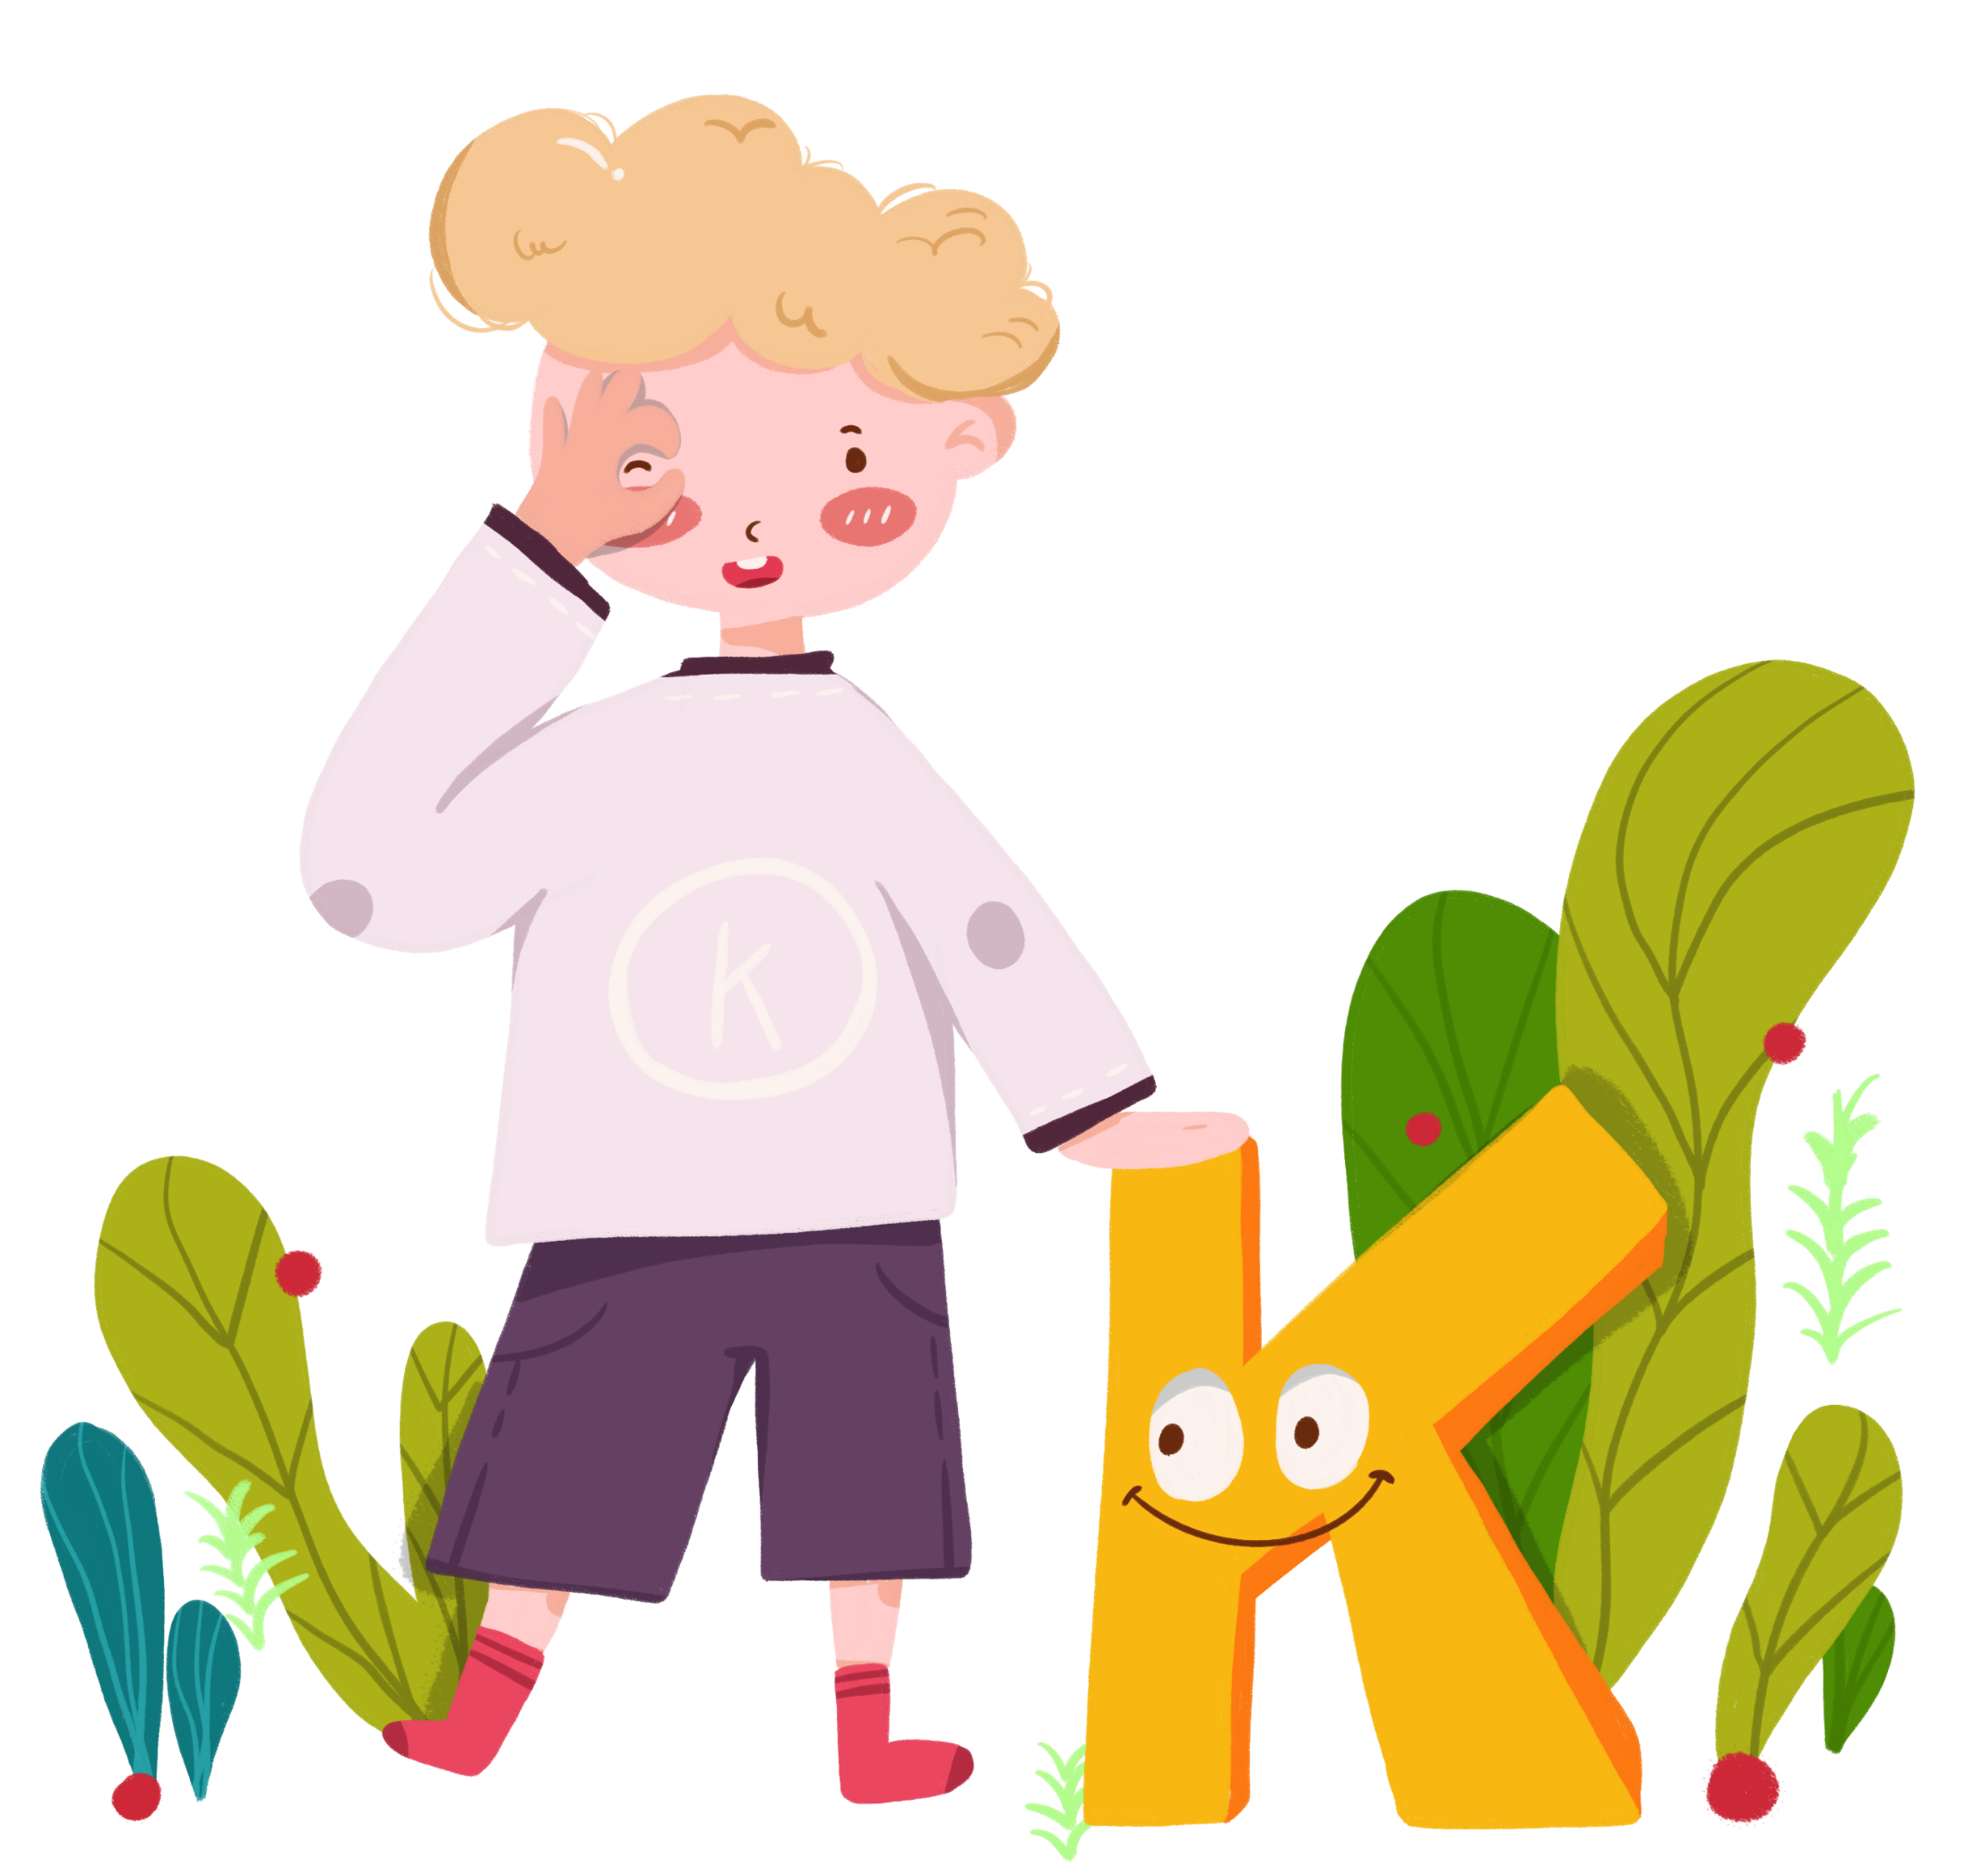
Comments on Teaching Plan
感谢您的观看
  Thanks
thanks
ABCDEFGHIJKLMNHIJKLMNOPQRSTUVWXYZ

