Slide 1




Lesson 4
Dogs Are Cute
ABCDEFGHIJKLMNHIJKLMNOPQRSTUVWXYZ

Slide 2
Dogs Are Cute.
Lesson 4
Looking Ahead
By the end of this lesson, you will be able to:
● read /əʊ/, /ɒ/, /ju:/, /ʌ/, /u:/, /u/, /w/, /j/ and /aɪ/correctly;
正确朗读 /əʊ/, /ɒ/, /ju:/, /ʌ/, /u:/, /u/, /w/, /j/和/aɪ/;
●match the words with their sounds correctly;
将单词与其发音正确配对；
●read the words, phrases and sentences aloud;
大声朗读单词、词组和句子；
●write the words according to their sounds;
根据发音写出单词；
●infer another sound of the letter "o";
推断字母“o”的另一种发音；
●use liaison well in speaking.
在口语中熟练运用连读。

Slide 3

Review
/eɪ/
/p/
/d/
/tæk/
/bed/
/æ/
/kɪd/
/aɪ/

Slide 4


Review
/baɪk/ or /bɪk/
/kaɪt/ or /kɪt/
bike
kite
/daɪg/ or /dɪg/
/saɪz/ or /saɪs/
dig
size

Slide 5
Learning to Learn
o |  | u |  |  |  | w/wh | y
/əʊ/ | /ɒ/ | /ju:/ | /ʌ/ | /u:/ | /ʊ/ | /w/ | /j/ | /aɪ/

Slide 6

Try to read
/əʊ/
/ɒ/
/ju:/
/ʌ/
/u:/
/ʊ/
/w/
/j/
/aɪ/

Slide 7
Have a try
/j/
/ʌ/
/əʊ/
/ɒ/
/aɪ/
/u:/
/ʊ/
/w/
/ju:/

Slide 8

Learning Actively
1、Listen and guess the sound of "o" and "u" in the words.
听录音，猜一猜单词中的“o”和“u”怎么发音。

Slide 9
Learning to Actively
o |  | u
/əʊ/ | /ɒ/ | /ju:/ | /ʌ/ | /u:/ | /ʊ/

Slide 10
Learning Actively
1) go home hope
2) not dog hot
3) tube cute huge
4) bus just sun
5) rule blue June
6) pull put bull
/əʊ/
/ɒ/
/ju:/
/ʌ/
/u:/
/ʊ/

Slide 11
2、 Read and think.读一读，想一想。
1)
/j/+/əʊ/
/jəʊ/
/t/+/u:/
/tu:/
/tʃ/+ /əʊ/
/tʃəʊ/
/h/+/u:/
/hu:/
/dʒ/+/əʊ/
/dʒəʊ/
/z/+/u:/
/zu:/

Slide 12
2、 Read and think.读一读，想一想。
1)
/m/+/ju:/
/mju:/
/ʌ/+/p/
/ʌp/
/s/+ /ju:/
/sju:/
/ʌ/+/s/
/ʌs/
/k/+/ju:/
/kju:/
/ɒ/+/n/
/ɒn/

Slide 13
2)
/s/+/ʌ/+/d/
/sʌd/
/h/+/ɒ/+/t/
/hɒt/
/b/+/ʌ/+/s/
/bʌs/
/d/+/ɒ/+/g/
/dɒg/
/p/+/ʌ/+/b/
/pʌb/
/w/+/ɒ/+/t/
/wɒt/

Slide 14
2)
/p/+/ʊ/+/t/
/pʊt/
/w/+/e/+/n/
/wen/
/b/+/ʊ/+/l/
/bʊl/
/j/+/e/+/s/
/jes/
/f/+/ʊ/+/t/
/fʊt/
/w/+/aɪ/+/t/
/waɪt/

Slide 15
Learning Actively
3、listen the words and find the right place for them.听单词，并将它们正确归类。
1)
note
hope
no
dog
mop
not
home
go
hot
so
/əʊ/
/ɒ/
note
hope
not
dog
mop
hot
no
home
so
go

Slide 16
Learning Actively
3、listen the words and find the right place for them.听单词，并将它们正确归类。
2)
huge
tube
must
bus
put
blue
cut
sun
June
just
rule
bull
/ju:/
/ʌ/
/u:/
/ʊ/
huge
must
bus
blue
June
tube
put
bull
cut
sun
rule
just

Slide 17
note
hope
home
o
/əʊ/
/əʊ/
no
go
so
通常情况下，以o结尾或在o_e中，o发字母本身的音/əʊ/

Slide 18
u
huge
/ju:/
/ju:/
tube
在u_e中，u发字母本身的音/ju:/

Slide 19
4、 Read aloud and match. Then listen, check and repeat.
大声朗读并连线,然后听录音核对并跟读。
swim just put home note blue tube hot
/həʊm/ /swɪm/ /tju:b/ /blu:/ /nəʊt/ /dʒʌst/ /hɒt/ /pʊt/
①
②
③
④
⑤
⑥
⑦
⑧

Slide 20
Learning Creatively
1、Read and write. 读一读，写一写。
/əʊ/
/kju:/
Oo
Qq
/ju:/
/'dʌblju:/
Uu
Ww

Slide 21
Learning Creatively
1、Read and write. 读一读，写一写。
/waɪ/
/ɑ:(r)/
Yy
Rr

Slide 22
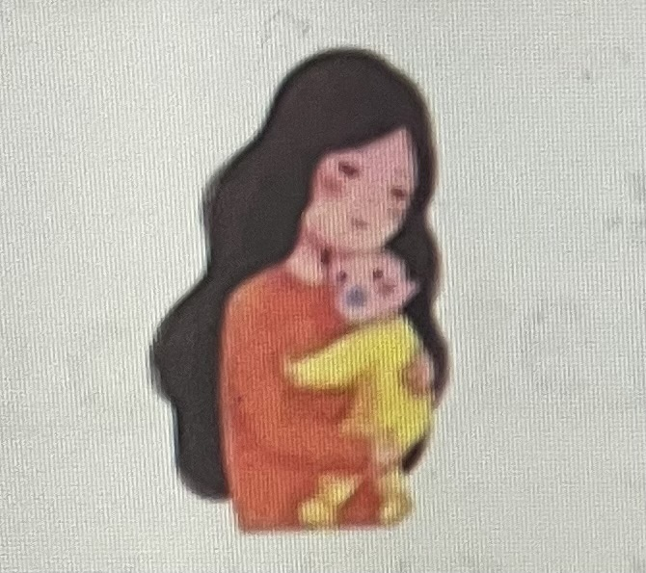

2、 Read aloud and then write the words and phrases. 大声朗读并写出单词或词组。
/maɪ/ /mɒm/
a /hju:dʒ/ /bʊl/
my mom
a huge bull

Slide 23
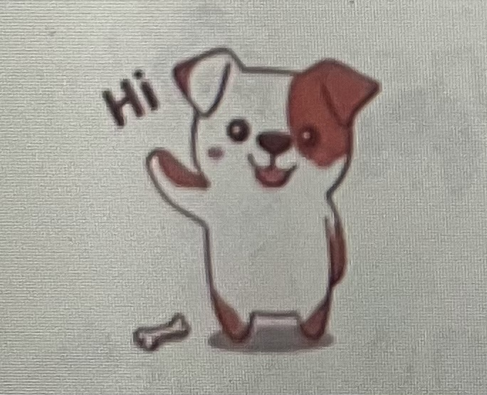
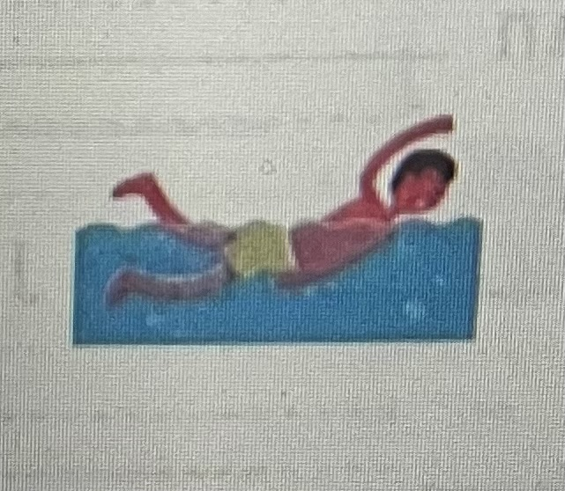
2、 Read aloud and then write the words and phrases. 大声朗读并写出单词或词组。
a /kju:t/ /dɒg/
/swɪm/ /ɪn/ /dʒu:n/
a cute dog
swim in June

Slide 24
home | dog | cute | bus | blue | bull | swim | when
hope | hot | huge | just | June | pull | wake | which
no | not | tube | sun | rule | put | well | white

Slide 25
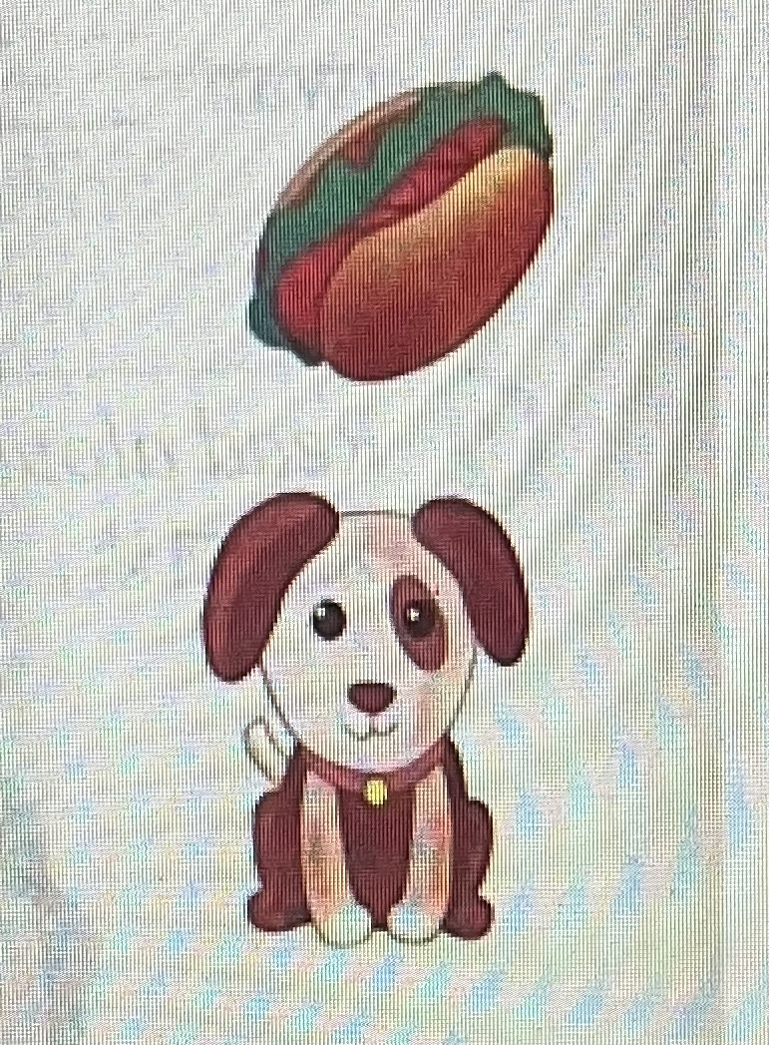
Learning Creatively
3、Mark the liaison( ◡) and tone. Then role-play the dialogue.
标出连读和升降调，然后分角色扮演。
Yoyo: Mum, can I swim and have a pancake?
Mum: An egg in it? Just like a hot dog.
Yoyo: Hot dog? Dogs are cute. We can't have dogs.
Mum: Well, Yoyo, hot dogs are not dogs.
Yoyo: OK. I'll have a pancake and a hot dog.
◡
◡
◡
◡
◡
◡
◡

Slide 26
Learning Creatively
4、Listen, write and read aloud.
听录音，补充下文并大声朗读。
John swims /wel/, so we can /gəʊ/ to swim in /hɒt/ June. I can take my bull from /həʊm/, and he cantake his /dɒg/.
well
go
hot
home
dog

Slide 27
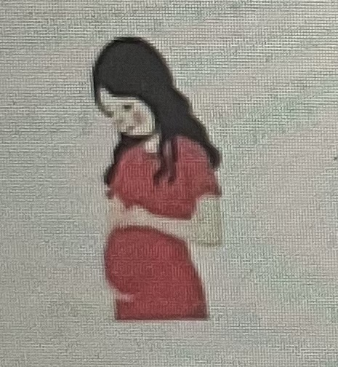
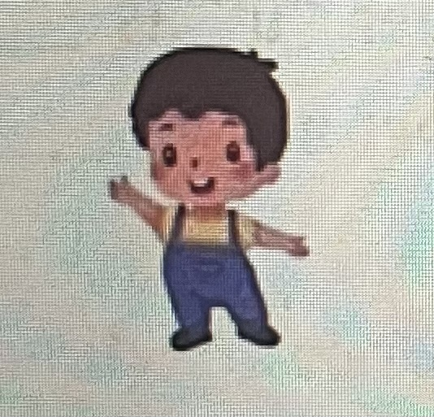


Challenging Yourself
1、Listen, repeat and choose the correct sound of the letter “o”.
听录音跟读，并选出字母“o”的正确发音。
A. /ʌ/
B. /ɑ:/
C./ɔ:/
D./əʊ/
mother son love come

Slide 28
Challenging Yourself
2、Read aloud first. Then listen, check and repeat.先大声朗读，然后听录音核对，并跟读。
1) His name is Bob.
2) Mum, come and kiss me.
3) Tom and Jane need a match.
4) I have a nice apple.
◡
◡
◡
◡
◡

Slide 29
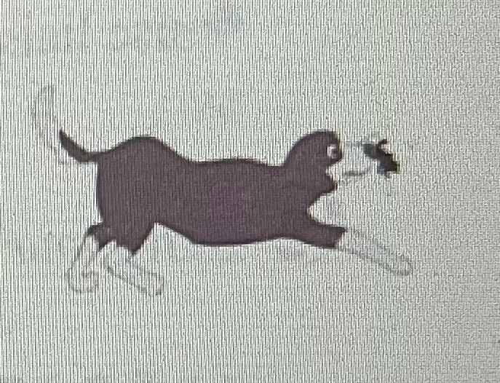
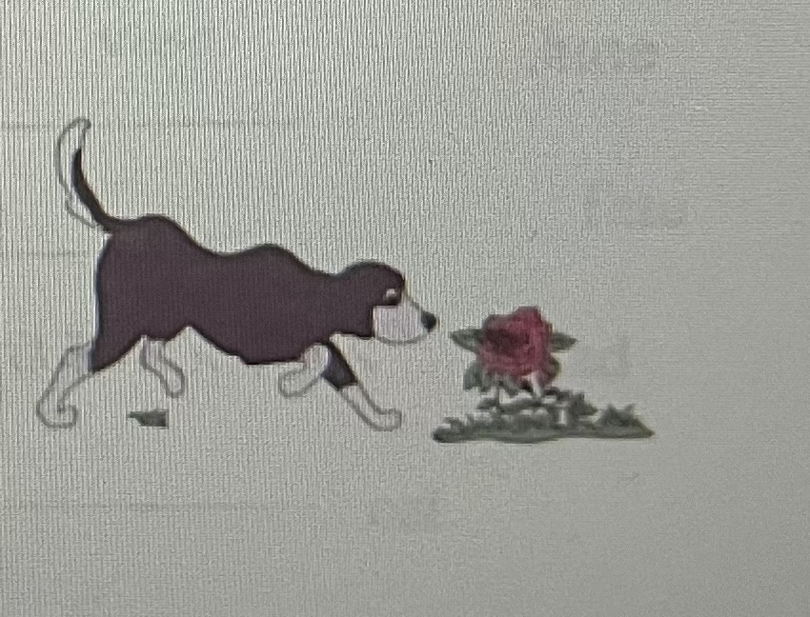
Challenging Yourself
3、Read aloud first. Then listen, write and repeat.先大声朗读，再听录音补全小诗，并跟读。
I my big black .
1）
love
dog
He can bite a big on the .
bug
nose
come
And he can and
put
the bug on the rose.
说话或朗读时，句子与句子之间需要适当的停顿。

Slide 30
Learning Reflectively
1、Try to work out the rules. 试着找出规律。
1) We can pronounce the letter “o” as in go and hope; as in not and dog.
2) We can pronounce the letter “u” as in up and just; as in cute and tube; as in blue and June; as in put and bull.
/əʊ/
/ɒ/
/ʌ/
/ju:/
/u:/
/ʊ/

Slide 31
o |  | u |  |  |  | w/wh |  | y
/əʊ/ | /ɒ/ | /ju:/ | /ʌ/ | /u:/ | /u/ | /w/ |  | /j/ | /aɪ/
home | dog | cute | bus | blue | bull | swim | when | yam | by
hope | hot | huge | just | June | pull | wake | which | yes | my
no | not | tube | sun | rule | put | well | white | yoyo | why

Slide 32
Learning Reflectively
2、Tick(√) what you can do.看看你今天学会了什么。
Now I can...
Great
Good
Ok
Try hard
read /əʊ/, /ɒ/, /ju:/, /ʌ/, /u:/, /u/, /w/, /j/ and /aɪ/correctly;
match the words with their sounds correctly;
read the words, phrases and sentences correctly;
write the words according to their sounds;
infer another sound of the letter "o";
use liaison well in speaking.

Slide 33
Learning Reflectively
3、Write vour learning log.完成学习日志
1)学完本课后你有什么收获呢?
2) 学完本课后你还有什么疑惑呢? 大胆写下来吧!

Slide 34
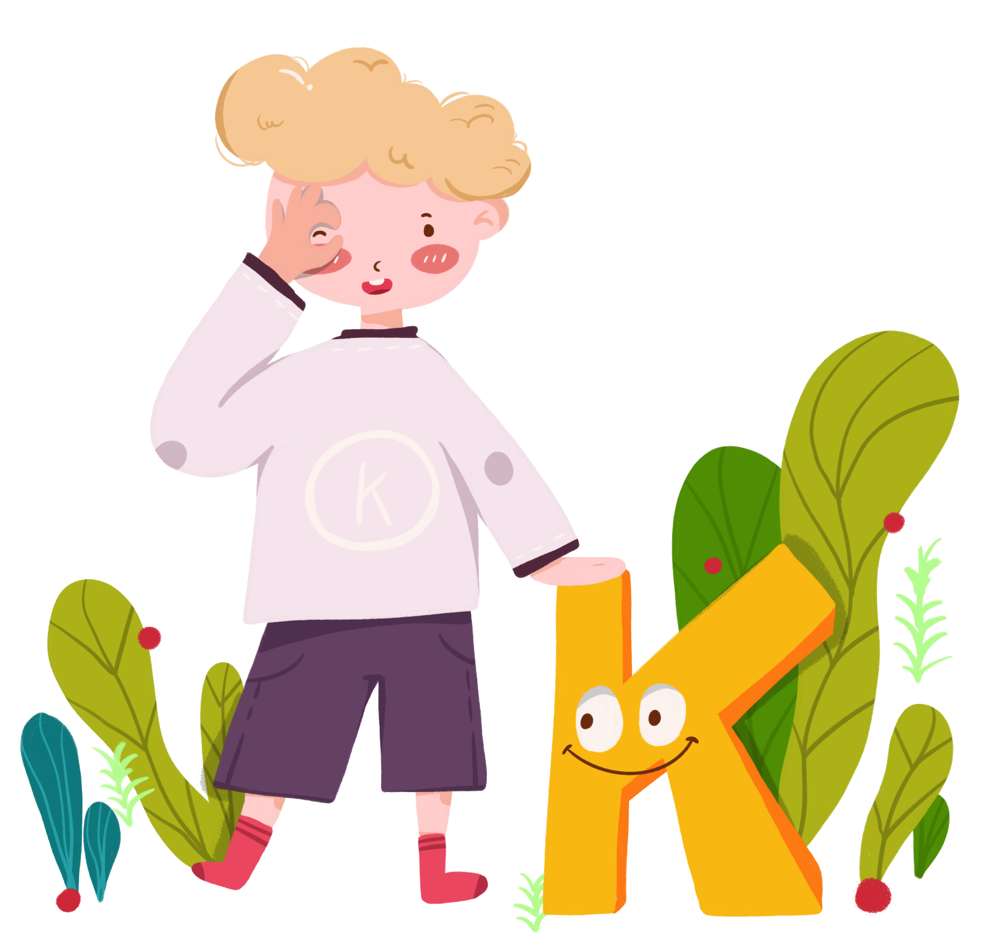
感谢您的观看
Thanks!
thanks
ABCDEFGHIJKLMNHIJKLMNOPQRSTUVWXYZ

