Slide 1

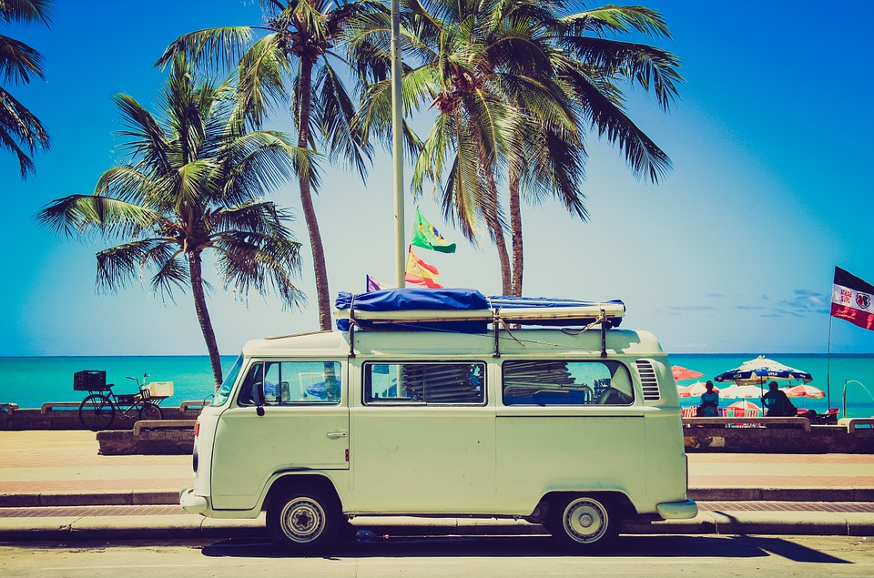
Let's travel
around the world!
1
transportation
customs
3
weather
2
travelling
4

Slide 2
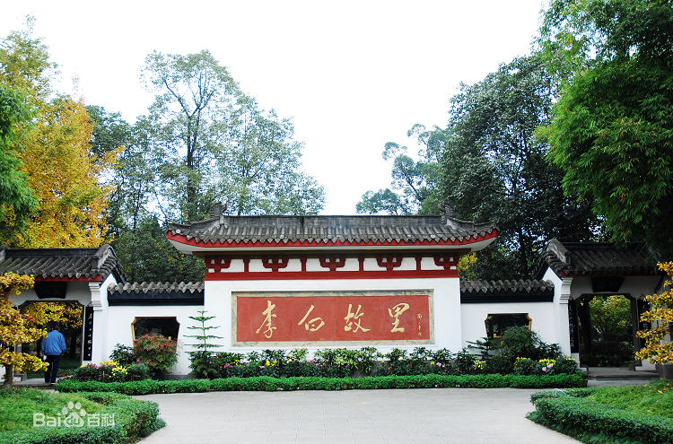
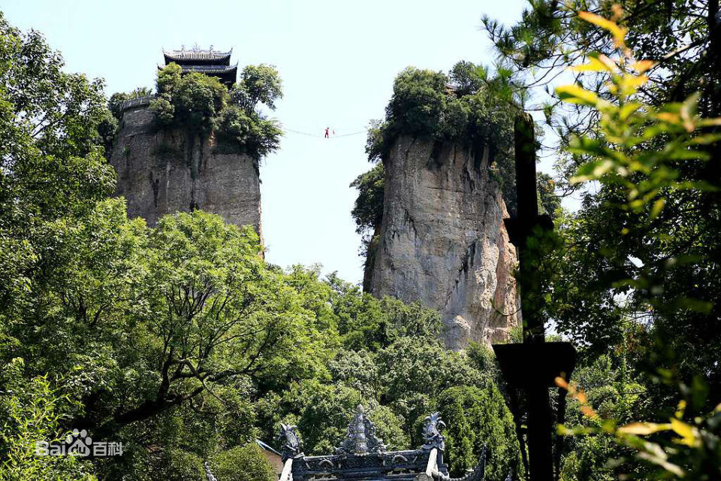
Jiangyou---an old city with a long history
Hometown of Libai
Douchui Mountain

Slide 3
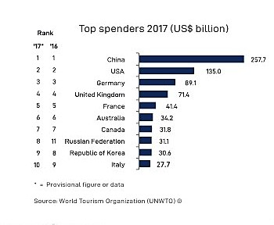
News Report
2018
It's reported that Chinese spent the most in travelling in 2018 around the world.

Slide 4


If you have a chance to travel around the world.......

Slide 5
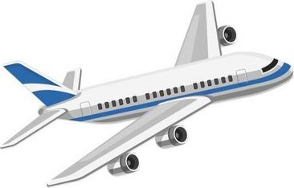
Before travelling

Slide 6
things you need to do:
Transportation
Weather
Personal things
Places of interest
Customs(table manners/greeting manners)

Slide 7

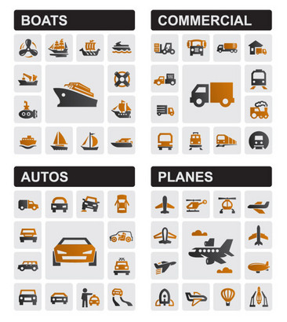
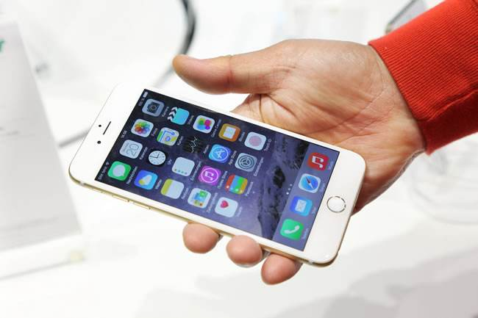
How can you book the ticket?
You can book it online with your phone.
You can buy it at ticket office in person.
take a plane/train/high-speed train
drive the car
go there by air/land/water
go there in a car/on a bus
ride a bicycle(shared bike)
Transportation:

Slide 8
things you need to do:
Transportation
Weather
Personal things
Places of interest
Customs(table manners/greeting manners)

Slide 9


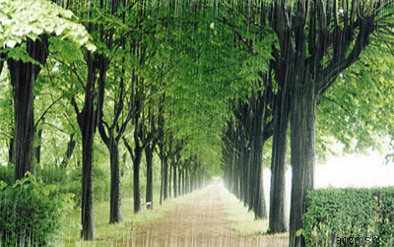

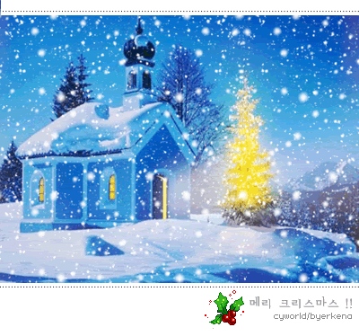
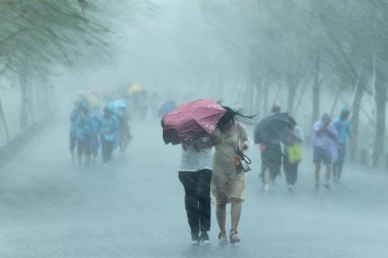
Weather:
a sunny day
a cloudy day
rainy
a ____ day
hard/heavily
rain _________
a snowy day
a ______rain
a rainstorm
heavy

Slide 10
things you need to do:
Transportation
Weather
Personal things
Places of interest
Customs(table manners/greeting manners)

Slide 11
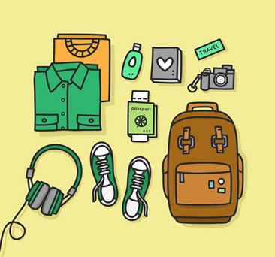
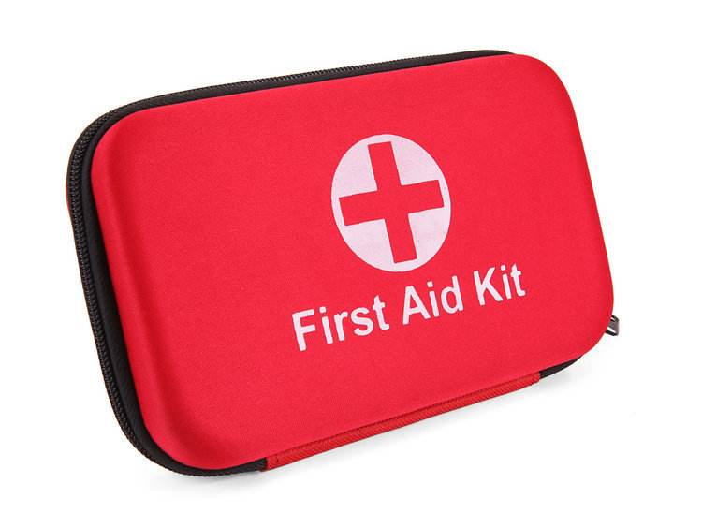
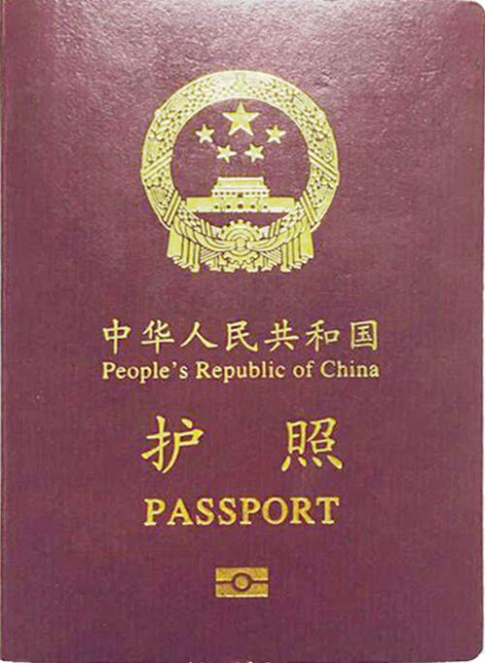
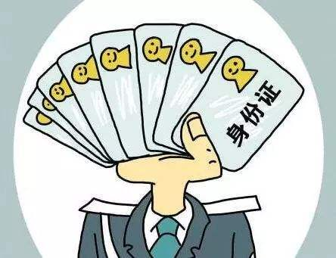
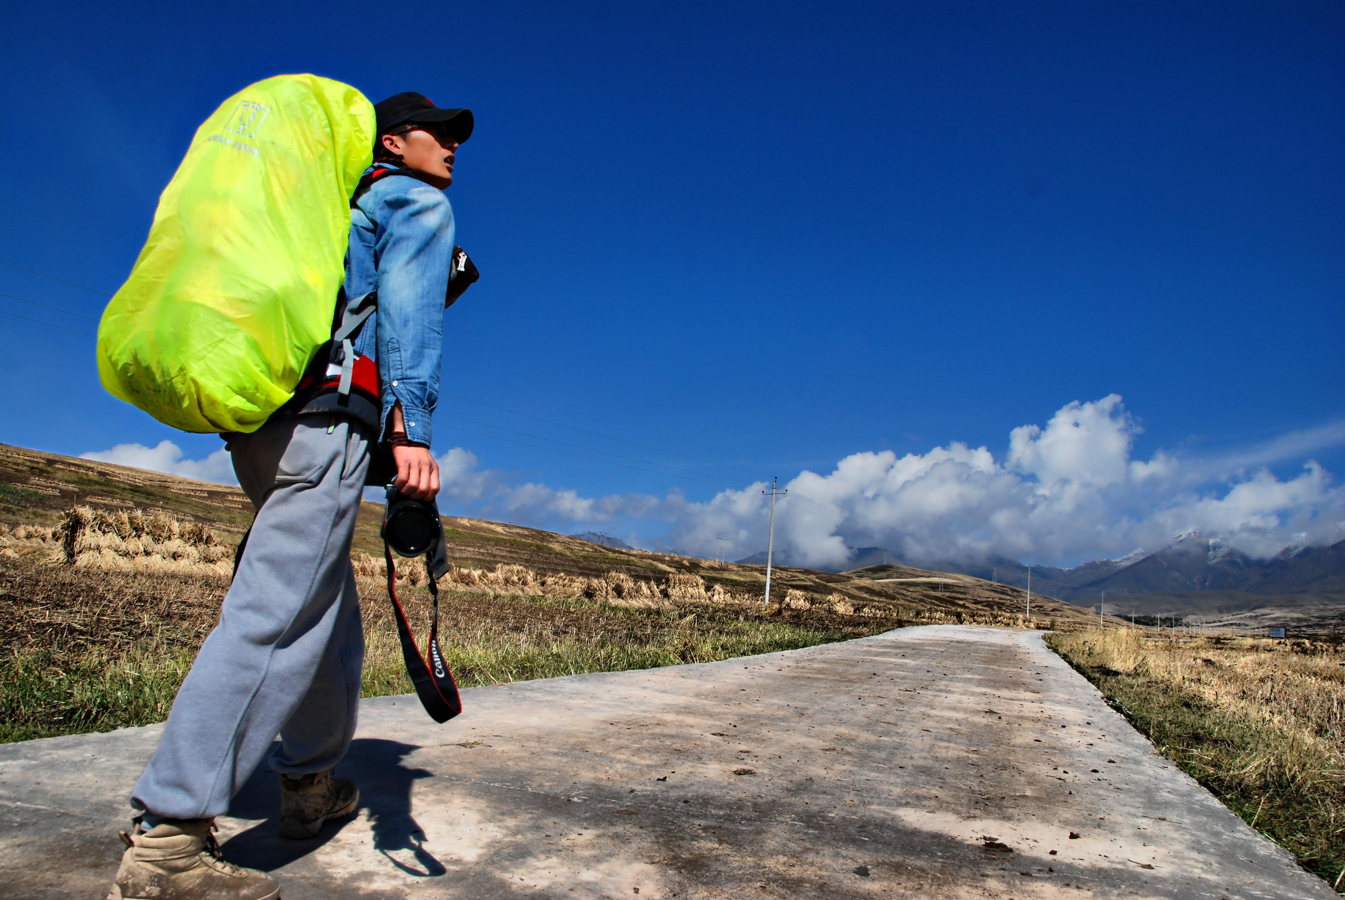
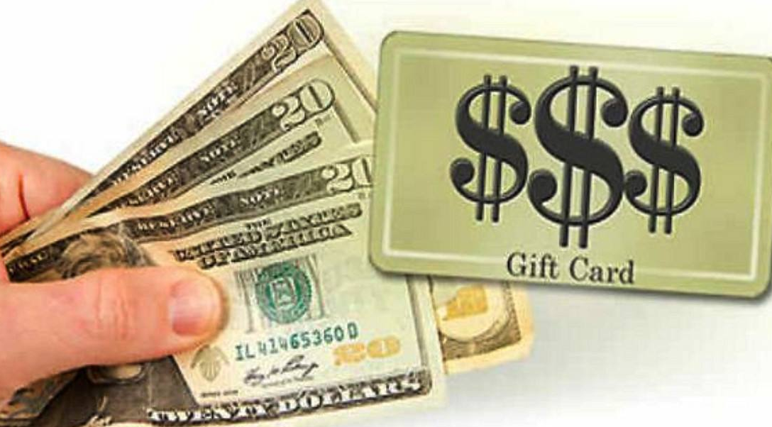
first aid box
急救包
things you need to bring:
ID card
cash
passport
backpack

Slide 12

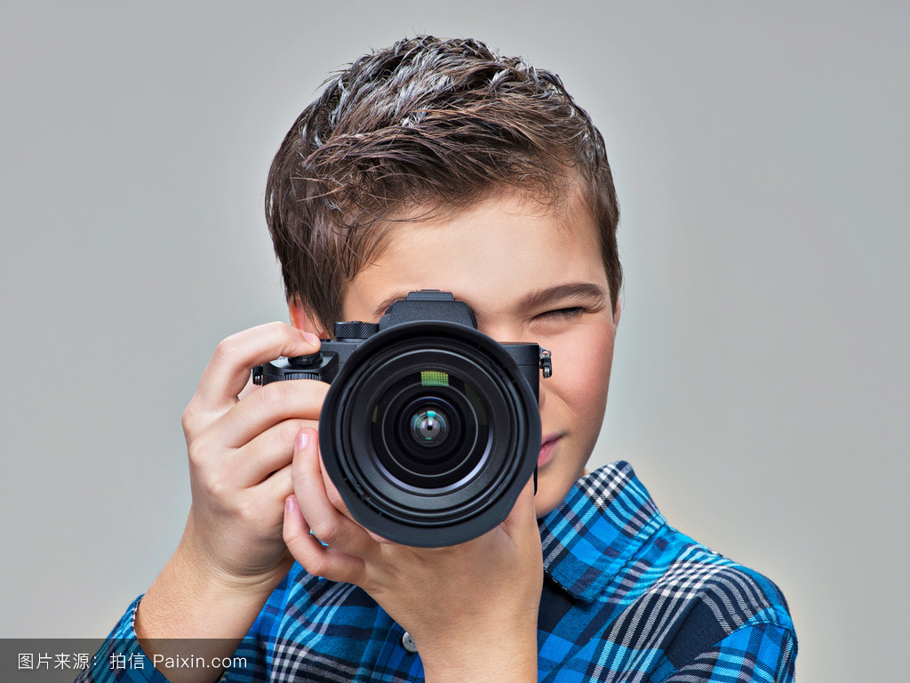
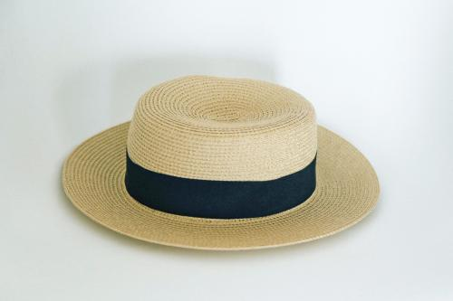
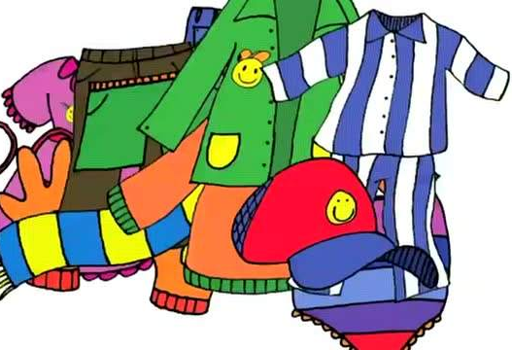
sunglasses
camera
clothes
hat

Slide 13
things you need to do:
Transportation
Weather
Personal things
Places of interest
Customs(table manners/greeting manners)

Slide 14
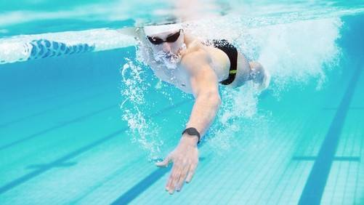
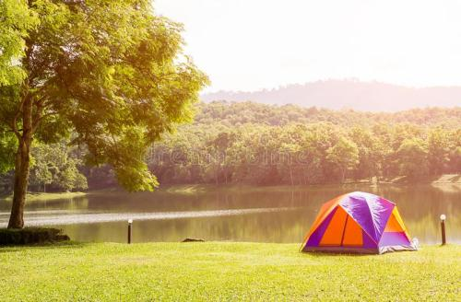



How can you describe a place?
What would you like to do if you go to this place?
relaxing
go shopping
go swimming
modern
camp by the lake
fascinating
practice English
beautiful
go hiking
fantastic
learn about the history
and traditional culture
warm
I would like to go to the place which.....
I would like to go to the place where......

Slide 15
things you need to do:
Transportation
Weather
Personal things
Places of interest
Customs(table manners/greeting manners)

Slide 16

Customs:
It's said that do as Romans
do when in Rome. If we take
a trip to other places, we
should follow the local
customs.
table manners/greeting manners

Slide 17


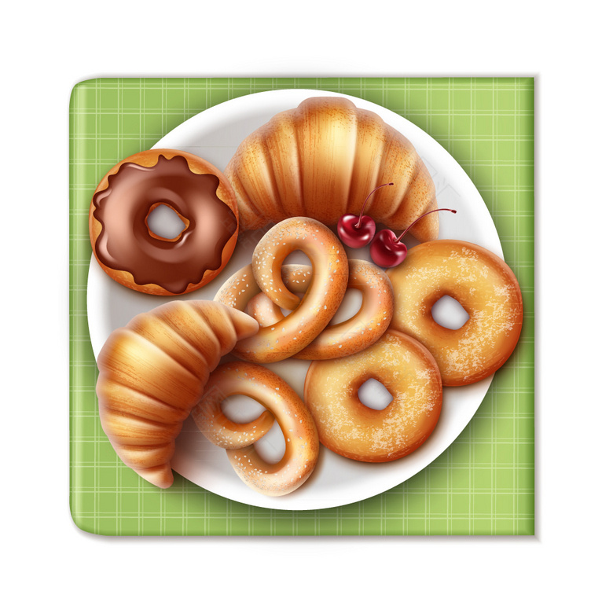


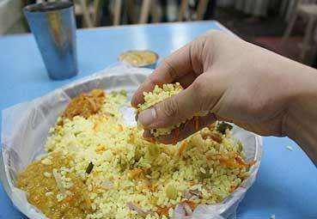
You're (not) supposed to/can't/shouldn't....
Switzerland
France
put the bread
on the plate
eat with hands
be on time

Slide 18
While travelling

Slide 19
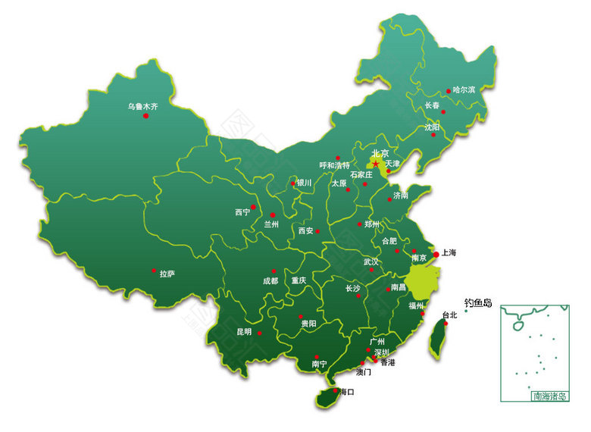

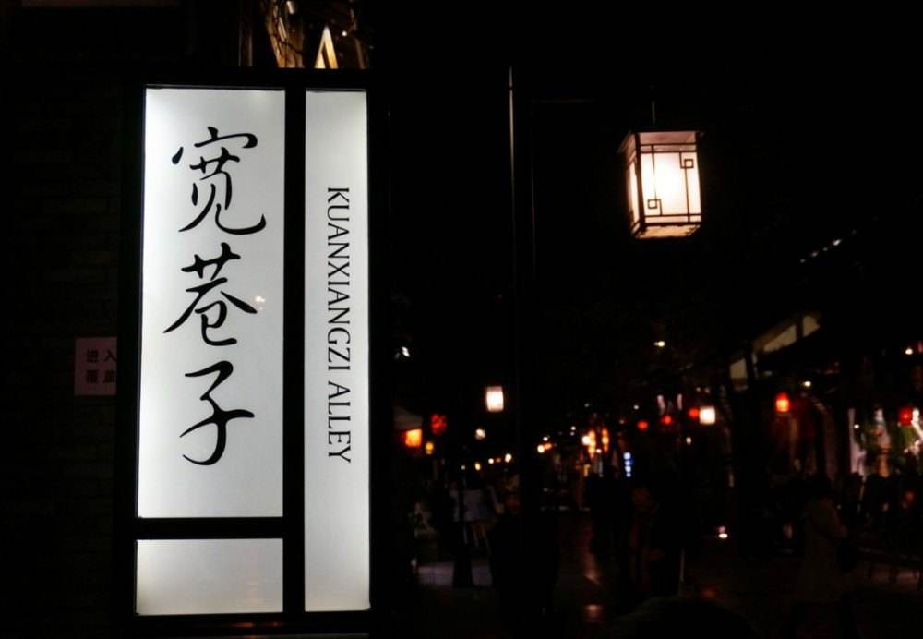
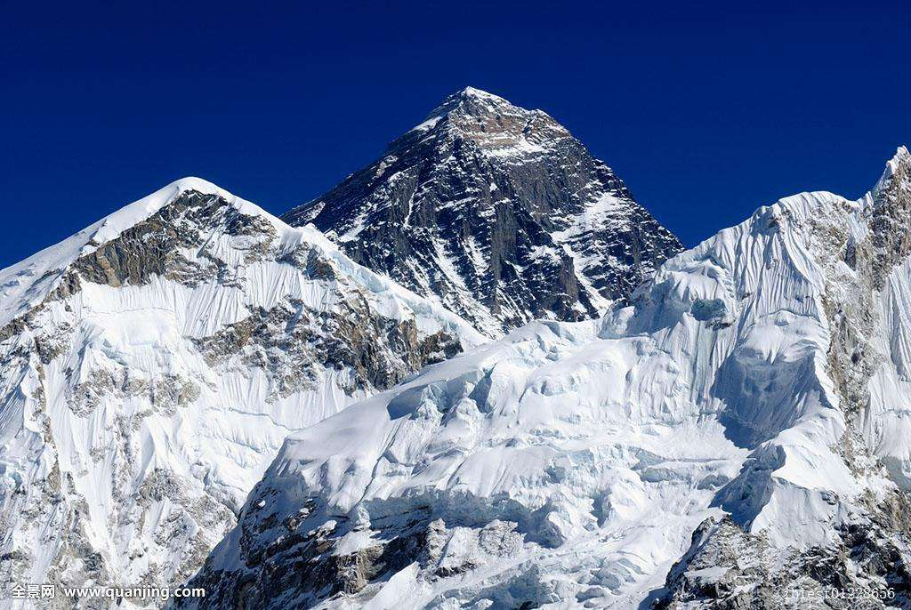
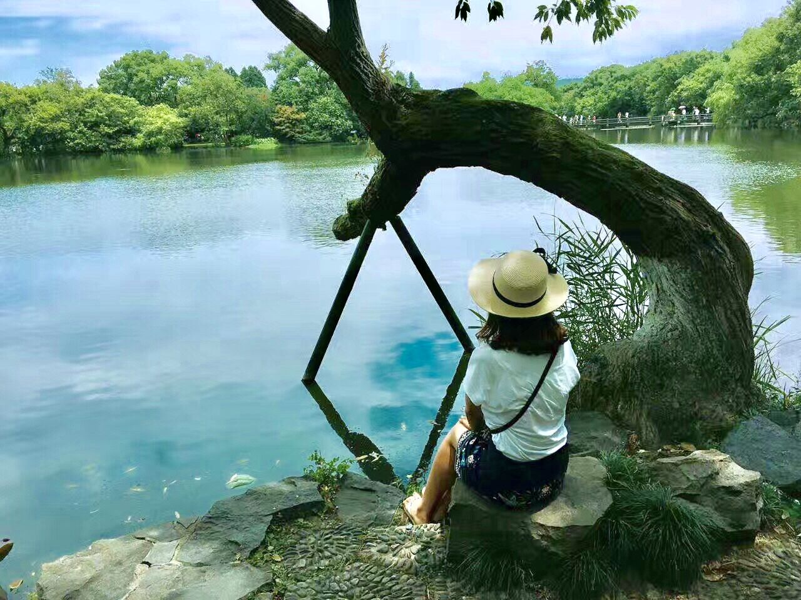
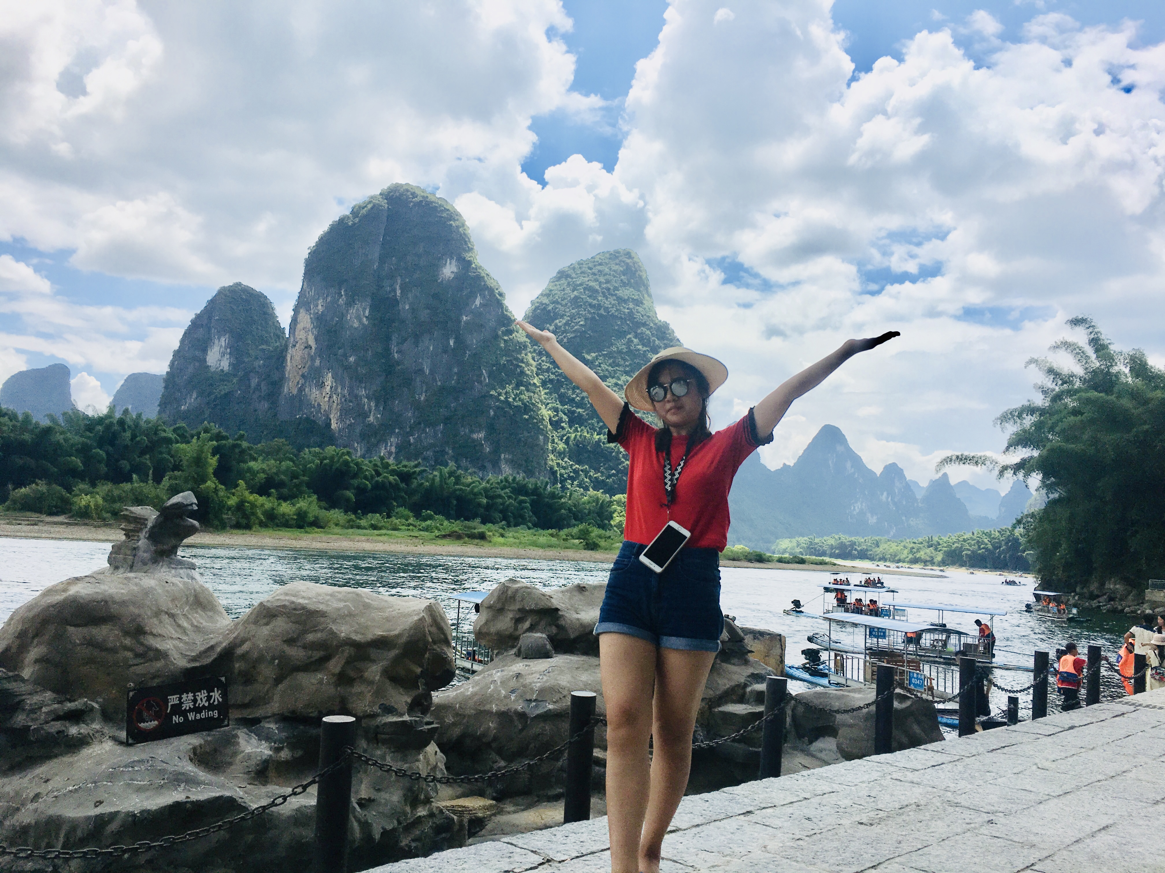
Travelling can not only bring us happiness,
but also give us knowledge.
Beijing
Qomolangma
Kuanzhai Alley
Lijiang River
West Lake

Slide 20
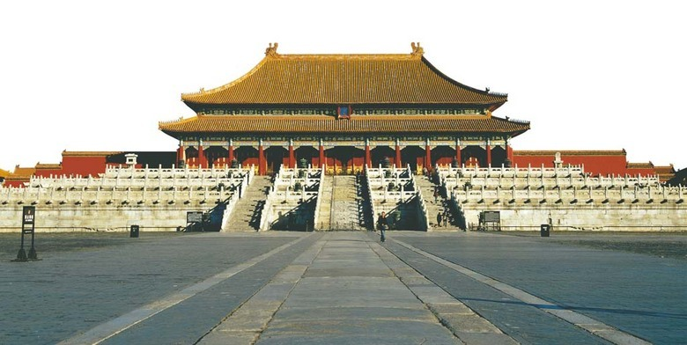
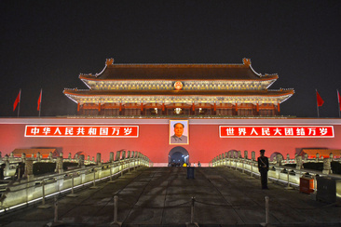
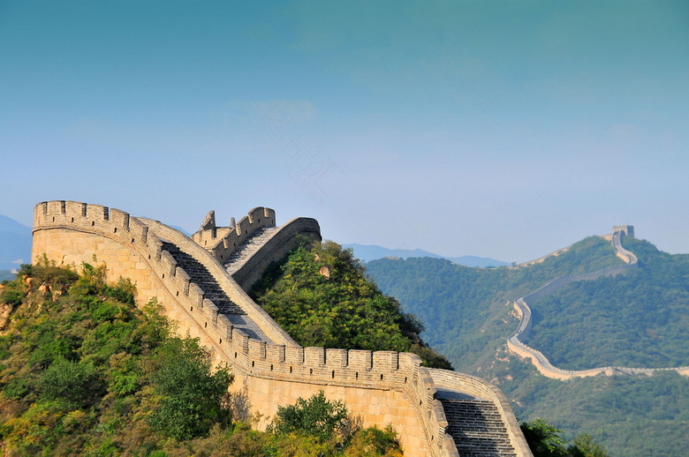
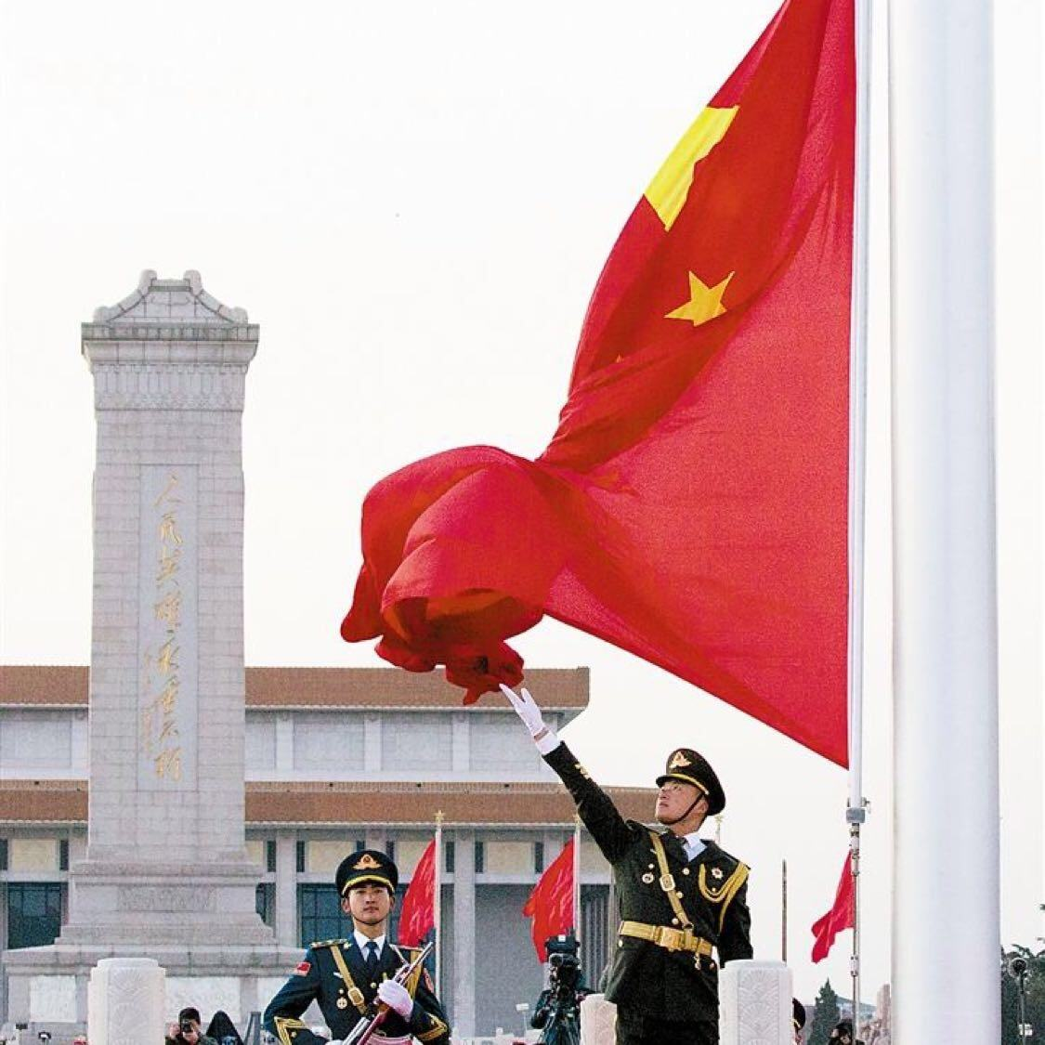
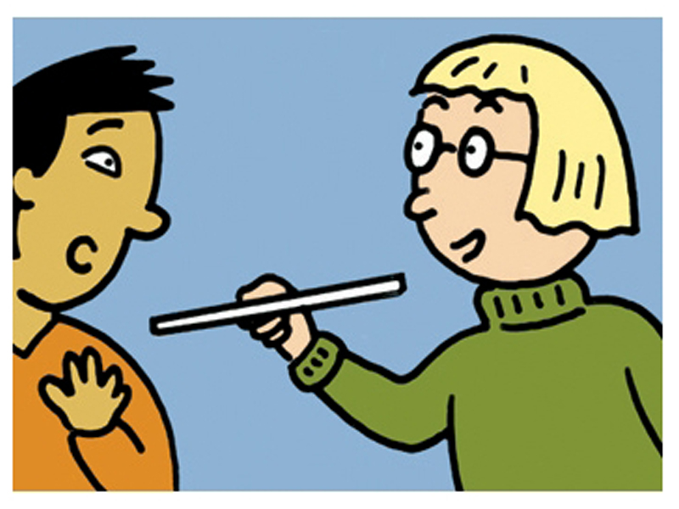
I would like to go to...because/the reason why....
I will eat....
I am going to......which/where........
be (not) allowed to...
the Palace Museum
Tian'an Men Square
the Great Wall
Do as Romans do
take a high-speed train
places of interest
activities
transportation
museums
visit some _______
learn about Chinese ______________
see the flag-raising ceremony
climb the _________wall in the world
Beijing Duck
Beijing
history and culture
food
(traditional food)
customs
greatest
reasons
capital
point at others with chopsticks
shake hands with others
while meeting for the first time.
the ______ of China
an old city with a_____ history
long

Slide 21
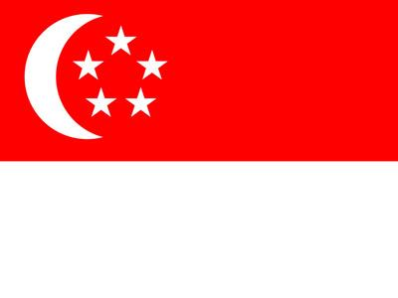


Speak and Draw: discuss the travelling plan and draw it on the paper
student 1:transportation
student 2:food
student 3:reasons
student 4&5:places of interest&activities
student 6:customs
student 7:give a speech about the plan
Singapore
_______________
_______________
_______________
_______________
transportation
places of interest
activities
the United Kingdom
_______________
_______________
food
Beijing
reason
customs
_______________
_______________
_______________
_______________
the United States

Slide 22

I would like to go to...because/the reason why....
I will eat....
I am going to......which/where........
be (not) allowed to...
Night Safari
Art and Science Museum
take a plane to Singapore
transportation
places of interest
activities
Whether Japanese food ,
Chinese food or Indian food,
I am going to taste it all in
Singapore!
watch animals at night
talk with local people to
practice English
go shopping
food
Singapore
reason
customs
bring a small gift when go to the local family
shake hands while meeting for the first time
not far from China
a warm place

Slide 23

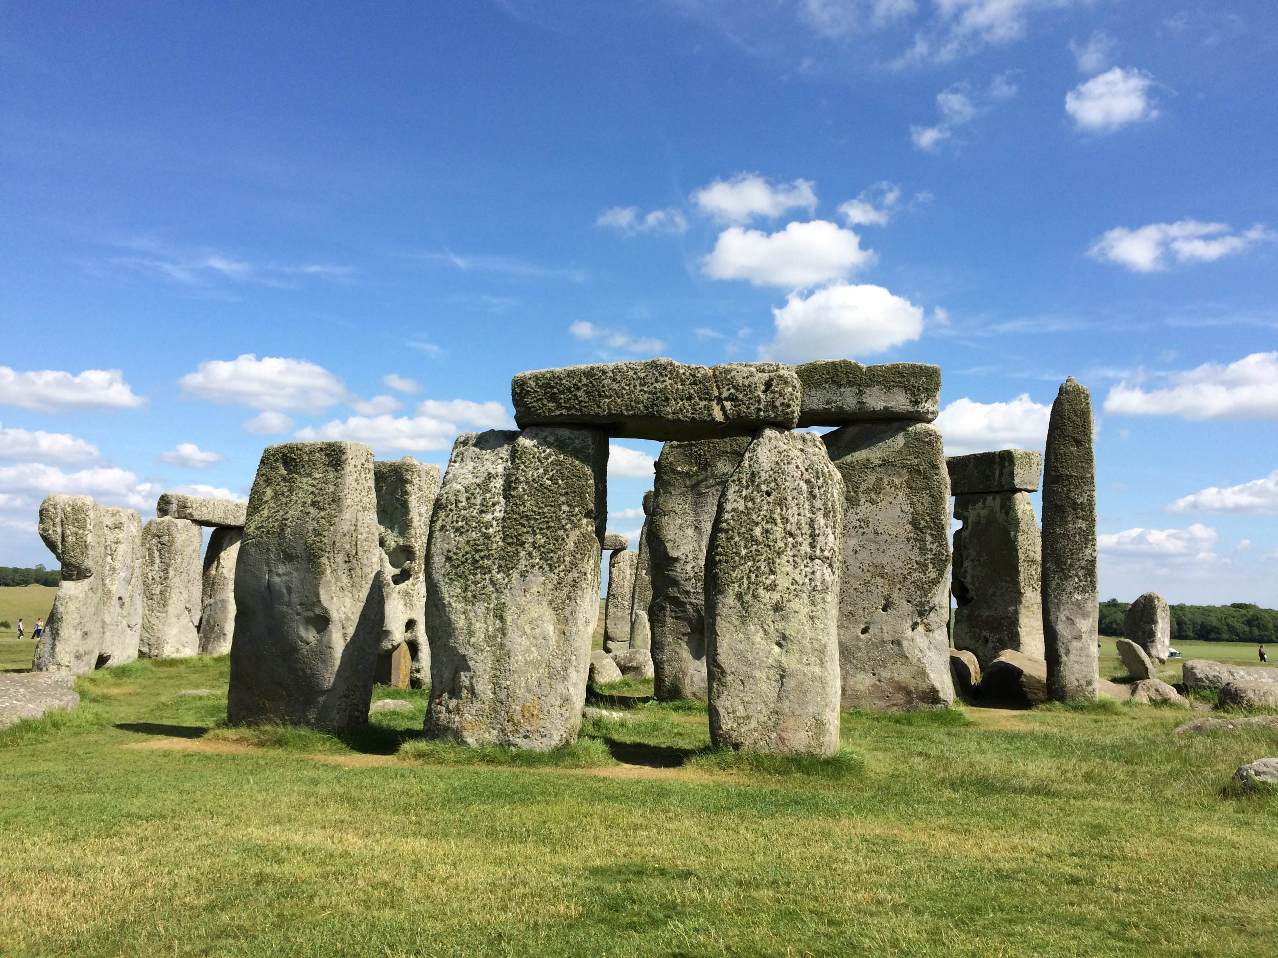
I would like to go to...because/the reason why....
I will eat....
I am going to......which/where........
be (not) allowed to...
go there by air
the Big Ben
the Stonehenge
the London Eyes
transportation
places of interest
activities
visit the historical building
see the sun rising on the
longest day in June
traditonal British food
food
the UK
shake hands while meeting
for the first time
don't put the elbow on the table
many beautiful buildings
reason
customs

Slide 24

Travelling can open up our eyes and broaden the mind.

Slide 25
信息摘录：
A New Journey
Advantages/Benefits
Reasons
Plans
_____________________
1.Enjoy beautiful scenery and fresh air
2.___________ new friends
happy
1.Sydney Opera House-go to a concert
2.Melbourne University---a wonderful chance_________ the great campus.
1.Make me _________
2.A good way to _____________ to see the world
go outside
Make
to visit

Slide 26
With the development of society, people would spend more time relaxing, travelling is the best choice. I love travelling, I can not only enjoy the beautiful nature and fresh air, but also make friends with others, therefore, I am going to make a plan for my new trip.
I would like to go to Australia which is full of fresh air and special culture. I will go there by air. I learn that the weather in Australia is completely different from that in China. First of all, I am going to the well-known Sydney Opera House which is like a shell lying in the bay, I will go to a concert held there, it must be unbelievable. Then, I would go to Melbourne by train. It is the trading center of Australia, and what’s more, the best college in Australia, the Melbourne University is located there. It ranks 22 in the world college billboard(世界名校排行榜）. It is such a wonderful chance for me to pay a visit to the great campus, hoping that one day in the future I will grasp(抓） the opportunity to study there through working hard. Lastly, I am going to go to the Gold Coast(黄金海岸）with the most beautiful beach in the world. It will be my first time to go to the beach, I hope that I can lie on the beach and enjoy the sunshine freely. How relaxing it is!
It’s said that as a travel lover, I can find happiness during trip, and getting out of the comfortable home is a good way to see outside world. There is no doubt that travelling is attractive to us all.I am looking forward to setting out on my new journey.
Beginning
Body
Ending

Slide 27
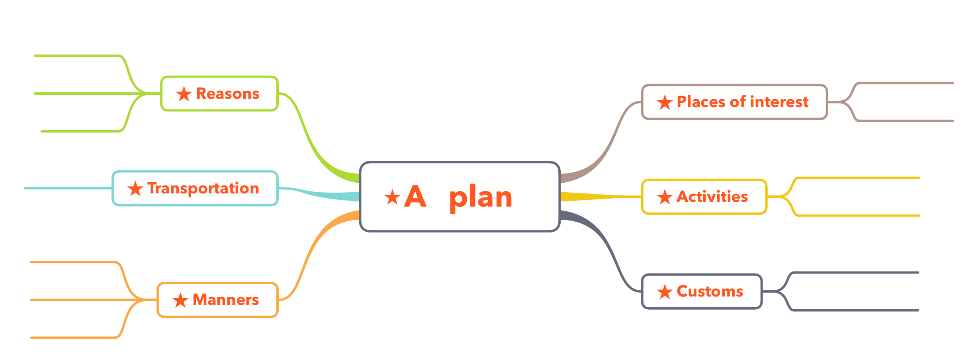
Writing Task
After junior high school, you will have a summer vacation, please make a plan for your summer trip according to the below map.
A plan for
my trip___
Food
A long summer vacation is coming, I have expected it for a long time. Now, I want to make a paln for my trip. In this summer vacation, I would like to go to a place which/where____________________ ____________________________________________________________________________________________________________________________________________________________________________________________________________________________________________________________________________________________________________________________________________

Slide 28
After travelling

Slide 29
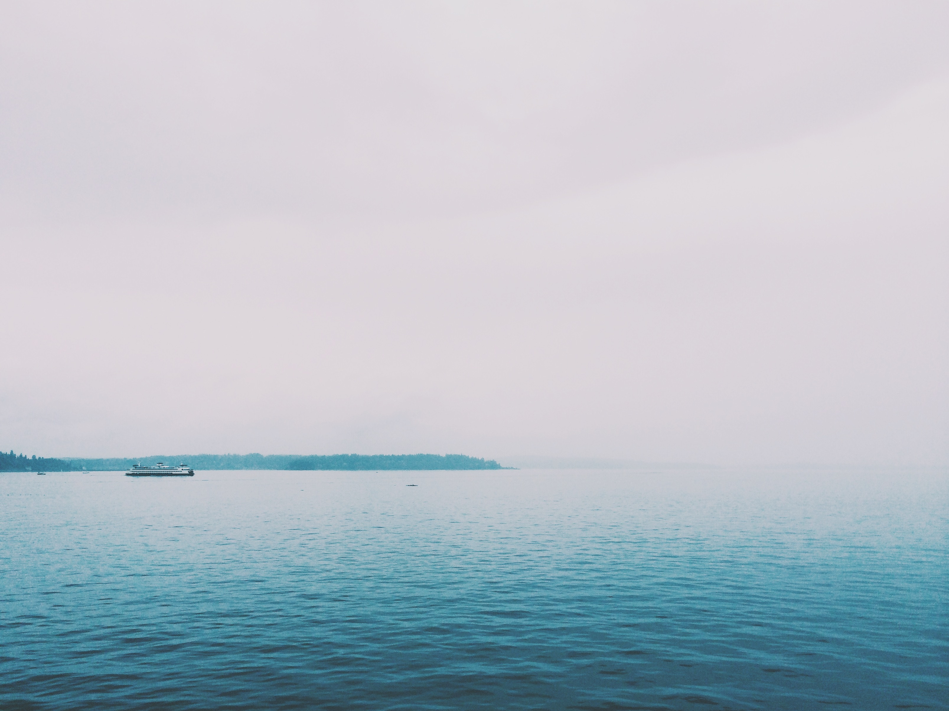
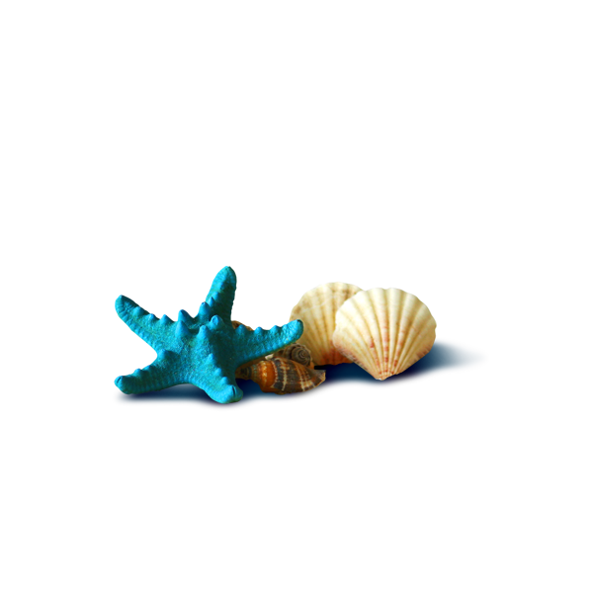
«
It's better to travel ten thousand miles than
to read ten thousand books.

Slide 30
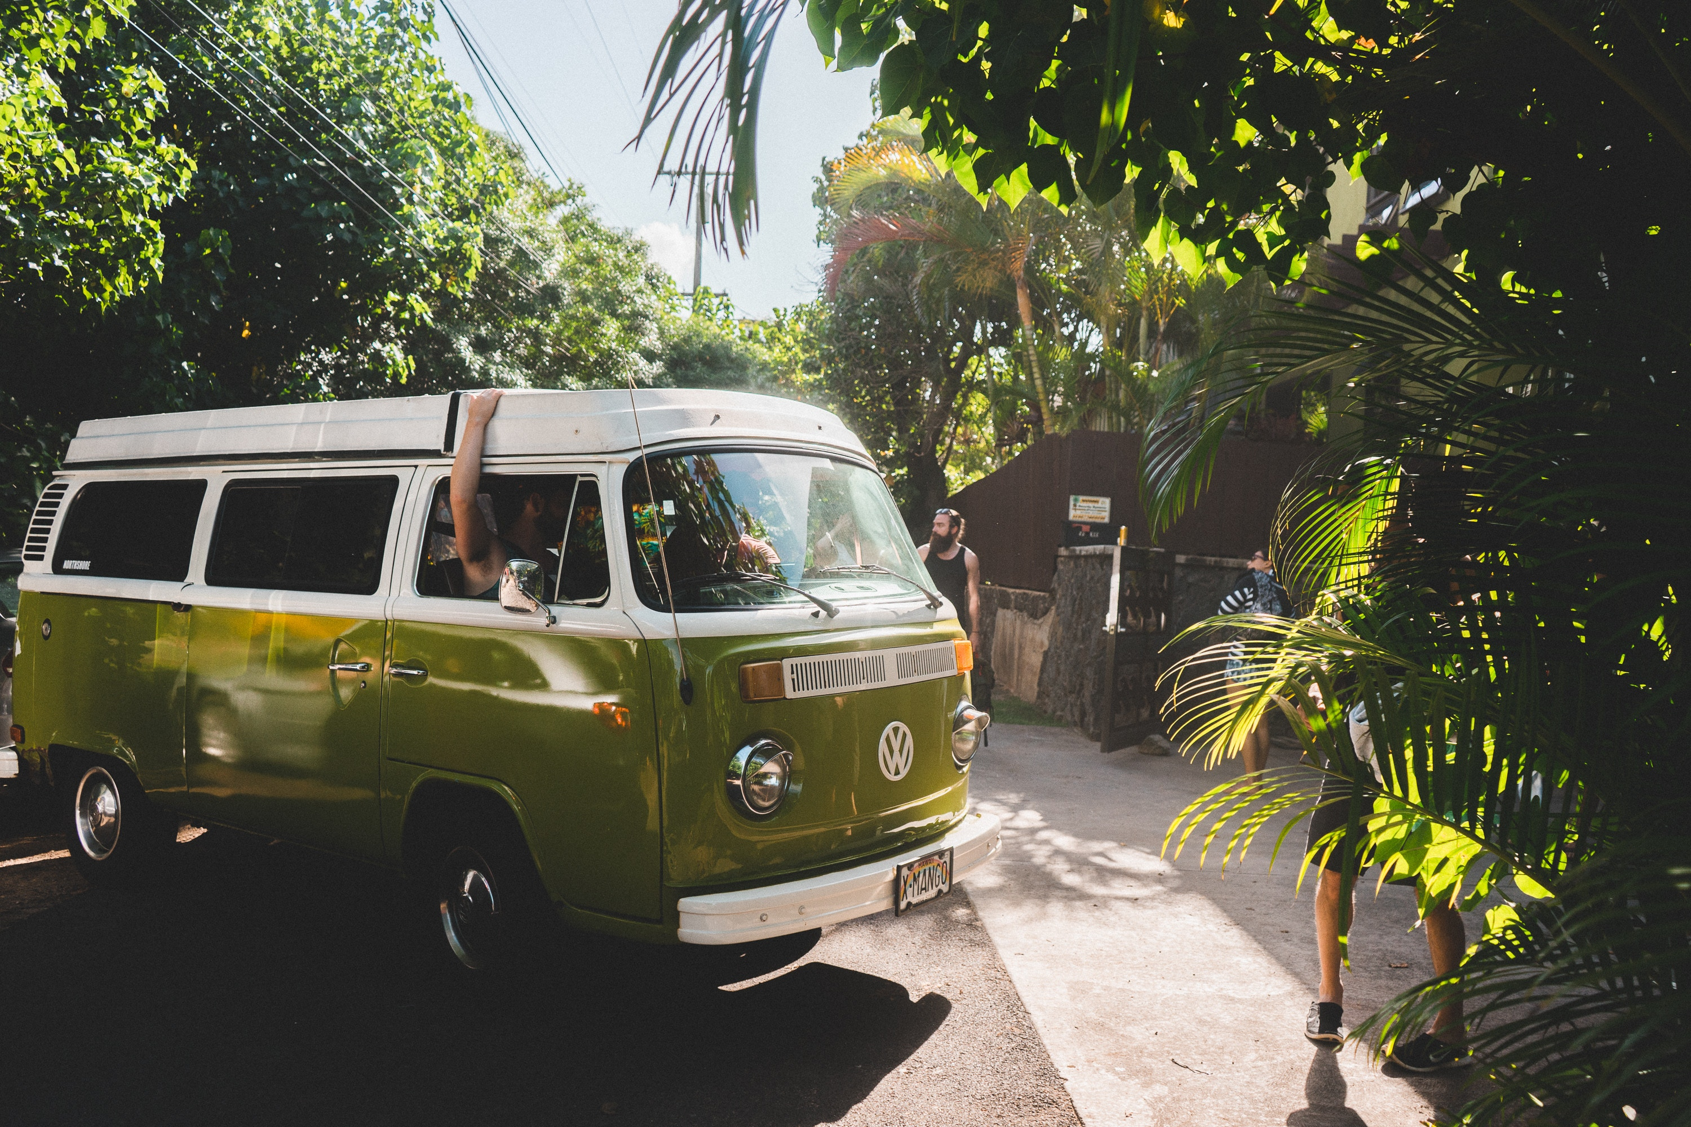
THANK
YOU

