Slide 1



Comments on Teaching Plan
Lesson 20
I Drink Fruit Juice Every Tuesday.
ABCDEFGHIJKLMNHIJKLMNOPQRSTUVWXYZ

Slide 2
A Cat, a Bag and Kate.
Lesson 1
Looking Ahead
By the end ofthis lesson, you will be able to:
read the words with the letters "u" "ui" and "y" correctly;
正确朗读含有“u” “ui”和“y”的单词;
use syllables, stress and linking sounds in speaking skillfully;
在口语中熟练运用音节、重音和连读；
read the passage skillfully;
熟练地朗读短文；
write the words and phrases according to their sounds;
根据发音写出单词和短语；
infer another sound of the letters “ui”;
推断字母组合“ui”的另一种发音；
look up the words in a dictionary effectively.
有效地查阅词典。

Slide 3
game time
/ɔɪ/
/n/
/ʊ/
/ʌ/
/u:/
brother
/nk/
school
/ŋ/
good
love
choose
look
thank
bring
choice
bank
night
enjoy
chicken
evening

Slide 4
Learning to Learn
u |  |  |  | ui | y
/ju:/ | /u:/ | /ʌ / | /ʊ/ | /u:/ | /j/ | /ɪ/ | /aɪ/

Slide 5

Try to read
/ju:/
/u:/
/ʊ/
/ʌ/
/j/
/ɪ/
/aɪ/

Slide 6
Have a try
/ju:/
/u:/
/ʊ/
/ʌ/
/j/
/ɪ/
/aɪ/

Slide 7
/ju:/
future Tuesday student
flute rule ruler
luck hurry hundred
bush full hundred
/u:/
u
/ʌ/
/ʊ/

Slide 8
ui
/u:/
fruit juice suit

Slide 9
/j/
year yellow young
busy hurry sorry
sky try why
y
/ɪ/
/aɪ/

Slide 10
Learning to Learn
u |  |  |  | ui | y
/ju:/ | /u:/ | /ʌ / | /ʊ/ | /u:/ | /j/ | /ɪ/ | /aɪ/

Slide 11
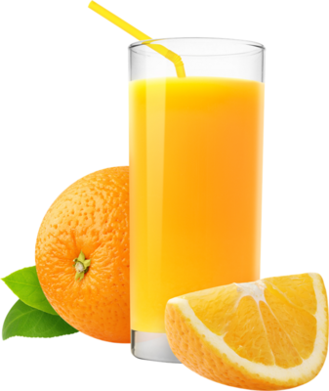
Learning Actively
1、Listen and put the sounds you hear in the yellow juice cup.听录音，将所听音标填入果汁杯。
/w/
/ɑ:/
/u:/
/j/
/ʌ/
/ju:/
/ʊ/
/s/
/θ/
/ɪ/
/ʃ/
/ʒ/

Slide 12
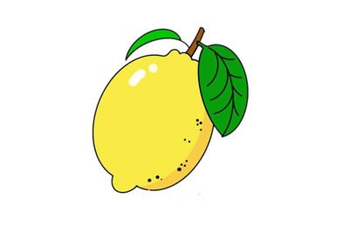
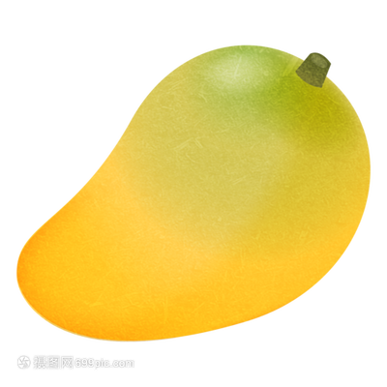

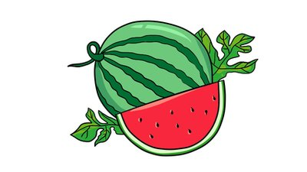
2、 Listen and tick (√) the words with the same sounds in the fruit. 听录音，并勾出与水果中有相同发音的单词。
juice busy
ruler push
funny fly
why city
√
√
/u:/
/aɪ/
√
√
blue full
lucky study
yard sorry
try yellow
/ʌ/
/j/
√
√
√
√

Slide 13
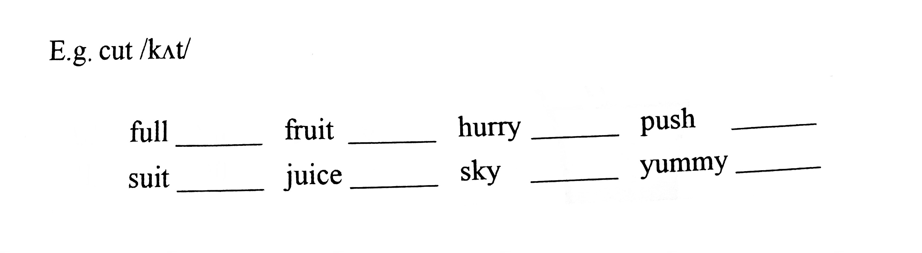
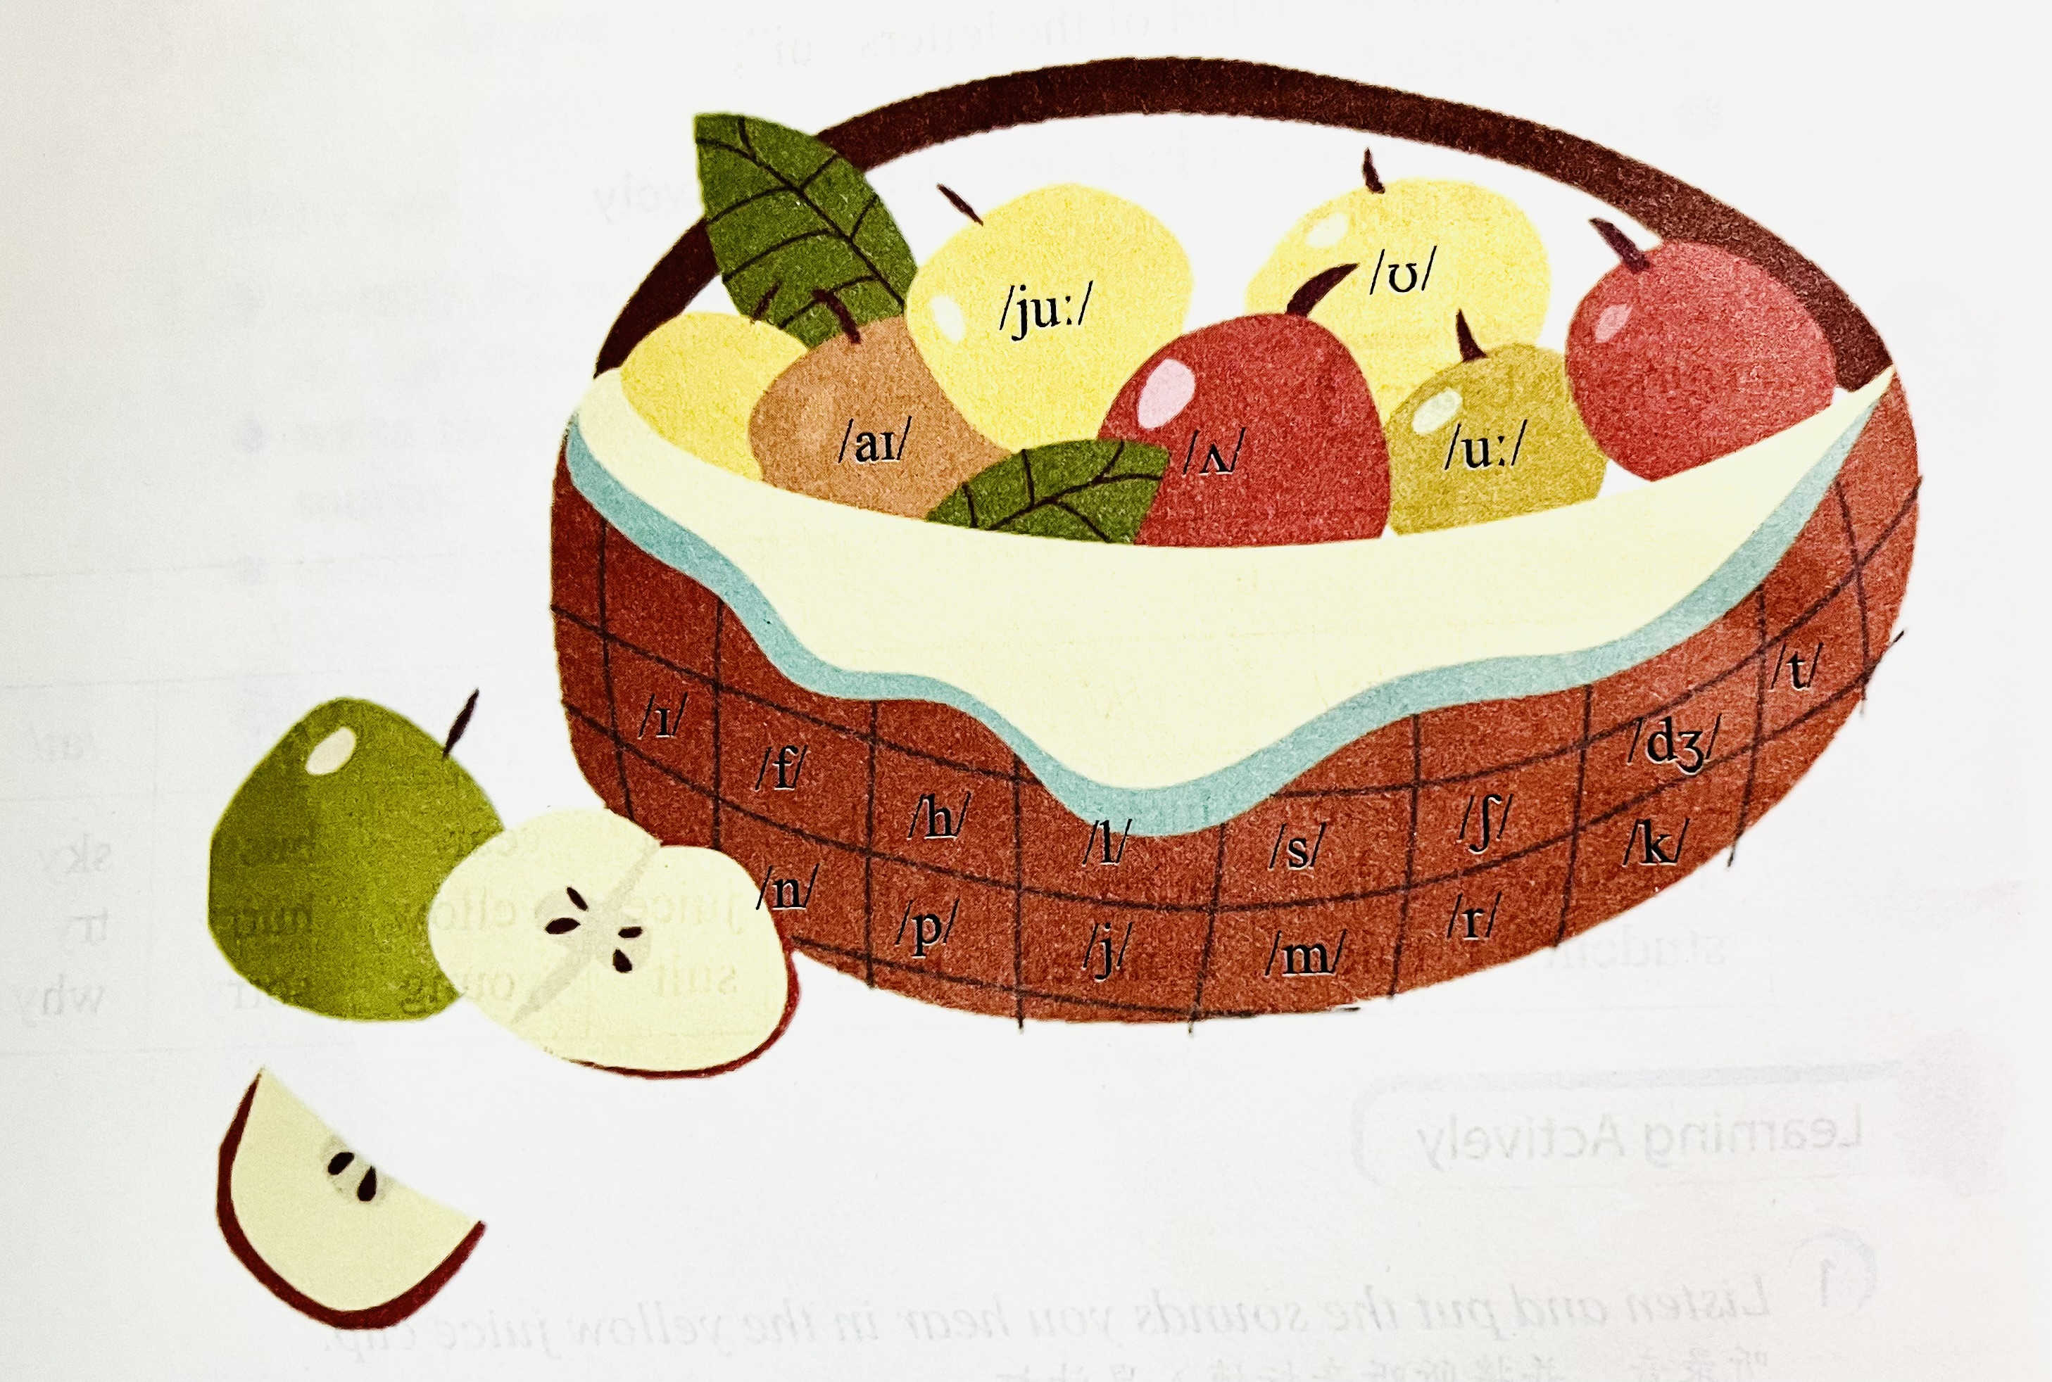
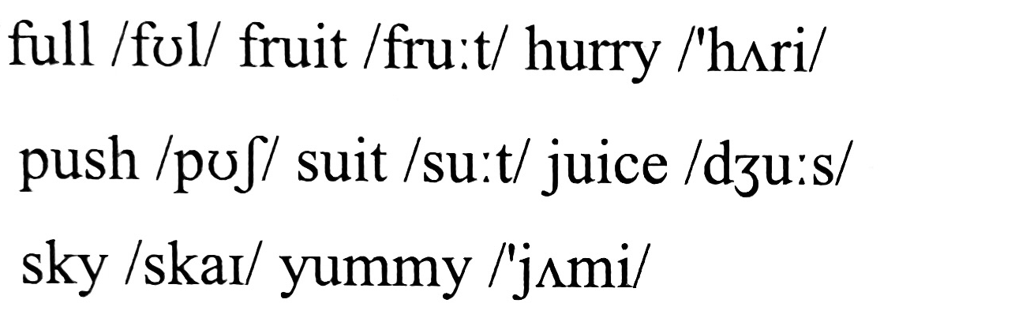
3、 Read and choose. Then listen, check and repeat. 读一读，选一选。然后听录音核对，并跟读。

Slide 14
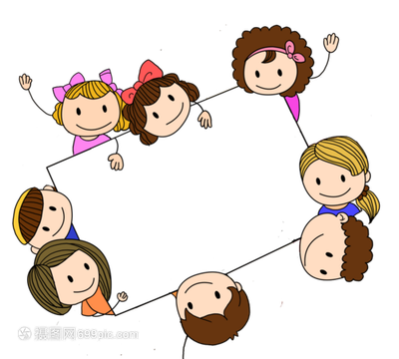
4、 Work in goups and write as many words as you can with the sounds above. 与同伴一起，用以上所学的音标组成尽可能多的词汇。
shut, fight, shoot,
tick, June, height,
nut, night, might, must...

Slide 15
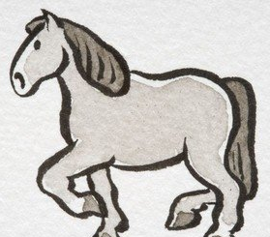
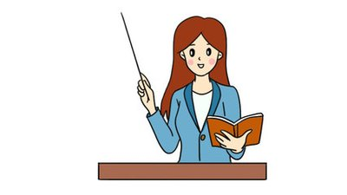

Learning Creatively
1、Complte the following sentences. 补全下列句子。
1）Oh, my god! The horse can / kʌt/ /ʌp/
the bananas.
cut up
2) I dream of becoming a teacher /ɪn/ /ðə/ /’fju:tʃə(r)/ .
in the future
Hurry up
3) /’hʌri/ /ʌp/ , or we will miss the last bus.

Slide 16



Learning Creatively
1、Complte the following sentences. 补全下列句子。
full moon
4）We like to talk and play with each other under a /fʊl/ /mu:n/ .
5) People always want to /flaɪ/ /ɪn/ /ðə/ /skaɪ/
just like birds.
fly in the sky
blue ruler
6) This /blu:/ /’ru:lə(r)/ is mine, and yours is yellow.

Slide 17
Learning Creatively
2、Try to read the sayings and match them with the meanings. 朗读谚语并匹配含义。
1) Behind bad luck comes good luck.
2) Learn young, learn fair.
A. 为学趁年轻，既学须学好
B. 塞翁失马，焉知非福。

Slide 18
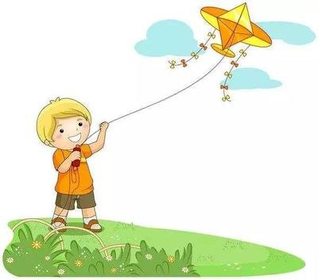
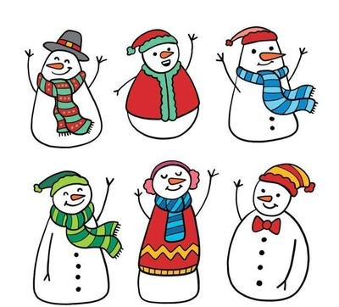
Learning Creatively
3、Listen and mark ( ) the linking sounds. Then sing the songs aloud. 听歌并标出 ( )连读部分，然后大声唱出来 。
1）Let Your Kite Fly High
Fly, fly, fly your kite.
High in the sky!
Up and down.
Round and round.
Let your kite fly high.
2) Do You Want to Build a Snowman?
Do you want to build a snowman?
Come on! Let’s go and play!
I never see you anymore.
Come out of the door.
It’s like you’ve gone away.

Slide 19
Challenging Yourself
1、Listen, repeat and choose the correct sound of the letters“ui”.
听录音跟读，并选出字母组合“ui”的正确发音。
A. /ju:/
B. /u:/
C./ʊ/
D./ɪ/
√
1) play the guitar 2) feel guilty
3) build a house 4) a strong, powerful built man

Slide 20
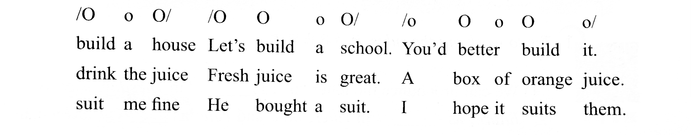
Challenging Yourself
2、Listen and repeat. Notice the stressed syllables. 听录音跟读，并注意重读音节。

Slide 21
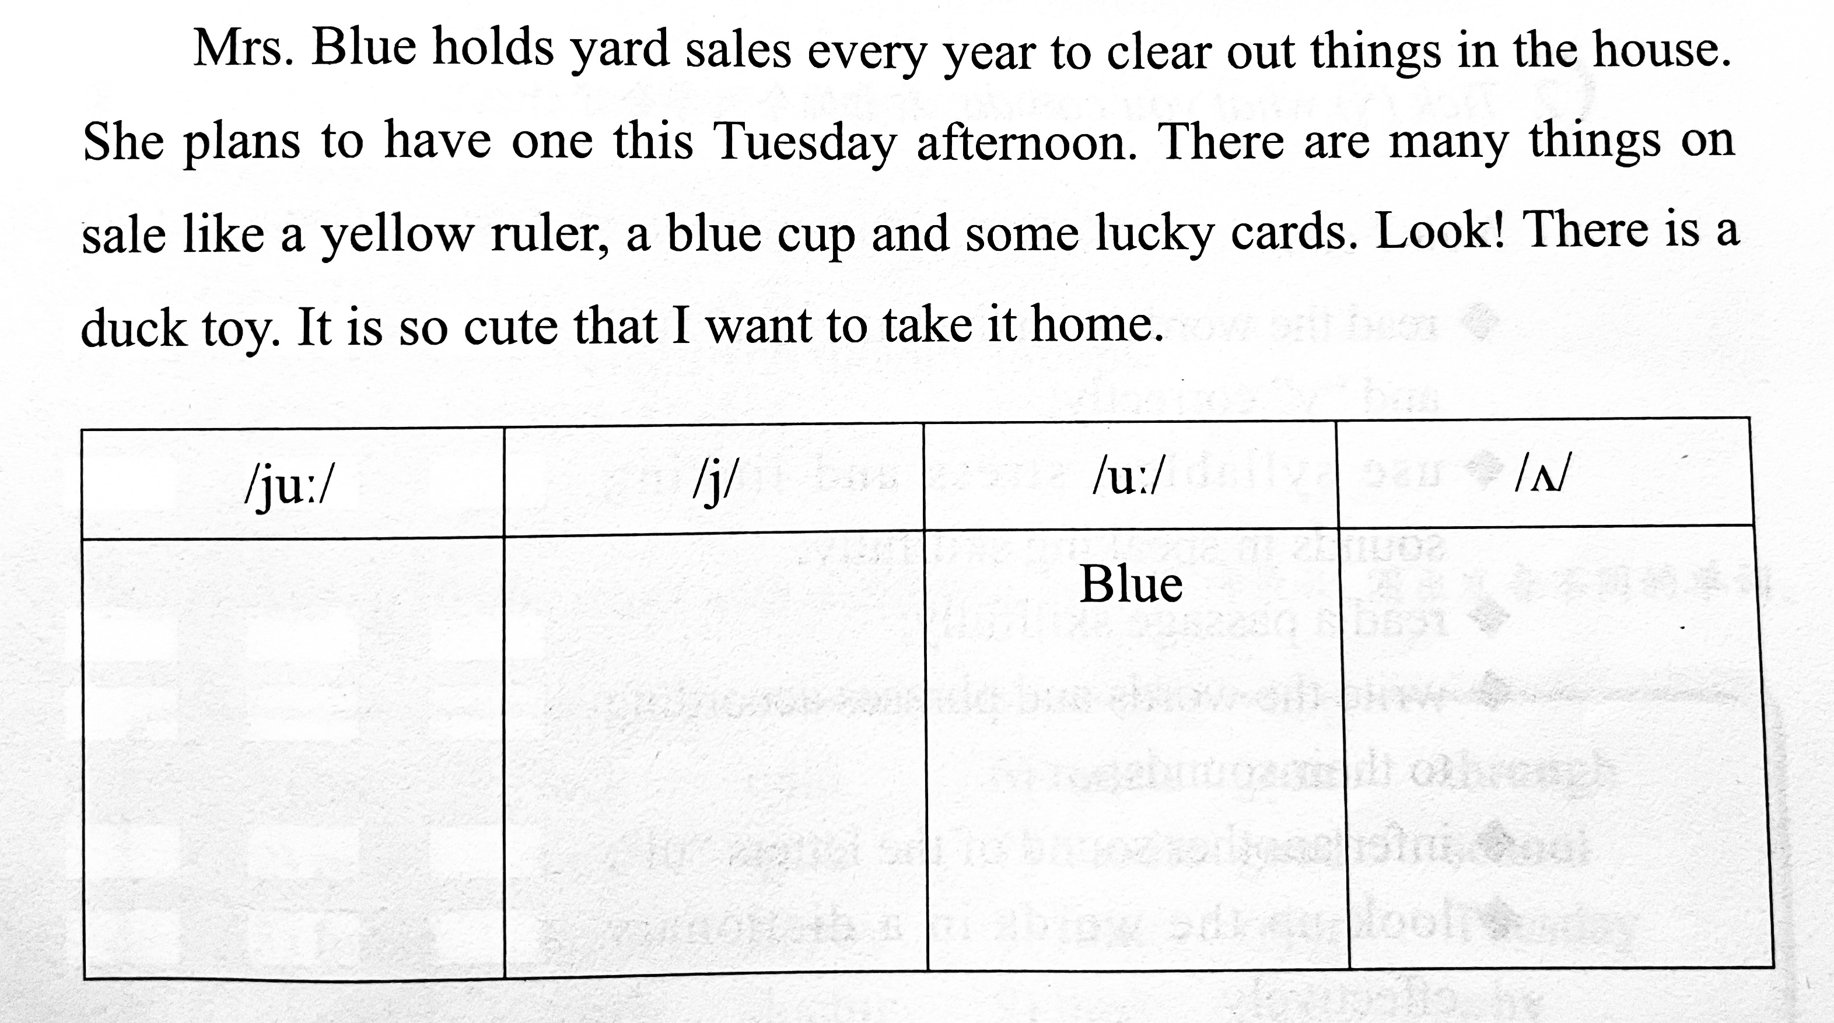
Challenging Yourself
3、Read and find the words with the certain sound and write them in the right column. Then listen, check and repeat. 阅读短文，找出表格中要求的发音，并把单词写在对应的方框里。然后，听录音核对，并跟读。
Tuesday yard afternoon cup
cute year ruler duck
yellow blue lucky

Slide 22
Challenging Yourself
4、Find the words with the target letter in a dictionary. Then make up short storues with the words. 根据目标字母在词典里查找相关单词，然后根据这些单词编一编小故事。
Nouns | Verbs | Adjectives | Adverb | ...
rabbit son t____ | run ____ ____ | red ____ ____ | really ____ ____ | ...
合理运用词典会让你成为一位独立的终身学习者。

Slide 23
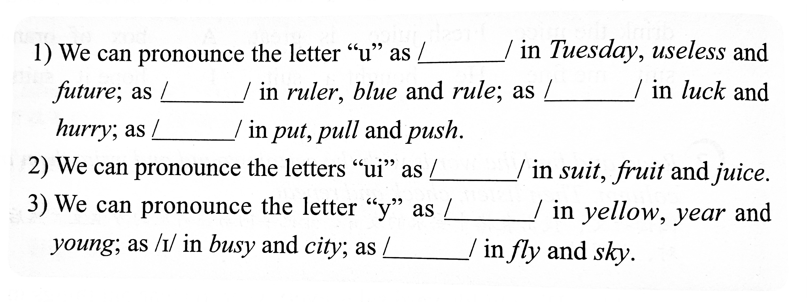
Learning Reflectively
1、Try to work out the rules. 试着找出规律。
ju:
u:
ʌ
ʊ
u:
j
aɪ

Slide 24
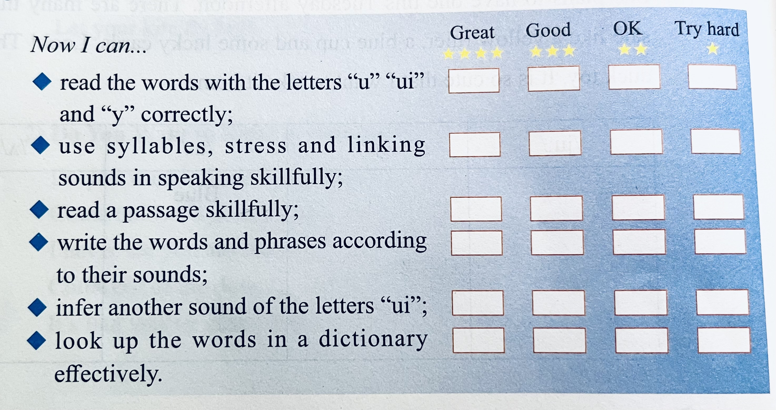
Learning Reflectively
2、Tick(√) what you can do.看看你今天学会了什么。

Slide 25
Learning Reflectively
3、Write vour learning log.完成学习日志
1)学完本课后你有什么收获呢?
2) 学完本课后你还有什么疑惑呢? 大胆写下来吧!

Slide 26
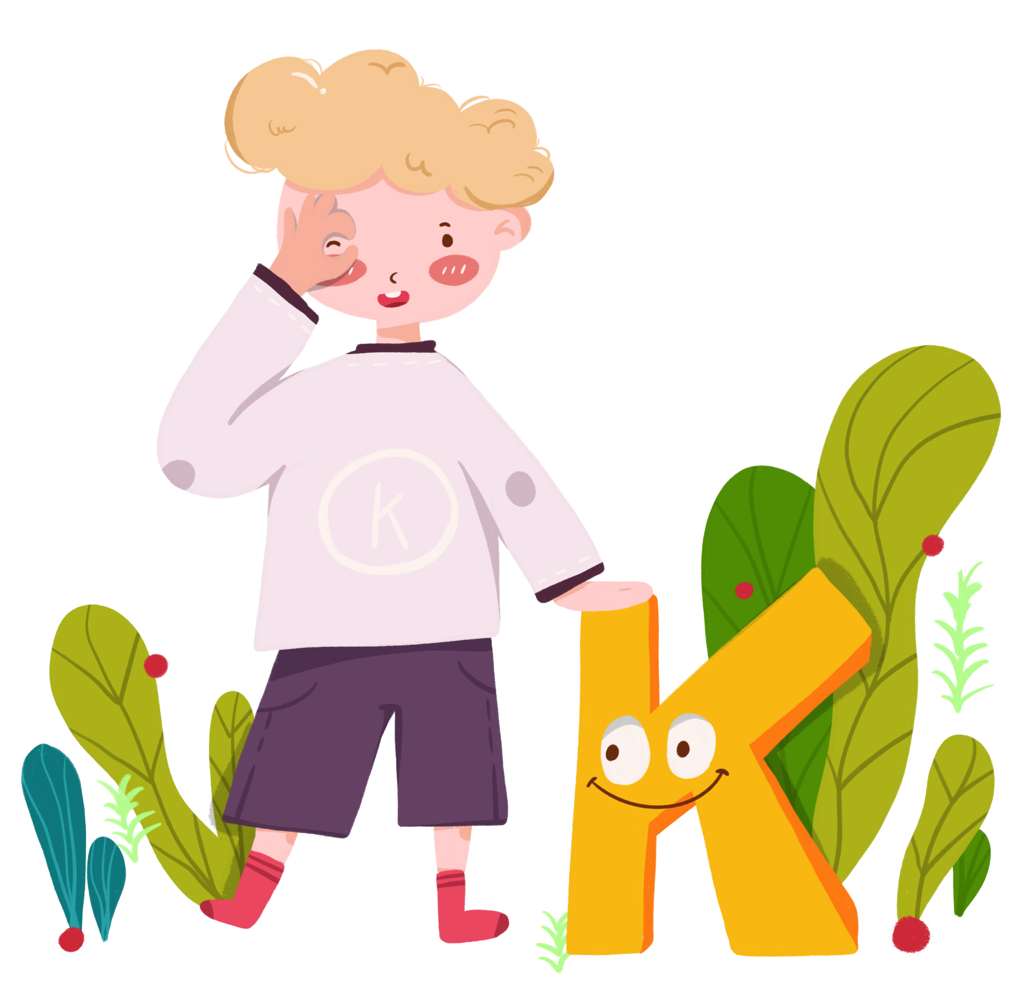
Comments on Teaching Plan
感谢您的观看
thanks
thanks
ABCDEFGHIJKLMNHIJKLMNOPQRSTUVWXYZ

