Slide 1



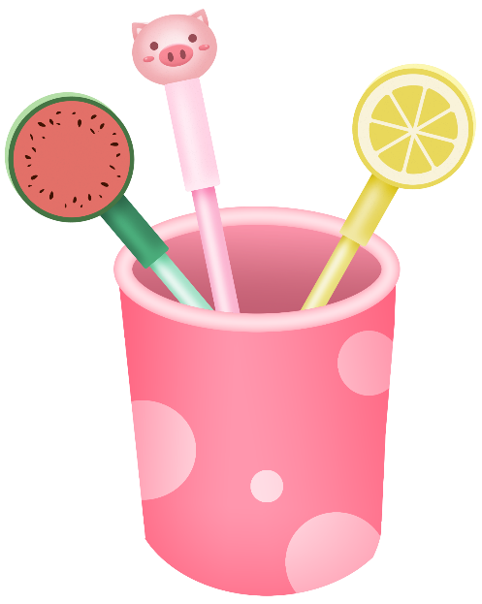
Comments on Teaching Plan
Lesson 20
I Drink Fruit Juice Every Tuesday

Slide 2
Looking Ahead
By the end of this lesson, you will be able to：
Read the words with the letters “u” “ui” and “y” correctly;
正确朗读含有”u” “ui” 和 “y” 的单词；
Use syllables, stress and linking sounds in speaking skillfully;
在口语中熟练运用音节、重音和连续；
Read a passage skillfully;
熟练地朗读短文；
Write the words and phrases according to their sounds;
根据发音写出单词和短语；
Infer another sound of the letters “ui”;
推断字母组合”ui”的另一种发音；
Look up the words in a dictionary effectively.
有效地查阅字典。

Slide 3
Learning to Learn
u |  |  |  | ui | y
/ju:/ | /u:/ | /ʌ/ | /ʊ/ | /u:/ | /j/ | /ɪ/ | /aɪ/
future Tuesday students | flute rule ruler | luck hurry hundred | bush full push | fruit juice suit | year yellow young | busy hurry sorry | sky try why

Slide 4
Learning Actively
1. Listen and put the sounds you hear in the chart. 听录音，并将所听音标填入表格中。
/w/ /ɑː/ /u:/ /j/ /ʌ/ /ju:/
/ʊ/ /s/ /θ/ /ɪ/ /ʃ/ /ʒ/
/u:/
/j/
/ʌ/
/ʊ/
/ɪ/

Slide 5
2. Listen and tick（ ）the words with the same sounds.
听录音，并勾出有相同发音的单词。
√
juicy busy
ruler push
/aɪ/
funny fly
why city
/u:/
√
√
√
√
blue full
lucky study
yard sorry
try yellow
/ʌ/
/j/
√
√
√
√

Slide 6
3. Read and choose. Then listen, check and repeat.
读一读，选一选。然后听录音核对，并跟读。
/ju:/ | /ʊ/ | /aɪ/ | /ʌ/ | /u:/
/ɪ/ | /f/ | /h/ | /l/ | /s/
/ʃ/ | /t/ | /n/ | /p/ | /j/
/m/ | /r/ | /k/ | /dʒ/
E.g. cut /kʌt/
/fʊl/
/fru:t/
/' hʌri/
/pʊʃ/
full_______ fruit_______ hurry______ push______
suit_______ juice_______ sky_______ yummy________
/su:t/
/dʒu:s/
/skaɪ/
/' jʌmi/

Slide 7
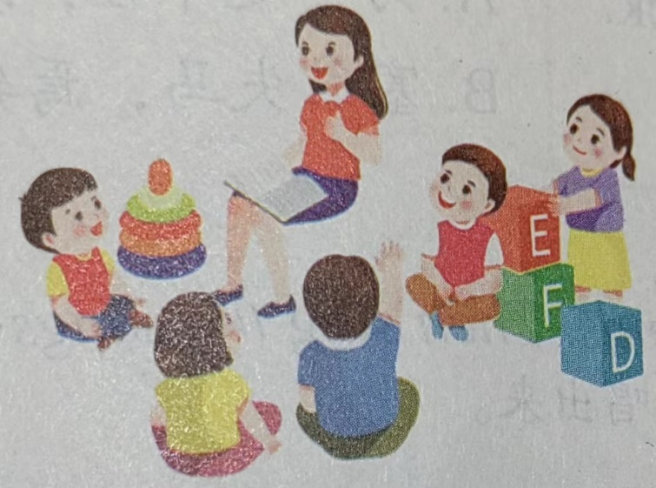
4. Work in groups and write as many words as you can with the sounds above.与同伴一起，用上所学的音标组成尽可能多的词汇。
________________________________________________________
________________________________________________________
________________________________________________________
________________________________________________________
参考答案：shut, fight, shoot, tick, June, height, nut, night, might, must, etc.

Slide 8
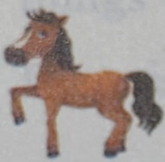
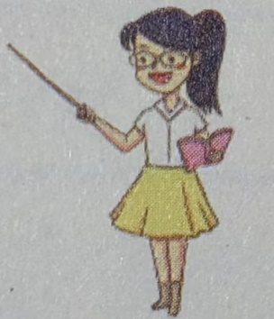
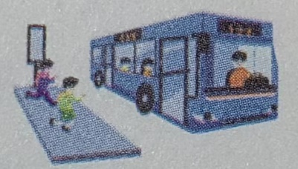
Learning Creatively
1. Complete the following sentences.补全下列句子。
1) Oh, my god! The horse can /kʌt/ /ʌp/ the bananas.
cut up
2) I dream of becoming a teacher. / ɪn/ / ðə / /’fju:tʃə(r)
in the future
Hurry up
3) /’hʌri/ / /ʌp/ , or we will miss the last bus.

Slide 9
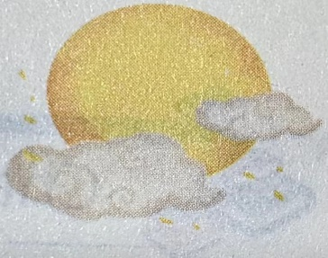
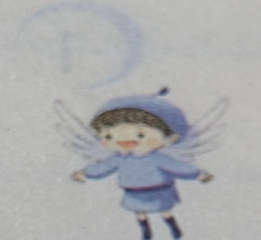
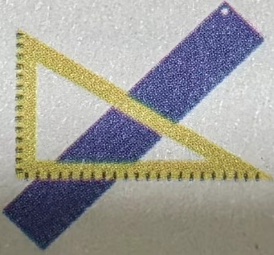
4) We like to talk and play with each other under a /fʊl/ /mu:n/.
full moon
fly in the sky
5) People always want to /flaɪ/ /ɪn/ /skaɪ/
just like birds.
6) This /blu:/ /’ru:lə(r)/ is mine, and yours
is yellow.
blue ruler

Slide 10
2. Try to read the sayings and match them with the meanings.朗读谚语并匹配含义。
Behind bad luck comes good luck.
2) Learn young, learn fair.
A. 为学趁年轻，既学须学好。
参考答案：1) A 2) B
B. 塞翁失马，焉知非福。

Slide 11
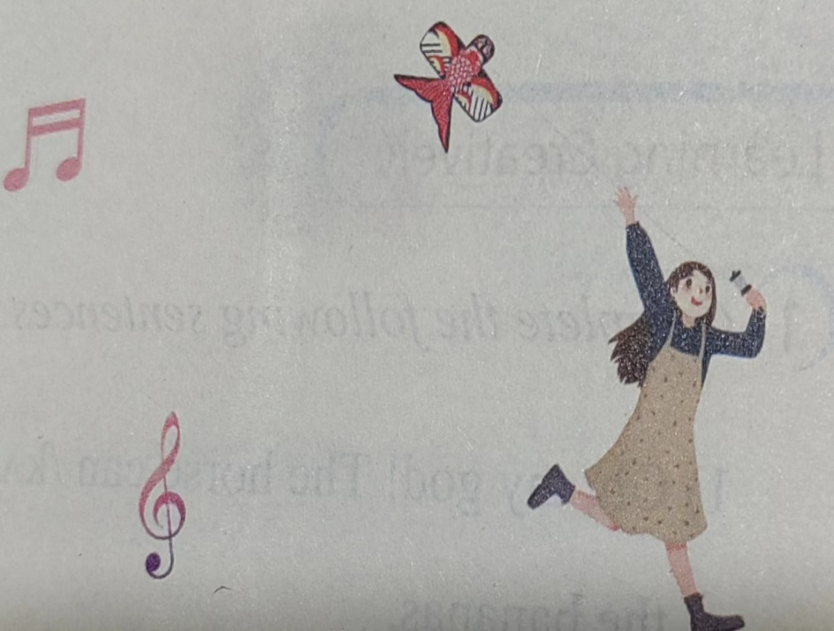
3. Listen and mark（ ） the linking sounds. Then sing the songs aloud. 听歌并标出（ ）连读部分，然后大声的唱出来。
1） Let Your Kite Fly High
Fly, fly, fly your kite.
High in the sky!
Up and down.
Round and round.
Let your kite fly high.

Slide 12
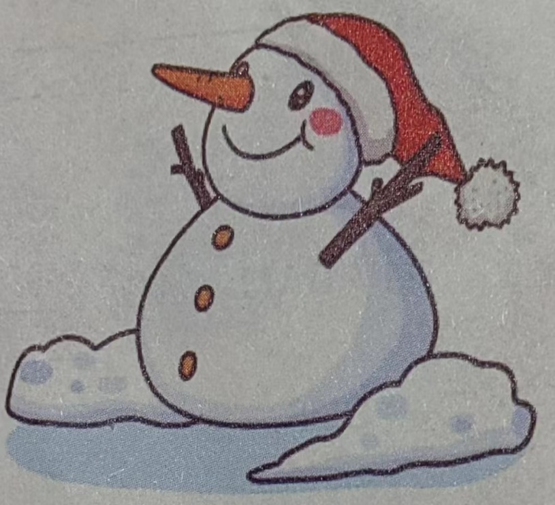
2) Do You Want to Build a Snowman?
Do you want to build a snowman?
Come on! Let’s go and play!
I never see you anymore.
Come out of the door.
It’s like you’ve gone away.

Slide 13
Challenging Yourself
1. Listen, repeat and choose the correct sound of the letters “ui”.听录音跟读，并选出字母组合“ui”的正确发音。
/ju:/ B. /u:/ C. /ʊ/ D. /ɪ/
play the guitar 2) feel guilty
3) build a house 4) a strong, powerfully built man
参考答案：D

Slide 14

2. Listen and repeat. Notice the stressed syllables. 听一听，读一读，并注意重读音节。
/ O o O/ /O O o O/ /o O o O o/
build a house Let’s build a school. You’d better build it.
drink the juice Fresh juice is great. A box of orange juice.
suit me fine He bought a suit. I hope it suits them.

Slide 15
3. Read and find the words with the certain sound and write them in the right column. Then listen, check and repeat. 阅读短文，找出表格中要求的发音，并把单词写在对应的方框里。然后，听录音核对，并跟读。
Mrs. Blue holds yard sales every year to clear out things in the house. She plans to have one this Tuesday afternoon. There are many things on sale like a yellow ruler, a blue cup and some lucky cards. Look! There is a duck toy. It is so cute that I want to take it home.
/ju:/ | /j/ | /u:/ | /ʌ/
 |  | Blue
yard
year
yellow
cup
duck
lucky
Tuesday
cute
afternoon
ruler
blue

Slide 16
4. Find the words with the target letter in a dictionary. Then make up short stories with the words. 根据目标字母在字典里查找相关单词，然后根据这些单词编一编小故事。
Nouns | Verbs | Adjective | Adverb | …
rabbit son t_____ | run _________ _________ | red _________ _________ | really _________ _________

Slide 17
Learning Reflectively
1. Try to work out the rules.试着找出规律。
We can pronounce the letter “u” as ____ in Tuesday, useless and future;
as ____ in ruler; blue and rule; as ____ in luck and hurry; as ___ in put, pull and push.
2) We can pronounce the letters “ui” as ____ in suit, fruit and juice.
3) We can pronounce the letters “y” as ____ in yellow, year, and young; as /I/ in busy and city; as ____ in fly and sky.
/ju:/
/u:/
/ʌ/
/ʊ/
/u:/
/j/
/aɪ/

Slide 18
2. Tick(√) what you can do.看看你今天学会了什么。
Now I can...
Great
Good
Ok
Try hard
read the words with the letters “u” “ui” and “y” correctly;
use syllables, stress and linking sounds in speaking skillfully；
read a passage skillfully；
write the words and phrases according to their sounds；
infer another sound of the letters “ui”;
Look up the words in a dictionary effectively.

Slide 19
Learning Reflectively
3. Write your learning log. 完成学习日志
1 ) 学完本课后你有什么收获呢?
2 ) 学完本课后你还有什么疑惑呢? 大胆写下来吧!

Slide 20
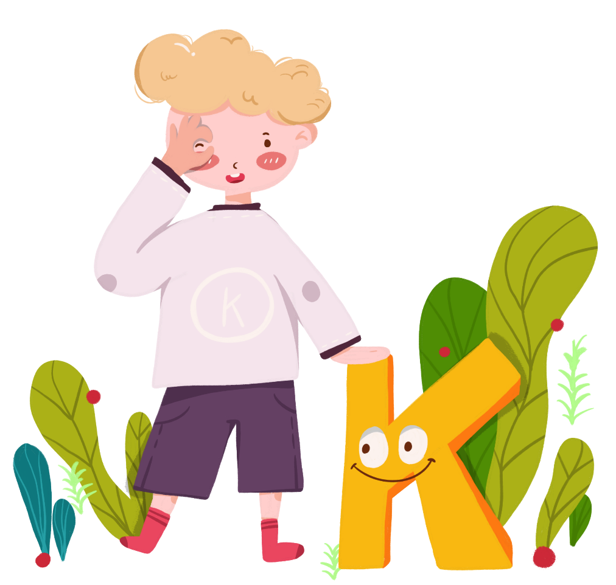
Comments on Teaching Plan
感谢您的观看
thanks
thanks
ABCDEFGHIJKLMNHIJKLMNOPQRSTUVWXYZ

