Slide 1




Comments on Teaching Plan
Lesson 17
Oh! It’s a Big Bad Wolf!
ABCDEFGHIJKLMNHIJKLMNOPQRSTUVWXYZ
Yang Tingting

Slide 2
Oh! It’s a Big Bad Wolf!
Lesson 17
Looking Ahead
By the end of this lesson, you will be able to:
read the words with the letters “ost” “old” and “qu” correctly;
正确朗读 含有的 “ost” “old” 和 “qu”的单词;
identify the different sounds of the same letter(s);
辨别相同字母(组合)的不同发音;
read the words, sentences and passages correctly;
大声朗读单词、句子和短文;
write the words according to their sounds and meanings;
根据发音和含义写出单词;
infer another sound of the letters “w”;
推断字母“w”的另一种发音;
be aware of the thought groups and pauses in the text.
建立语篇中的意群与停顿意识。

Slide 3
Learning to Learn
o |  | o+st/ld | oa | h |  | j | qu
/əʊ/ | /ɒ/ | /əʊ/ | /əʊ/ | /h/ | silent /h/ | /dʒ/ | /kw/
joke rose smoke | copy fox knock | cold old post | boat coat road | happy help hen | honest hour oh | jacket Japan job | queen quick quiet

Slide 4

Learning Actively
1、Listen and tell the same sound of each group. 听一听，说出每组单词中相同的音。
rose | fox
cold | copy
boat | knock
jacket | queen | honest | hen
Japan | quick | hour | help
job | quiet | oh | happy
字母h 在honset, hour和oh 等单词中不发音。

Slide 5
2、 Read and think.读一读，想一想。
1)
/ dʒəʊk/ /fɒks/ /əʊld/ /rəʊd/ /help/ /’ɒnɪst/ /dʒɒb/ /kwi:n/

Slide 6
2)
smoke copy post boat Japan quiet

Slide 7
3)
happy hour bring a rose quick knock wild hen find your coat

Slide 8
3、 Listen and read aloud in pairs. Then circle the odd one out. 听录音，两人一组大声朗读，然后再圈出不同的单词。
1) quick quiet queue queen quite quote
2) hope home smoke joke fox rose
3) knock copy not dog hot note
4) cold mop post boat coat road
5) honor help hour oh honest heir

Slide 9
4. Write，listen and notice“／”.写一写，听一听，注意句中的“／”。
1) Fill in the blanks according to the sounds. Then listen and check. 根据音标填空，然后听录音核对。
A.Don't /sməʊk/ / in the library.
B. Thank you / for your big /help/! I got my dream _______/dʒɒb/ now.
C.It's too /kəʊld/ / to go out without a coat.
D.My mum buys me a new /'dʒækit// and I like it very much.
E. It's so /'kwaɪət/a road / that I _______ /kwaɪt/enjoy it.
F.To be /'ɒnɪst/, / I'm not always an honest girl.

Slide 10
2) Listen again and notice “/” in the sentences. Then read aloud. 再听一遍录音，注意句中的斜线“／”，并大声朗读。
Tip: 意群是意义相对完整的一组单词。一个意群可以是一个短句子，也可以是一个长句子中的一部分，一般用斜线（／）标出。

Slide 11
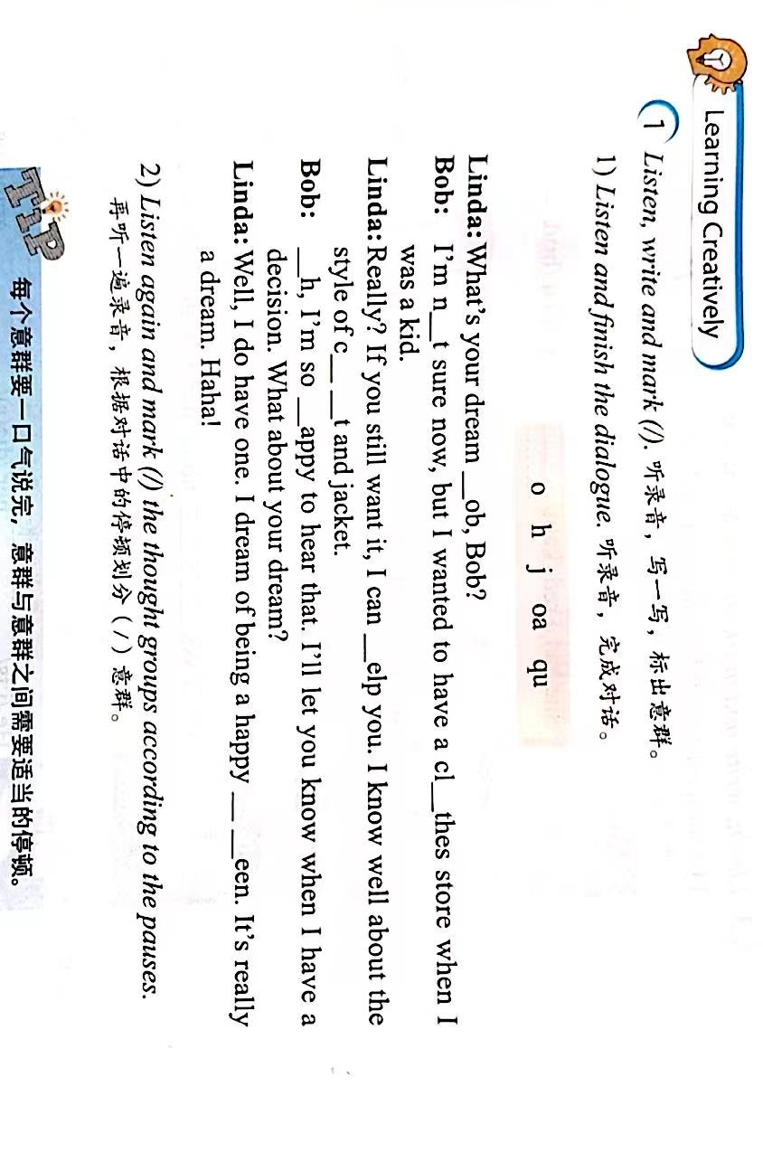
Learning Creatively
j
o
o
h
oa
O
h
qu

Slide 12
Tip: 每个意群要一口气说完，意群和意群之间需要适当的停顿。

Slide 13
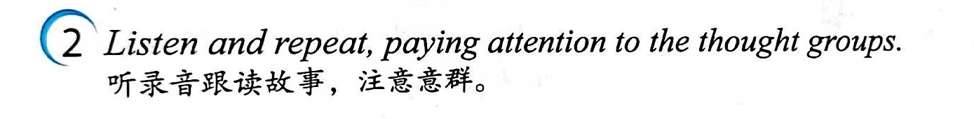
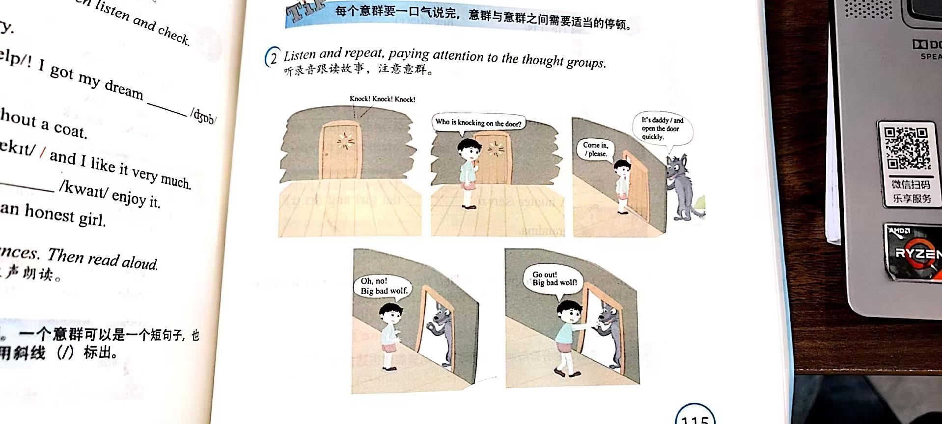

Slide 14
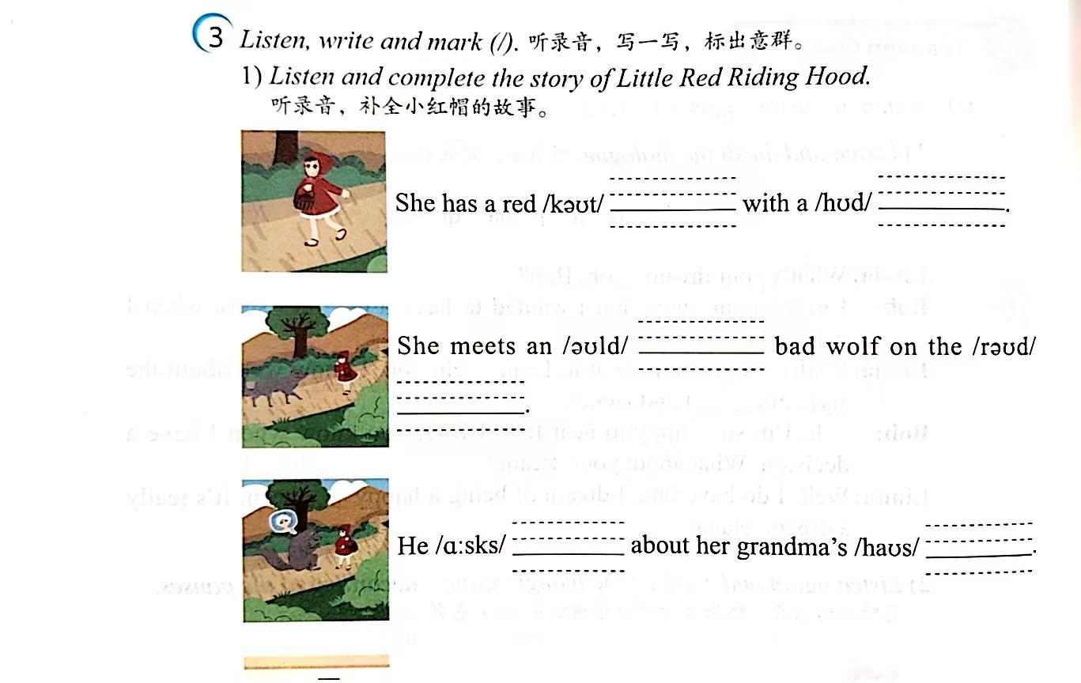

Slide 15
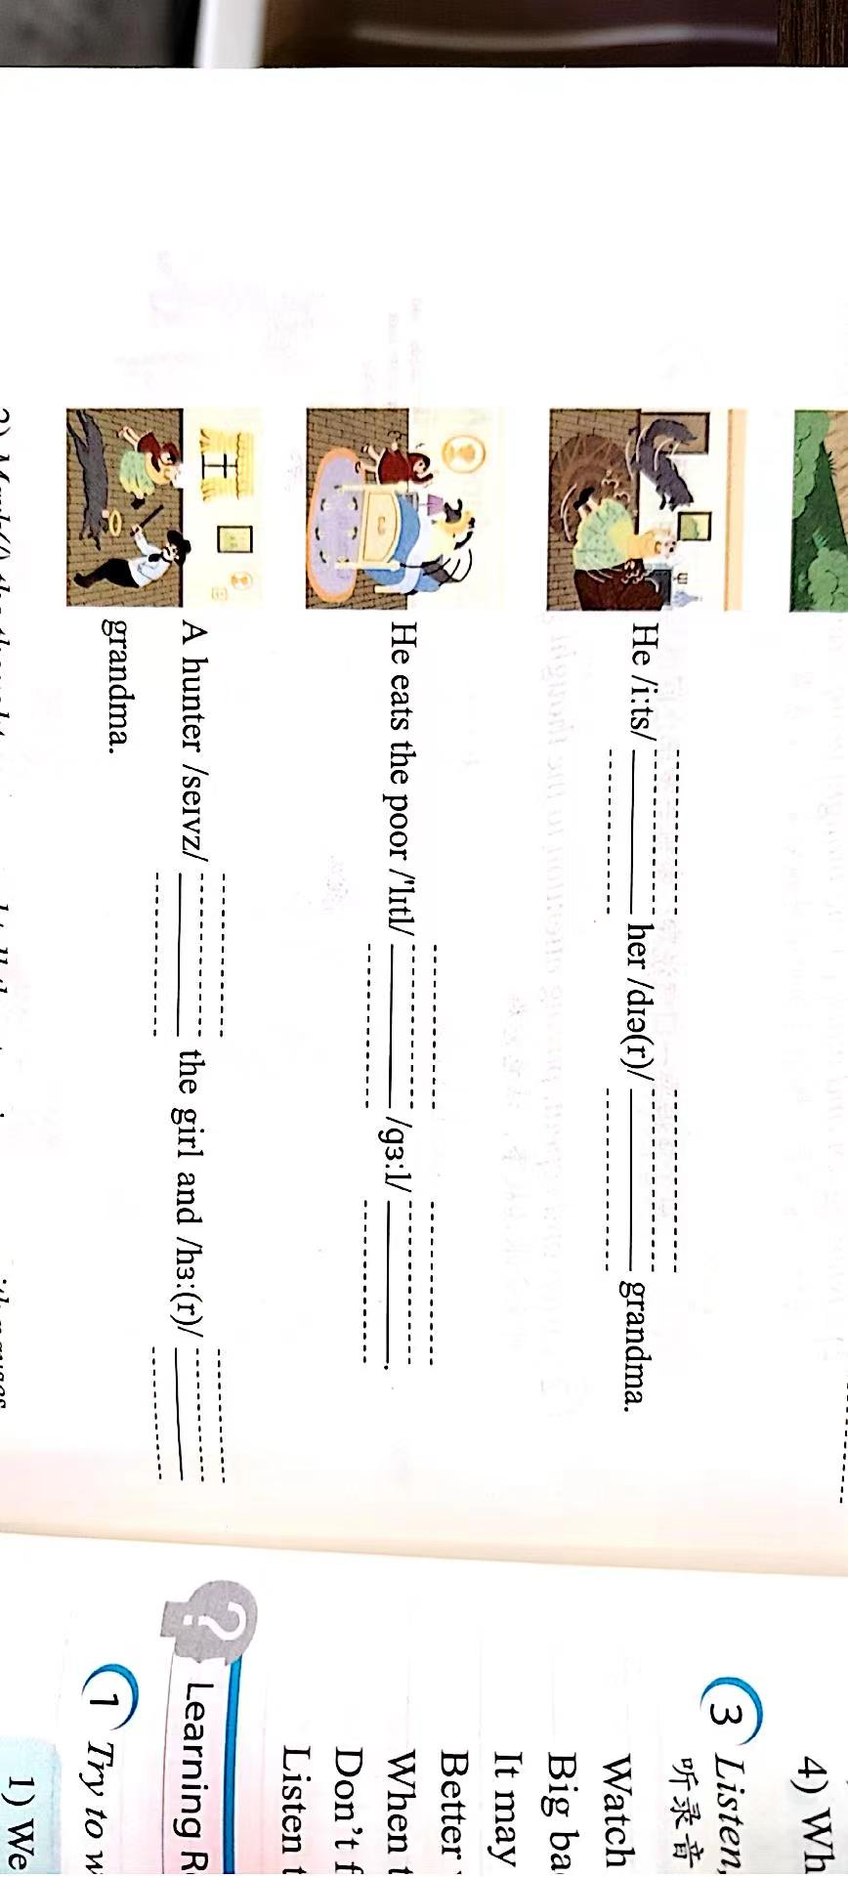

Slide 16
2) Mark(/) the thought groups and tell the story in groups with pauses. 用斜线“／”标出意群，并在小组内讲述该故事，注意停顿。正确地划分意群能够帮助你更好地理解和表达意义。
Tip: 正确地划分意群能帮助你更好地理解和表达意义。

Slide 17
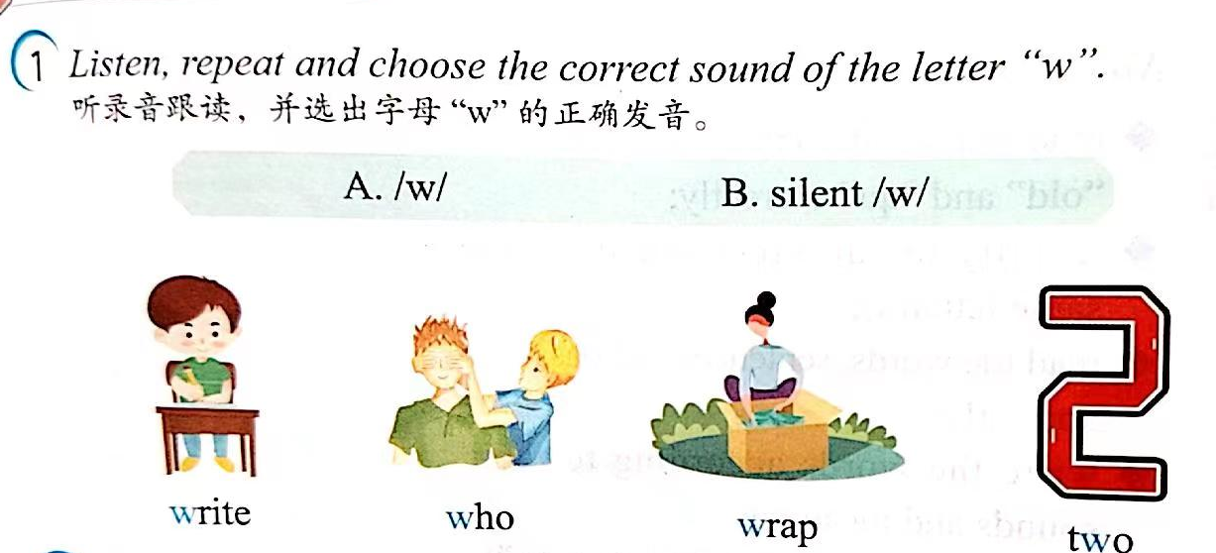
Challenging Yourself

Slide 18
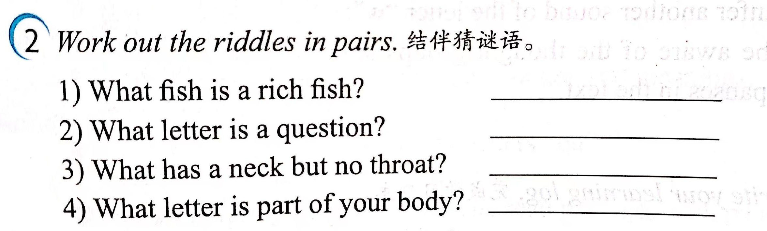
Challenging Yourself

Slide 19
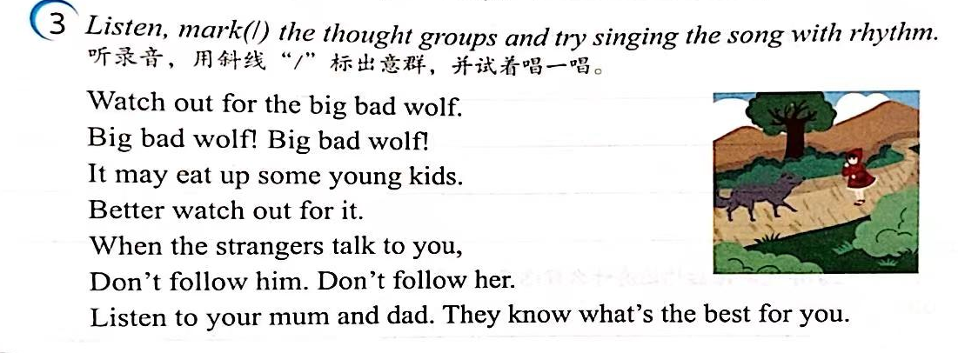
Challenging Yourself

Slide 20
Learning Reflectively
1、Try to work out the rules. 试着找出规律。
1) We can pronounce the letter "o” as/ /in joke, cold and boat.
2) We can pronounce the letter "o”as/ /in fox, copy and knock.
3) We can pronounce the letters "oa"as/ /in boat and coat.
4) WVe usually pronounce the letter "h” as/ /in happy, help and hen, but we don't pronounce it in honest and ./
5) We can pronounce the letter "j"as/ / in job and jacket.
6) We can pronounce the letters “qu" as/ / in quick and quiet.

Slide 21
Learning Reflectively
2、Tick(√) what you can do.看看你今天学会了什么。
Now I can...
Great
Good
Ok
Try hard
read /ei/, /ae/, /p/, /b/, /t/, /d/, /k/and/g/correctly;
match the words with their sounds well；
read the words. phrases and sentencesaloud；
write the words according to theirsounds；
infer the sound of the letters “c’ and “ck”；
use the rising tone (/) and falling tone)correctly.

Slide 22
Learning Reflectively
3、Write vour learning log.完成学习日志
1)学完本课后你有什么收获呢?
2) 学完本课后你还有什么疑惑呢? 大胆写下来吧!

Slide 23
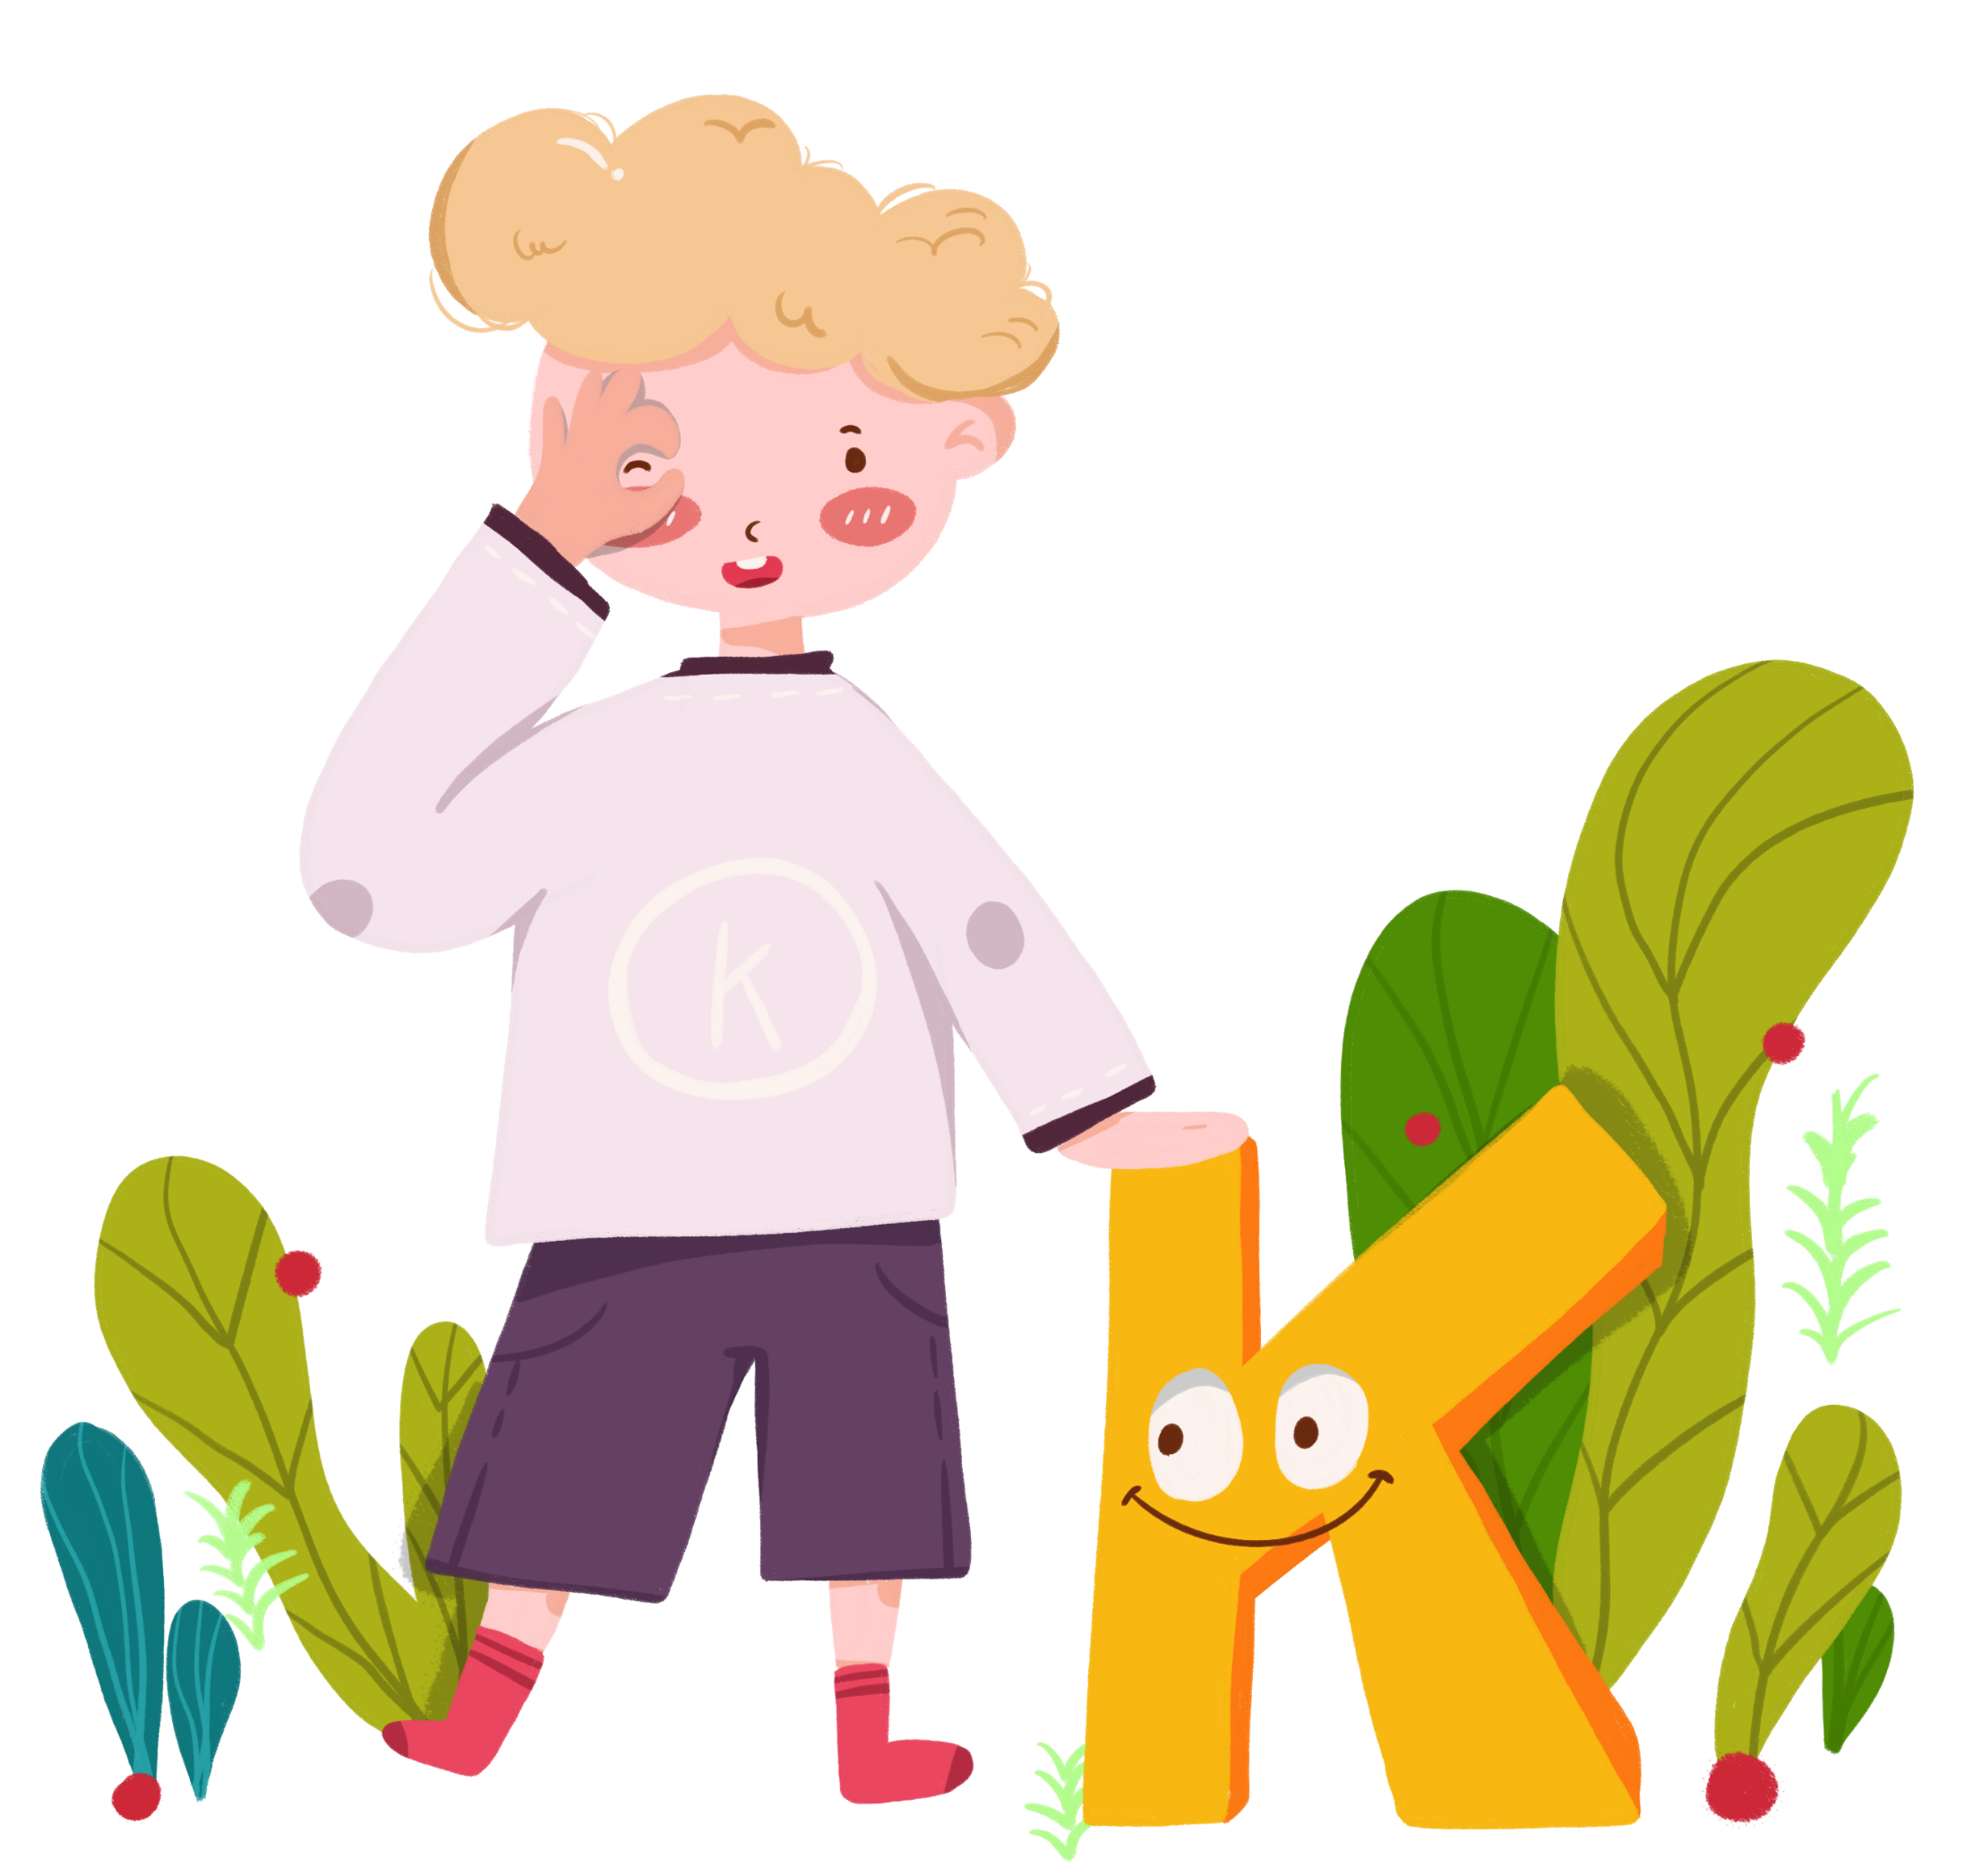
Comments on Teaching Plan
感谢您的观看
Thanks
thanks
ABCDEFGHIJKLMNHIJKLMNOPQRSTUVWXYZ

