Slide 1




Comments on Teaching Plan
Lesson 13
Ted likes Bread
ABCDEFGHIJKLMNHIJKLMNOPQRSTUVWXYZ

Slide 2
Ted likes Bread.
Looking Ahead
Lesson 13
By the end of this lesson, I will be able to.
(1）正确朗读含有“ea”“ee”“ei”“dge”的单词;
（2）将单词与其发音正确配对;
（3）根据图片编对话;
（4）正确朗读单词、词组和句子;

Slide 3
game time
either
dead
dish
/i:/
/e/
evening
/dʒ/
bread
/aɪ/
Chinese
lend
edge
judge
/d/
tell
dad
neither

Slide 4

try to read
/i:/
/e/
/aɪ/

Slide 5
try to read
/d/
/dʒ/

Slide 6
Learning to Learn
e |  | ea/ee | ea | ei | d | dge
/i:/ | /e/ | /i:/ | /e/ | /aɪ/ | /d/ | /dʒ/
Chinese evening meter | end lend tell | feet meat team | bread dead head | either feisty neither | bad deaf dish | bridge edge judge

Slide 7

Learning Activeɪy
What are the sounds of the underlined letters ?
1、Listen and identify.听一听，辨一辨。
A:Good evening. May I take your order?
B:Yes, I’d like a piece of bread, one meat pizza and some beef.
A : Any drinks ?
B : Yes , I ' d like a cup of coffee , please .
Tip:e,ee,ea可以发/i:/，字母组合ea还可以发/e/。

Slide 8
2、 Read and think.读一读，想一想。
/def/ /brɪdʒ/ /pen/ /dʒʌdʒ/ /ˌtʃaɪ'niːz/ /ˈmiːtə/ /hed/ /dɪʃ/
1)

Slide 9
2、 Read and think.读一读，想一想。
see we breakfast knowledge door egg end either
2)

Slide 10
2、 Read and think.读一读，想一想。
a bad peach, an ice cream, a cup of tea, eat meat, cheese bread
3)

Slide 11
3、Listen and circle the odd one out.听一听，圈出发音不同的单词。
1) bean bread weak eat
2) evening me these tell
3) leisure neither either feisty
4) dish Wednesday bad card

Slide 12
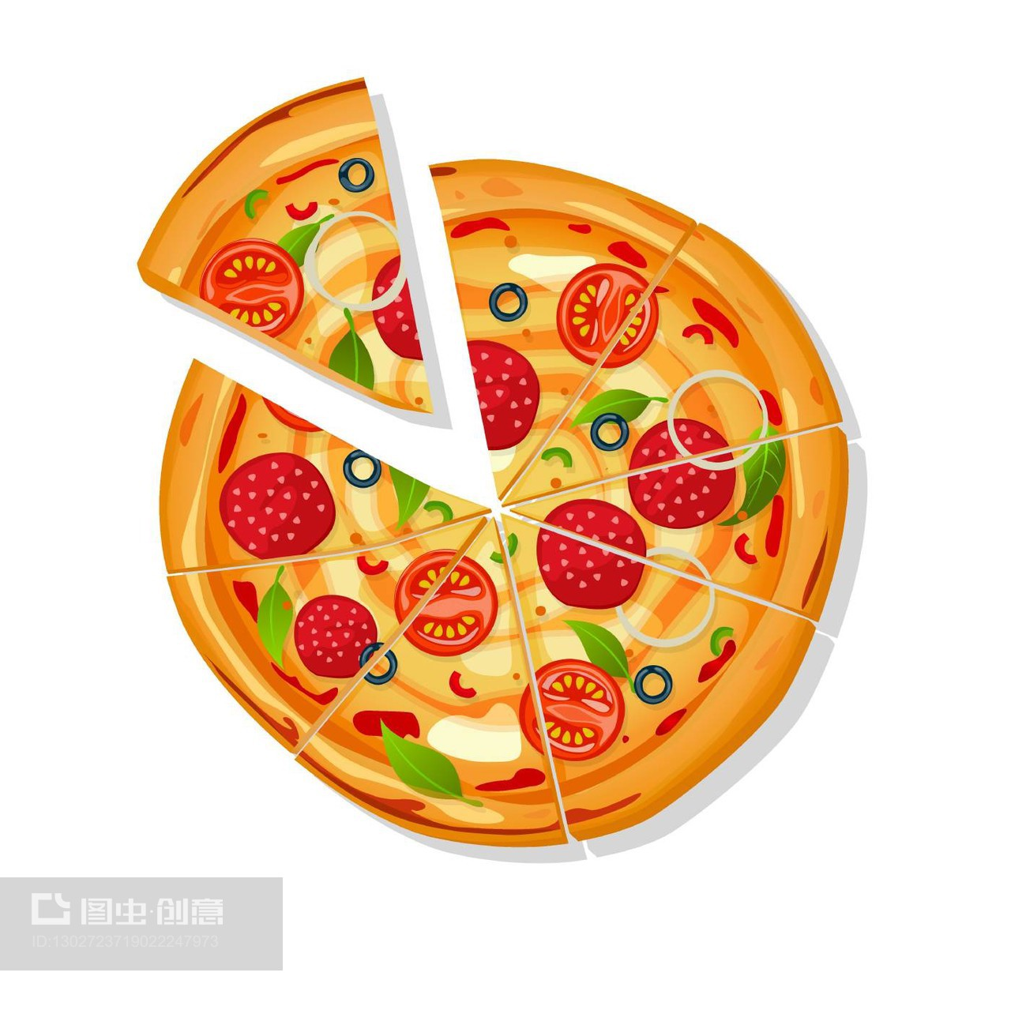
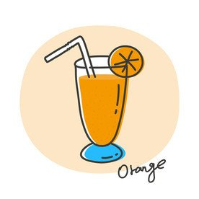
4、Read the poster .读海报。
1) Circle the words with / i :/.圈出含有音标／ i :／的单词。
PETE ' S PIZZA
MENU
Complete Meal Only ¥20
Bean Soup or Egg Soup
Two Cheese Pizzas or One Beef Pizza
Ice Cream or Cheese Cake or Peaches ( in season )
Green Tea or Coffee

Slide 13
2) Listen , check the answers and group the words with /i:/
听录音，核对答案，并将含有音标 /i:/的单词分类。
/i:/
ee | ea | e
cheese | meal | Pete
tea
beef
cream
complete
green
peach
season

Slide 14



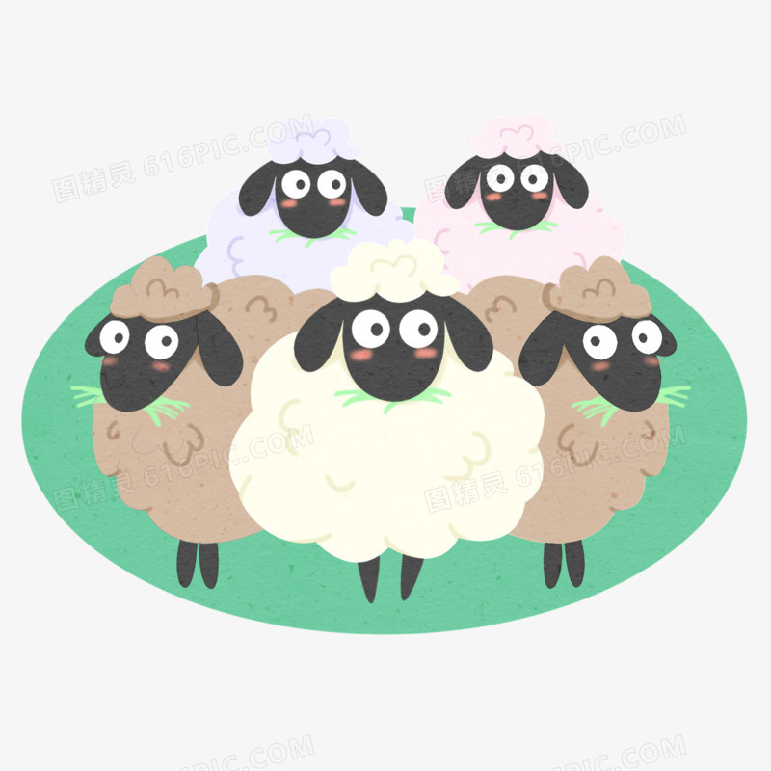

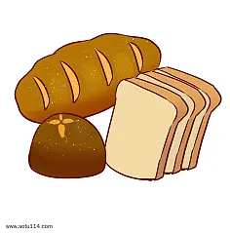
Learning Creatively
1.Read and match ．读一读，将音标与图片连线
/dɪʃ/
/best/
/tʃiːz/
/triː/
/ʃiːp/
/bred/

Slide 15
2.Listen , read and write .听一听，读一读，写一写。
1) Listen and read . Notice the stressed syllables .
听一听，读一读，注意重读音节。
A. What’s that? Don’t talk . Stand up.
B. ( ) Write it down. Wash your feet . Where’s the bread ?
C. ( )Give him a dish . What is she like ? Swim in a lake .

Slide 16
2) Read and write . Then listen , repeat and mark the stressed syllables with“ ” , unstressed syllables with“ ”。
读一读，写一写，然后听录音跟读，并在小诗中用“ ” 标出重读音节，用“ ”标出非重读音节。
best
‘Good ,' better ,__________/best/ _________________
let
rest
Never________/let/ it _________/rest/ _____________________
Till good is better , ____________________
And better best . ___________________

Slide 17
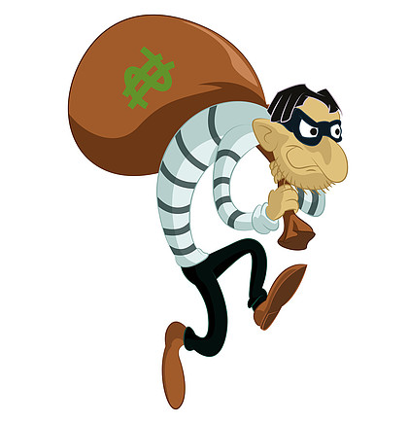

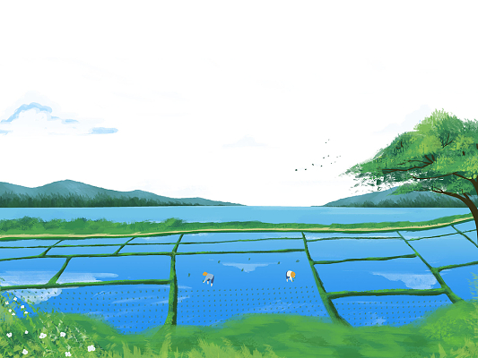

Challenging Yourself
1、Listen , repeat and choose the correct sound of the letters " ie ".
听录音跟读，并选出字母组合" ie "的正确发音。
A./i:/
B./e/
C./eI/
D./aI/
thief
cookie
movie
field

Slide 18
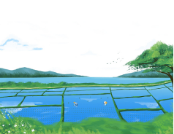
2.Listen and repeat the chant to your partner.
听一听，并把小诗读给你的同伴听。
Ted lives on a field .
He has his belief .
He believes he can
Make the best cookies
With the wheat on the field .

Slide 19
3.Listen and complete the song . Sing the song to your partner , paying attention to the stress and rhythm ．
听一听，补全歌曲。喝一唱，注意重音和节奏。
LEMON TREE
When I was just a lad of
My father said to me ,
" Come here and take a from the lovely lemon tree ."
" Don ' t put your faith in love , my boy ," my father said to me ."
“I fear you ' ll find that love is like the lovely lemon tree ."
Lemon tree , very pretty , and the lemon flower is
But the fruit of the poor lemon is impossible to eat .
Lemon tree , very pretty , and the lemon flower is sweet .
But the fruit of the poor lemon is impossible to

Slide 20
Learning Reflectively
1.Try to work out the rules ．试着找出规律。
e
1) We can pronounce the letter " e " as /_____/ or /_________/ in
evening , Chinese , end and tell .
2) We can pronounce the letters " ea " as /_______/ or /________/ in meat, team , bread and head .
3) We can pronounce the letters " ee " as /_______/ in feet and meet .
4) We can pronounce the letters " ei " as /_________/ in either and neither .
i:
i:
e
i:
aI

Slide 21
Learning Reflectively
2、Tick(√) what you can do.看看你今天学会了什么。
Now I can...
read the words with " ea "" ee "" ei "
and " dge " correctly ;
match the pictures with the sounds correctly ;
read the words , phrases and sentences correctly ;
make up a dialogue according to the pictures ;
infer the sound of the letters " ie ";
read the sentences and the chant with correct rhythm .
Great
Good
Ok
Try hard

Slide 22
Learning Reflectively
3、Write vour learning log.完成学习日志
1)学完本课后你有什么收获呢?
2) 学完本课后你还有什么疑惑呢? 大胆写下来吧!

Slide 23
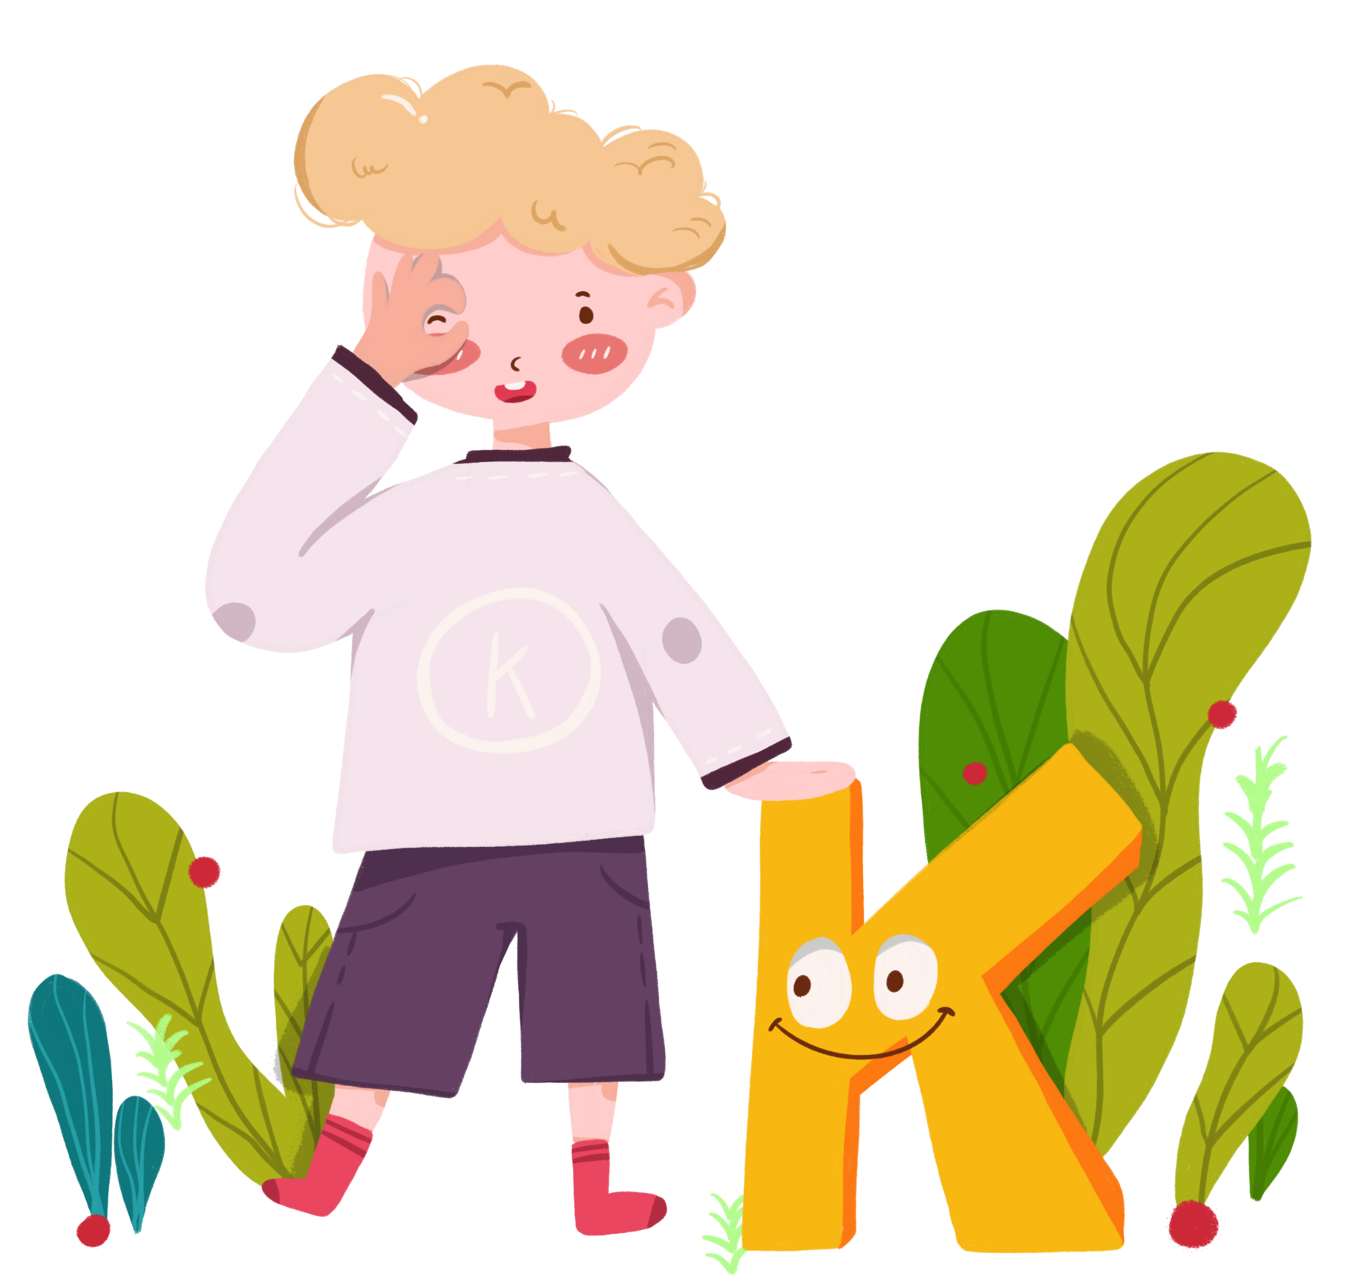
Comments on Teaching Plan
感谢您的观看
thanks
thanks
ABCDEFGHIJKLMNHIJKLMNOPQRSTUVWXYZ

