Slide 1




Comments on Teaching Plan
Lesson 15
Where Are the Girl’s Knots?
ABCDEFGHIJKLMNHIJKLMNOPQRSTUVWXYZ

Slide 2
Where Are the Girl’s Knots?
Lesson 15
Looking Ahead
By the end of this lesson, you will be able to:
read the words with “i” “ir” “k””f” and “kn” correctly;
正确认读含有 “i” “ir” “k””f” 和 “kn”的单词;
Describe the location of knots in different ways:
用不同方式描述出蝴蝶结的位置
read the words, sentences and passages correctly;
正确朗读单词、句子和短文;
write the words according to their sounds;
根据发音写出单词;
infer the sound of the letters “ten”;
推断字母组合“ten”的发音;
be aware of the stress of a sentence in English.
建立英语句子重读意识。

Slide 3
Learning to Learn
i |  | ir | k | f | kn
[ai] | [i] | [ɜ:] | [k] | [f] | [n]
behind life lion | film little milk | bird girl shirt | kettle key kiss | fish free fruit | knife knot know

Slide 4
Learning Actively
1、Listen and circle the word with the different sound.听录音圈出发音不同的单词
1）hide lion little behind
knife kettle king kiss
Shirt skirt hair girl
Live life food leaf

Slide 5
2、 Read and think.读一读，想一想。
1)
[bɪˈhaɪnd] [mɪlk] [ɡɜːl]
[kiː] [fɪʃ] [naɪf]

Slide 6
2)
life film shirt kettle fruit knot

Slide 7
3)
time and tide little by little a firm bird take a look feel free

Slide 8
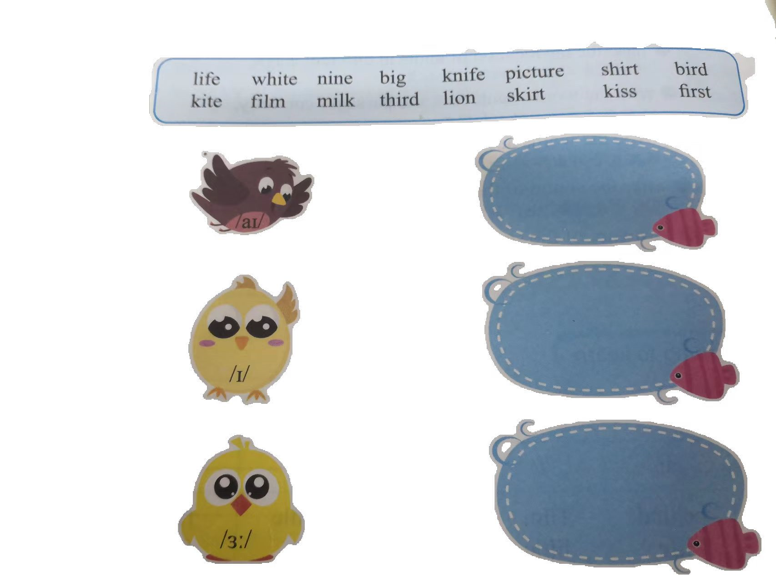
3、 Help the three little birds find the fish to eat.帮助三只小鸟吃到对的鱼。

Slide 9
4、 Listen and circle the words you hear. If the words contain the same sound and form a line, you shout “Bingo!” 听录音并圈出你听到的单词。如果这些单词都包含同样的发音并且能够连成一条线，请大声喊出”Bingo”
Kate | knot | kiss | fate | between | fake
cake | neck | knife | Jack | back | first
black | life | milk | know | below | fruit

Slide 10
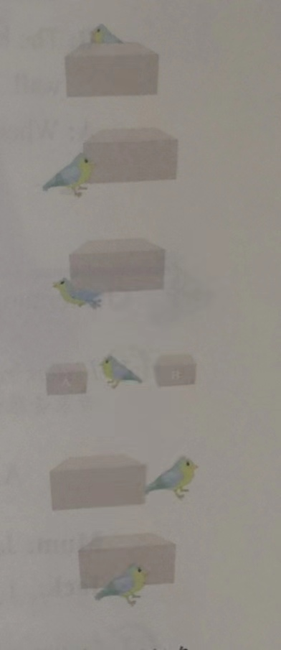
Learning Creatively
1、Fill in the blanks according to the sounds and pictures.
根据发音和图片进行填空。
1)The bird is_________ [bɪˈhaɪnd] the box.
2) The bird is_________ [nekst] to the box.
3)The bird is_________ [bɪˈləʊ] the box.
4)The bird is_________ [bɪˈtwiːn] the box A and box B.
5)The bird is on the _________ [raɪt] the box.
6)The bird is______ [ɪn] ________ [frʌnt]of the box.

Slide 11
2、Listen to a dialogue and finish the following tasks.
听对话，完成以下任务。
1）、Listen and circle the things Frank wants. 听录音,圈出Frank需要的物品。
bed book door fruit kettle shirt table toy lion
2)、Listen again and draw a picture of the locations of Frank’s things.再听一遍录音。将Frank 的物品位置画出来。

Slide 12
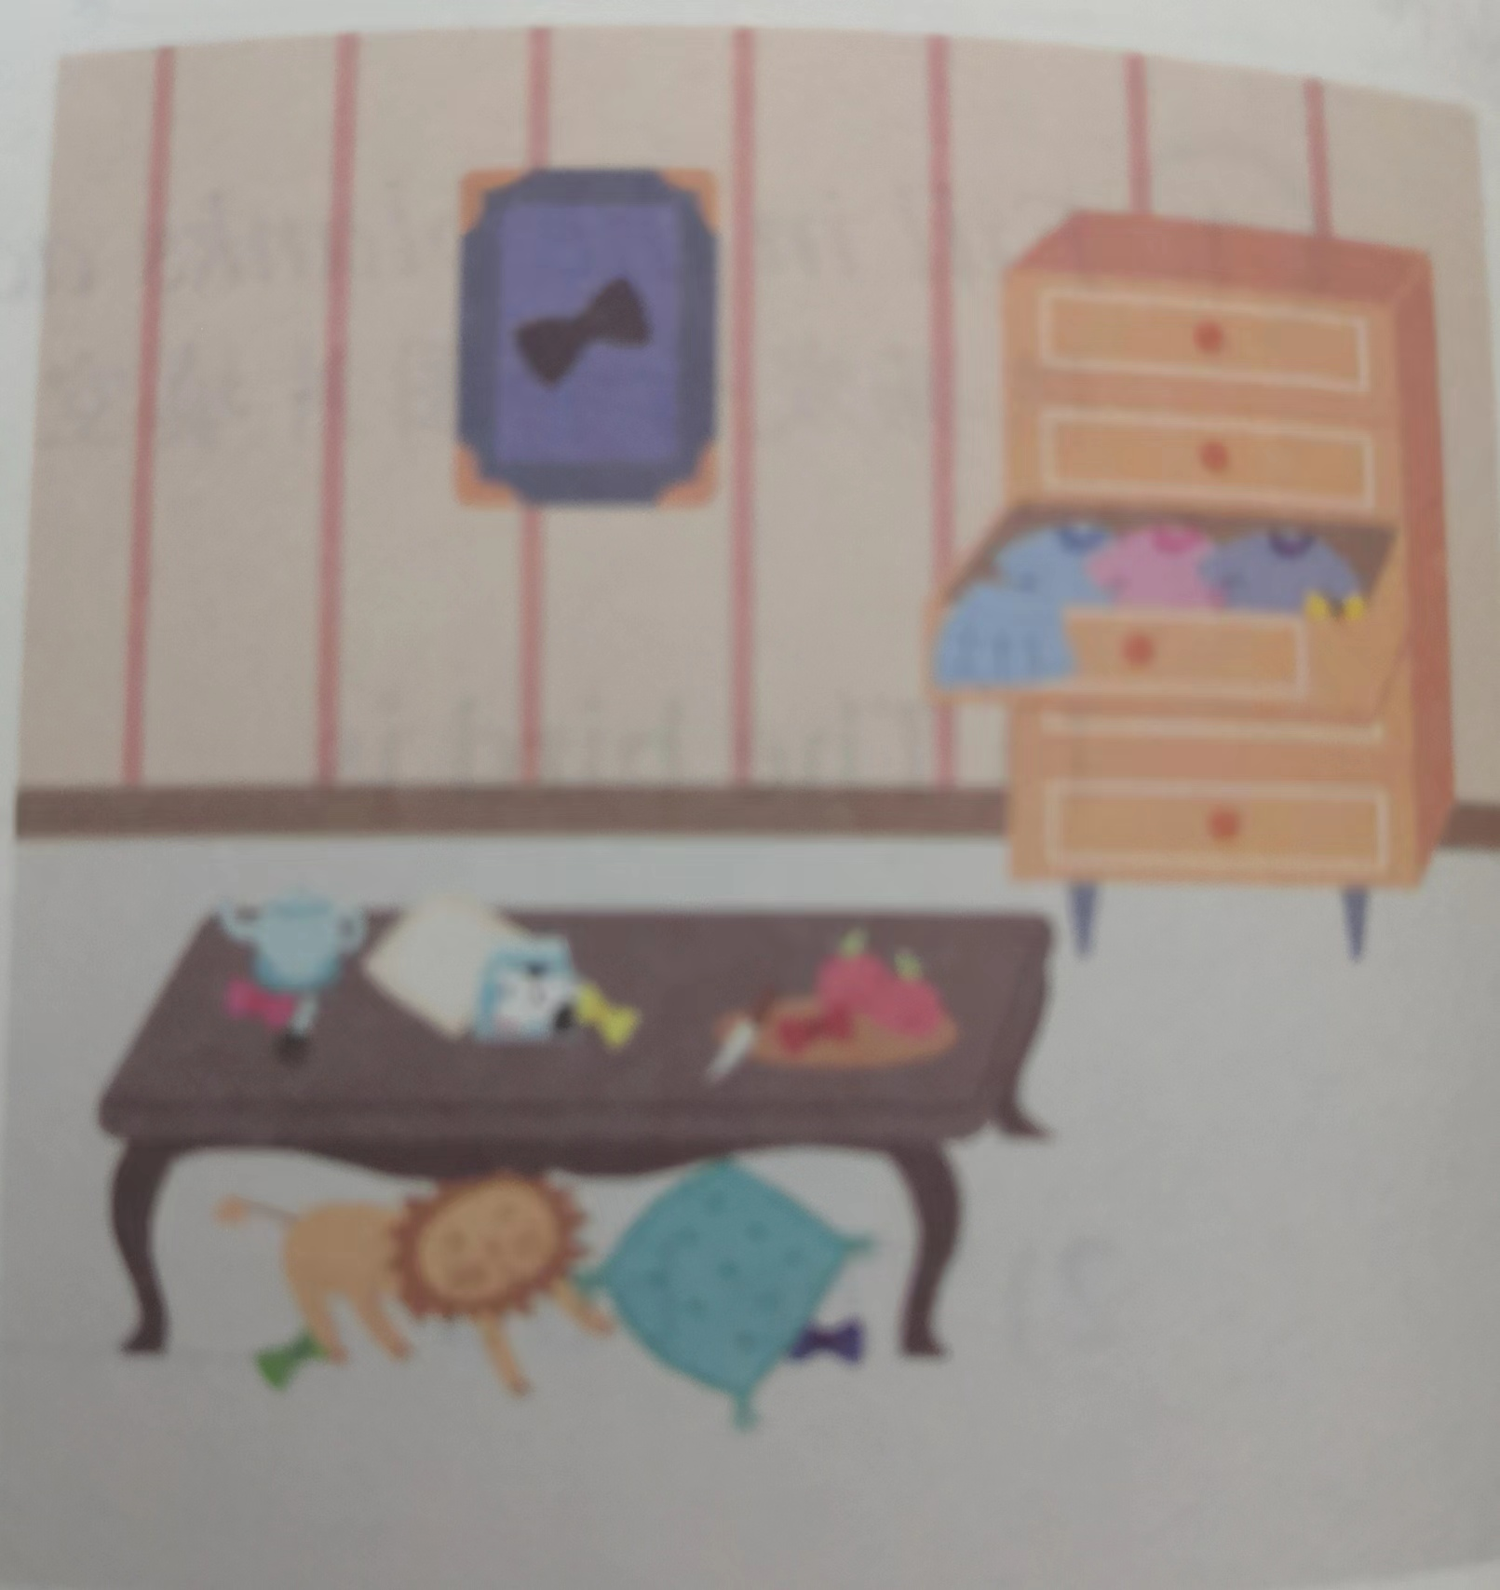
3、Look at the picture and make a dialogue.看图编对话。
A：There are seven knots in the picture. Where is the black knot?
B:The black knot is in the picture on the wall.
A:Where is the red knot?
……

Slide 13
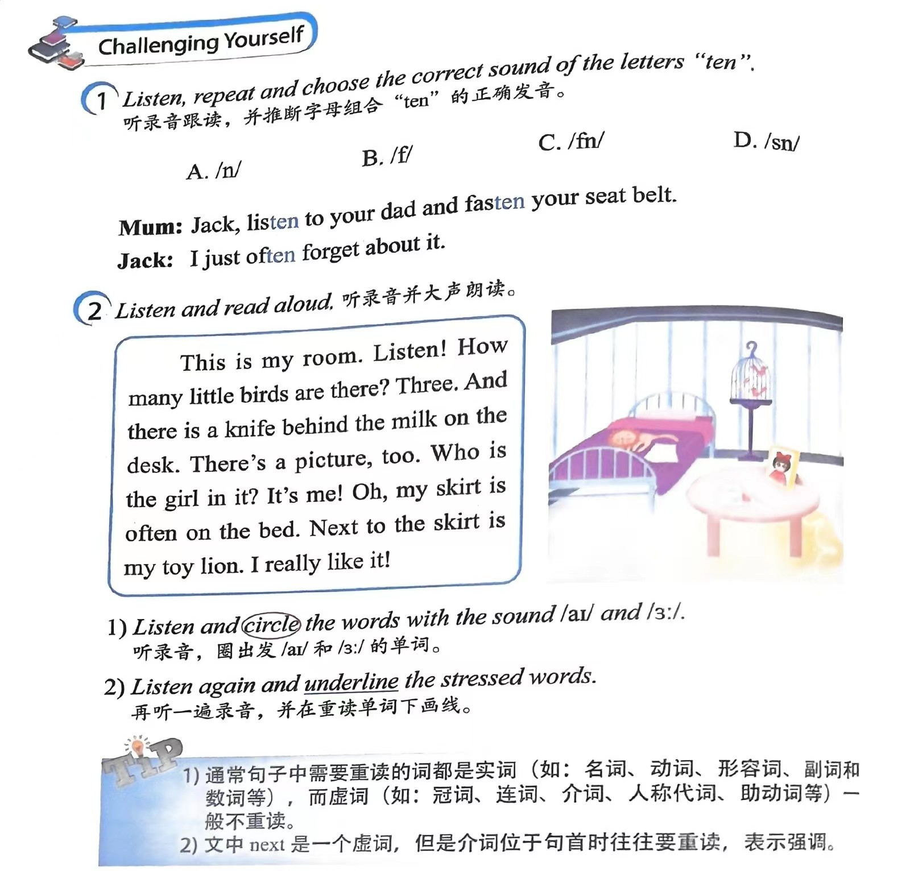

Slide 14
Challenging Yourself

Slide 15
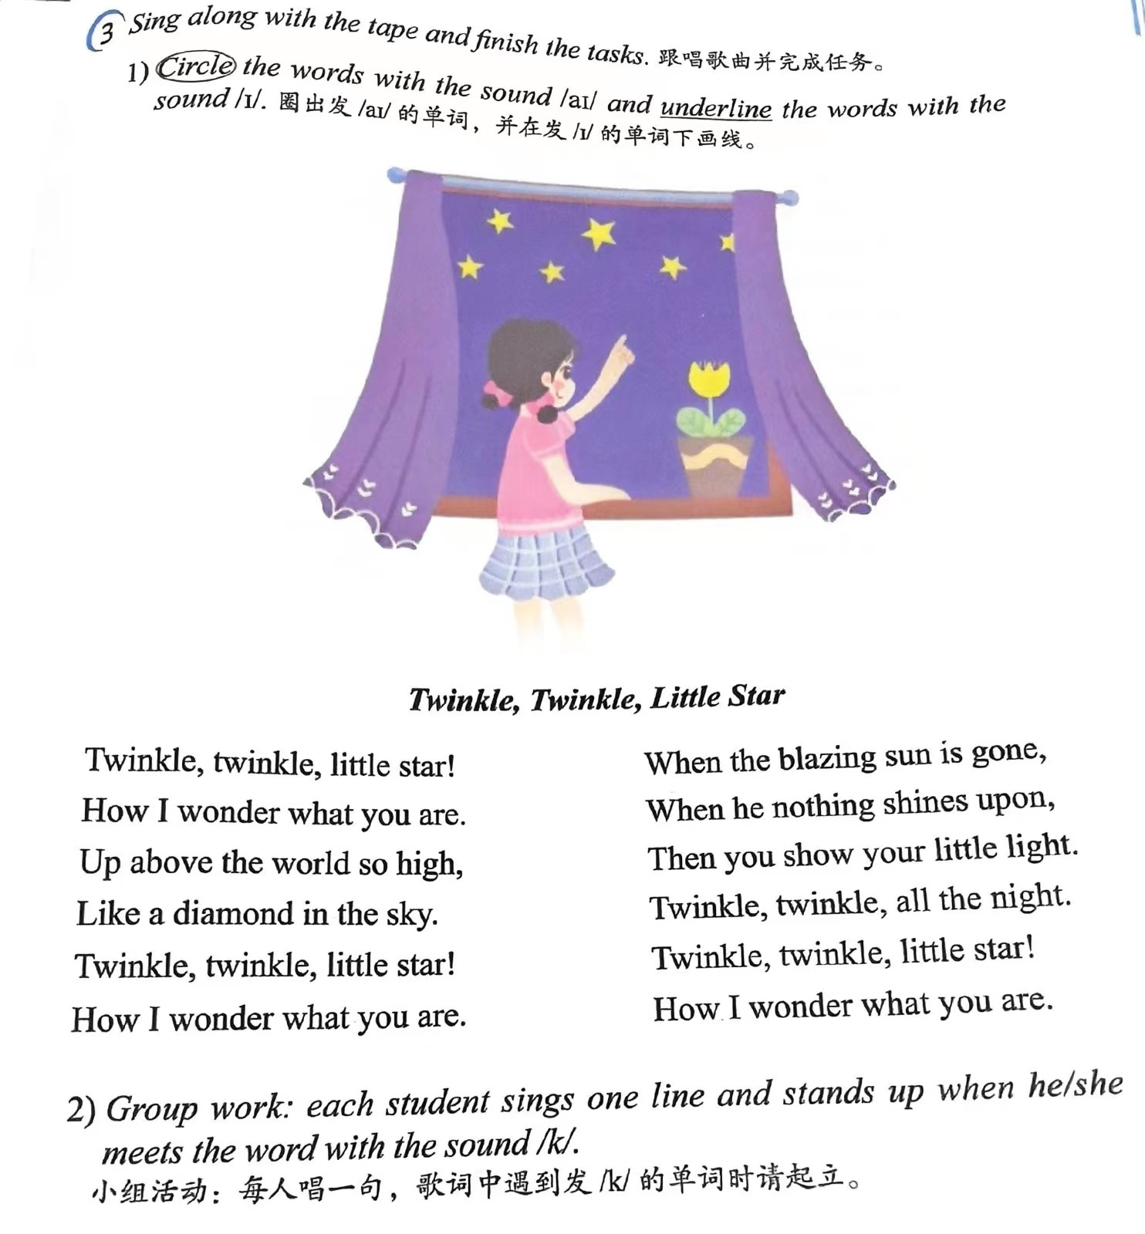

Slide 16
Learning Reflectively
1、Try to work out the rules. 试着找出规律。
1) We can pronounce the letter “ir” as/ /in girl and skirt.
2) We can pronounce the letter “kn”as/ /in knight and know.
3) We can pronounce the letters as [n] in often and fasten.

Slide 17
Learning Reflectively
2、Tick(√) what you can do.看看你今天学会了什么。
I think I can...
Great
Good
Ok
Try hard
read the words with “i” “ir” “k””f” and “kn” correctly;
Describe the location of knots in different ways:
read the words, sentences and passages correctly;
write the words according to their sounds;
infer the sound of the letters “ten”;
be aware of the stress of a sentence in English.

Slide 18
Learning Reflectively
3、Write your learning log.完成学习日志
1)学完本课后你有什么收获呢?
2) 学完本课后你还有什么疑惑呢? 大胆写下来吧!

Slide 19
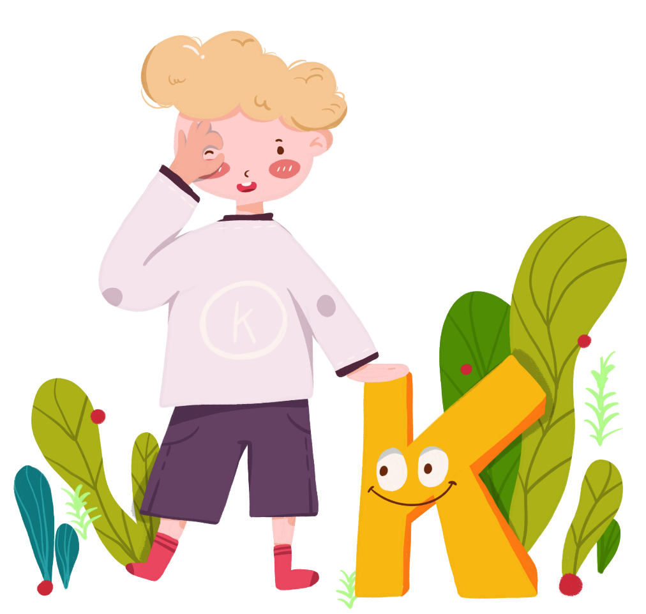
Comments on Teaching Plan
感谢您的观看
Thanks
thanks
ABCDEFGHIJKLMNHIJKLMNOPQRSTUVWXYZ

